Slide 1


Calistoga’s Measure T
Five-Year Work Plan

Slide 2
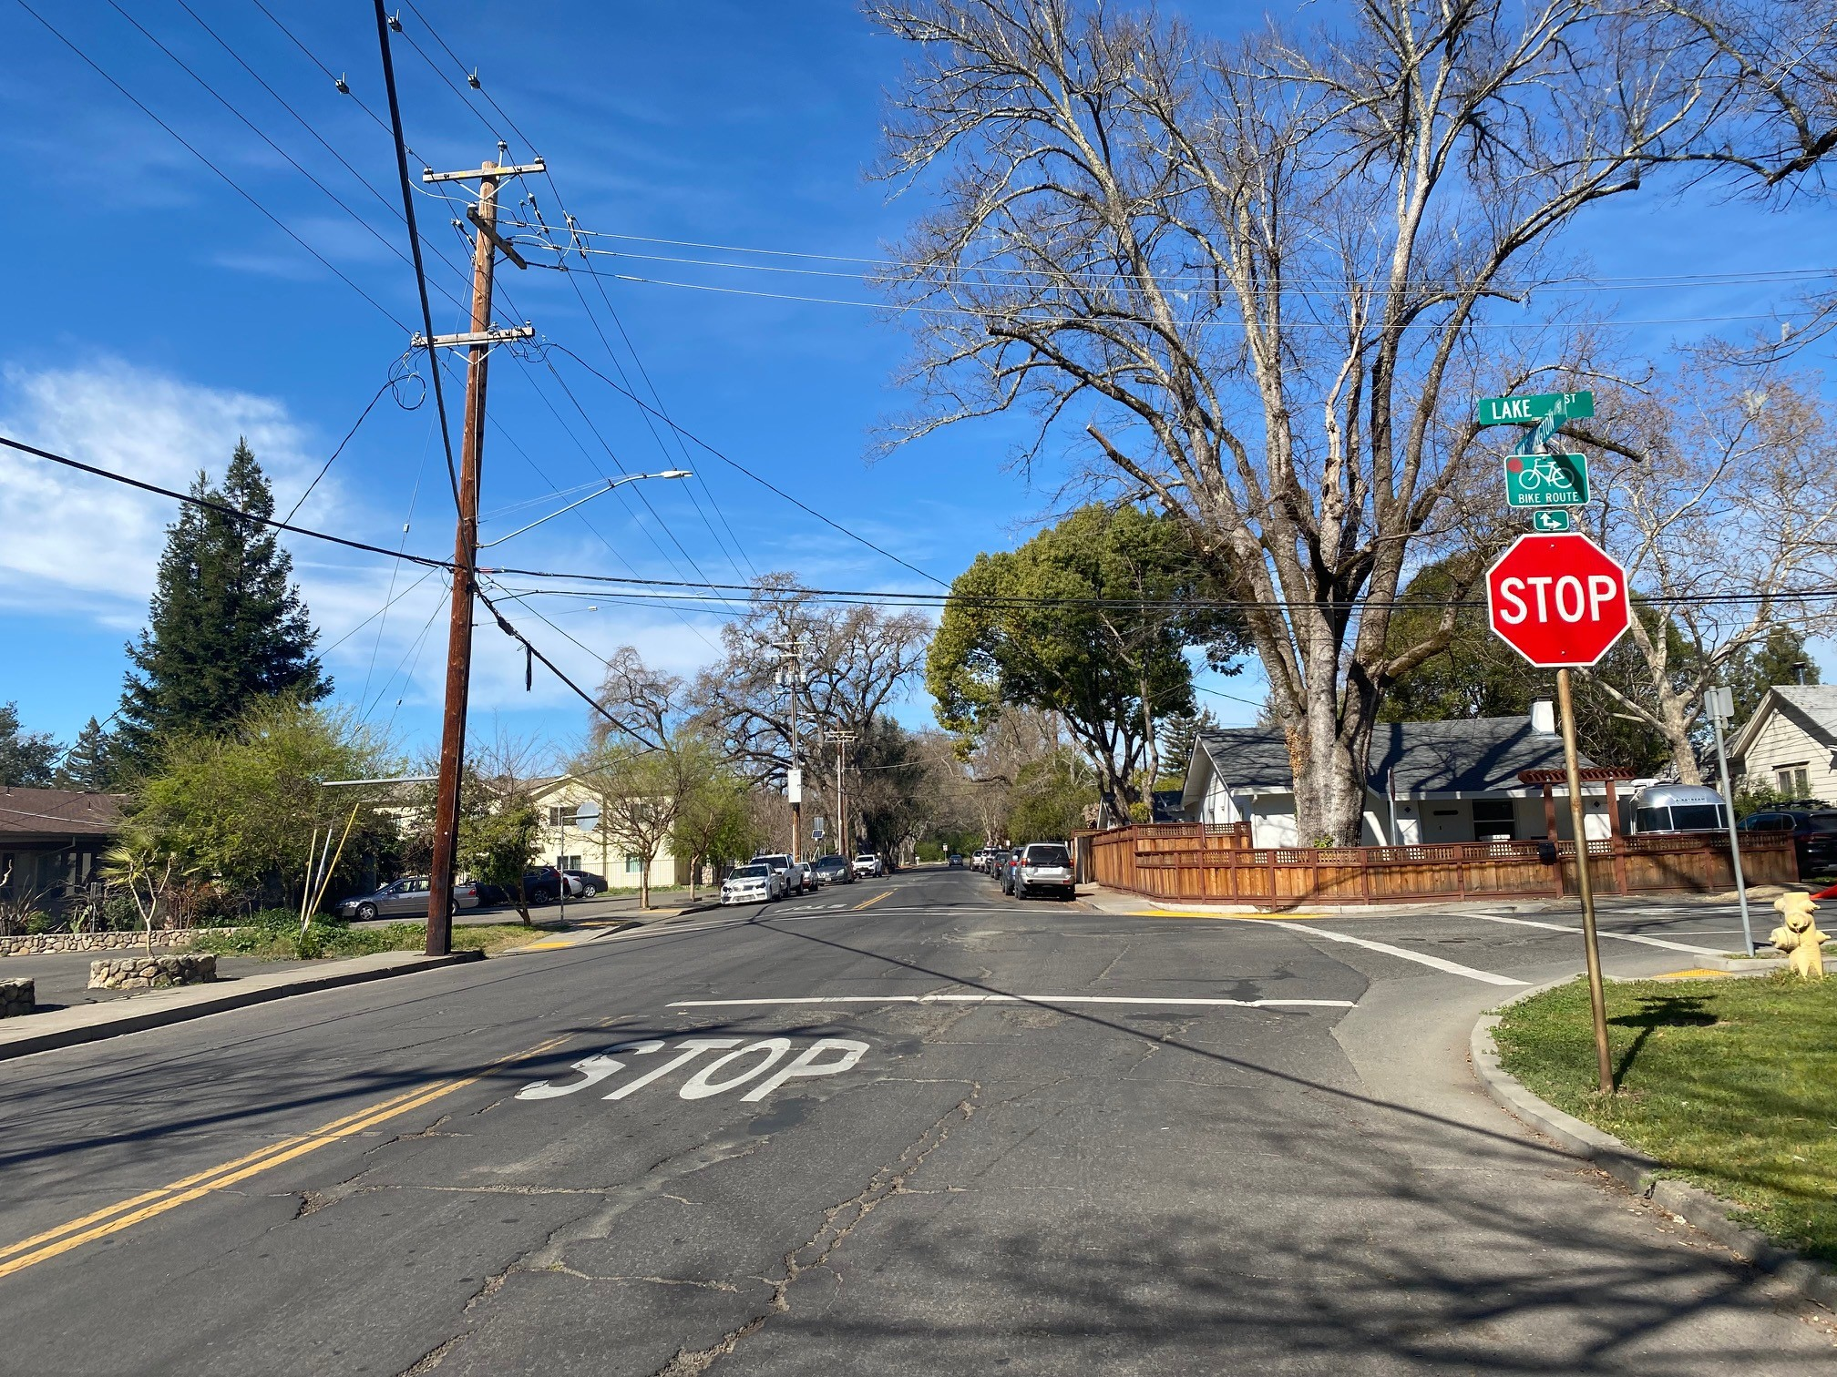
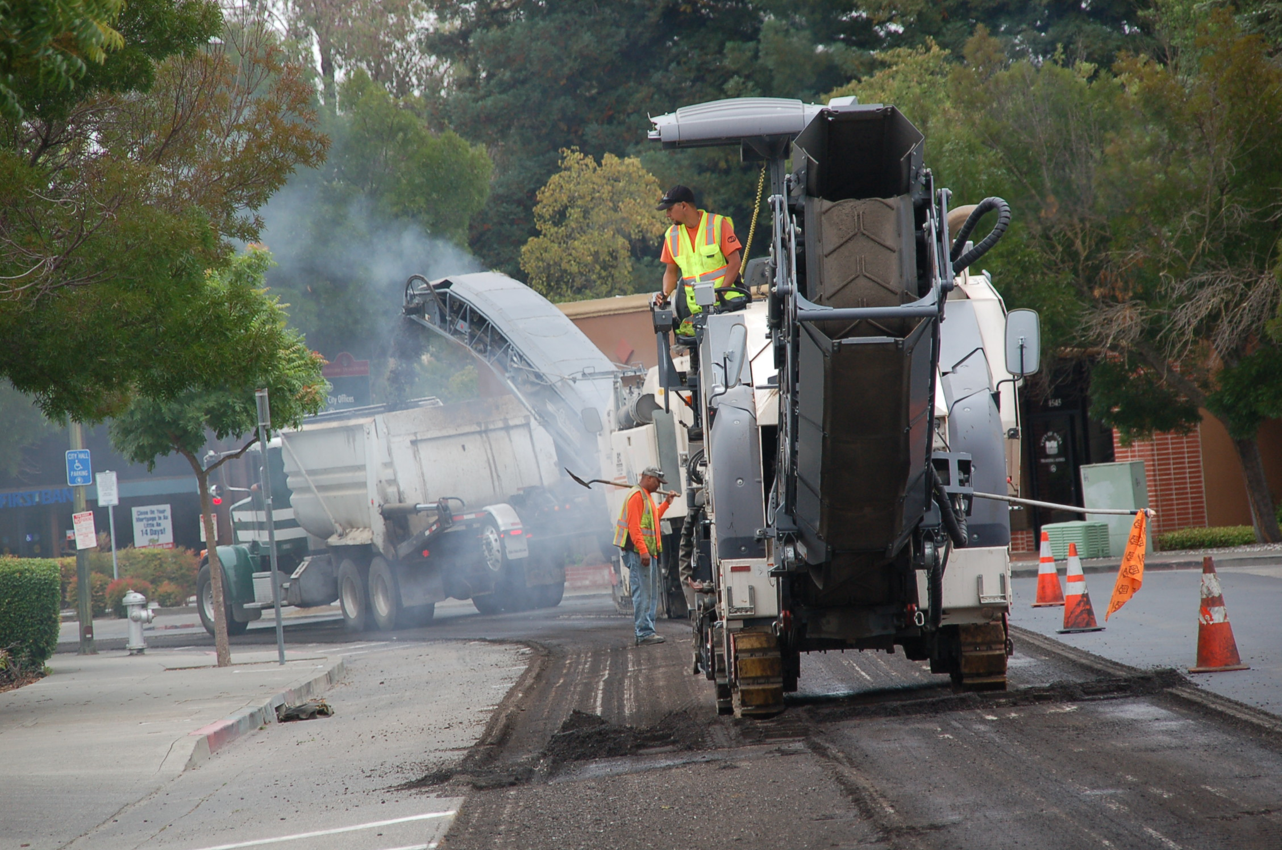
5-Year Work Plan
How we intend on utilizing the funding:
Street Design
Street Reconstruction
Curb, Gutter & Sidewalk
Bike & Pedestrian
Curb Ramps
Pedestrian Signals
Street Drainage
Signing/Striping
Safety Enhancements
Traffic Calming
Equipment Purchasing
Notes:
We will use the funds to provide street and paving improvements in the City focusing on Collectors and Arterials. Part of the street improvements include the repair of curb gutter and sidewalk, updating existing curb ramps to meet ADA compliance. we will install new. traffic calming measures and repair any street drainage and signing as striping as necessary for the paving and concrete improvements

Slide 3
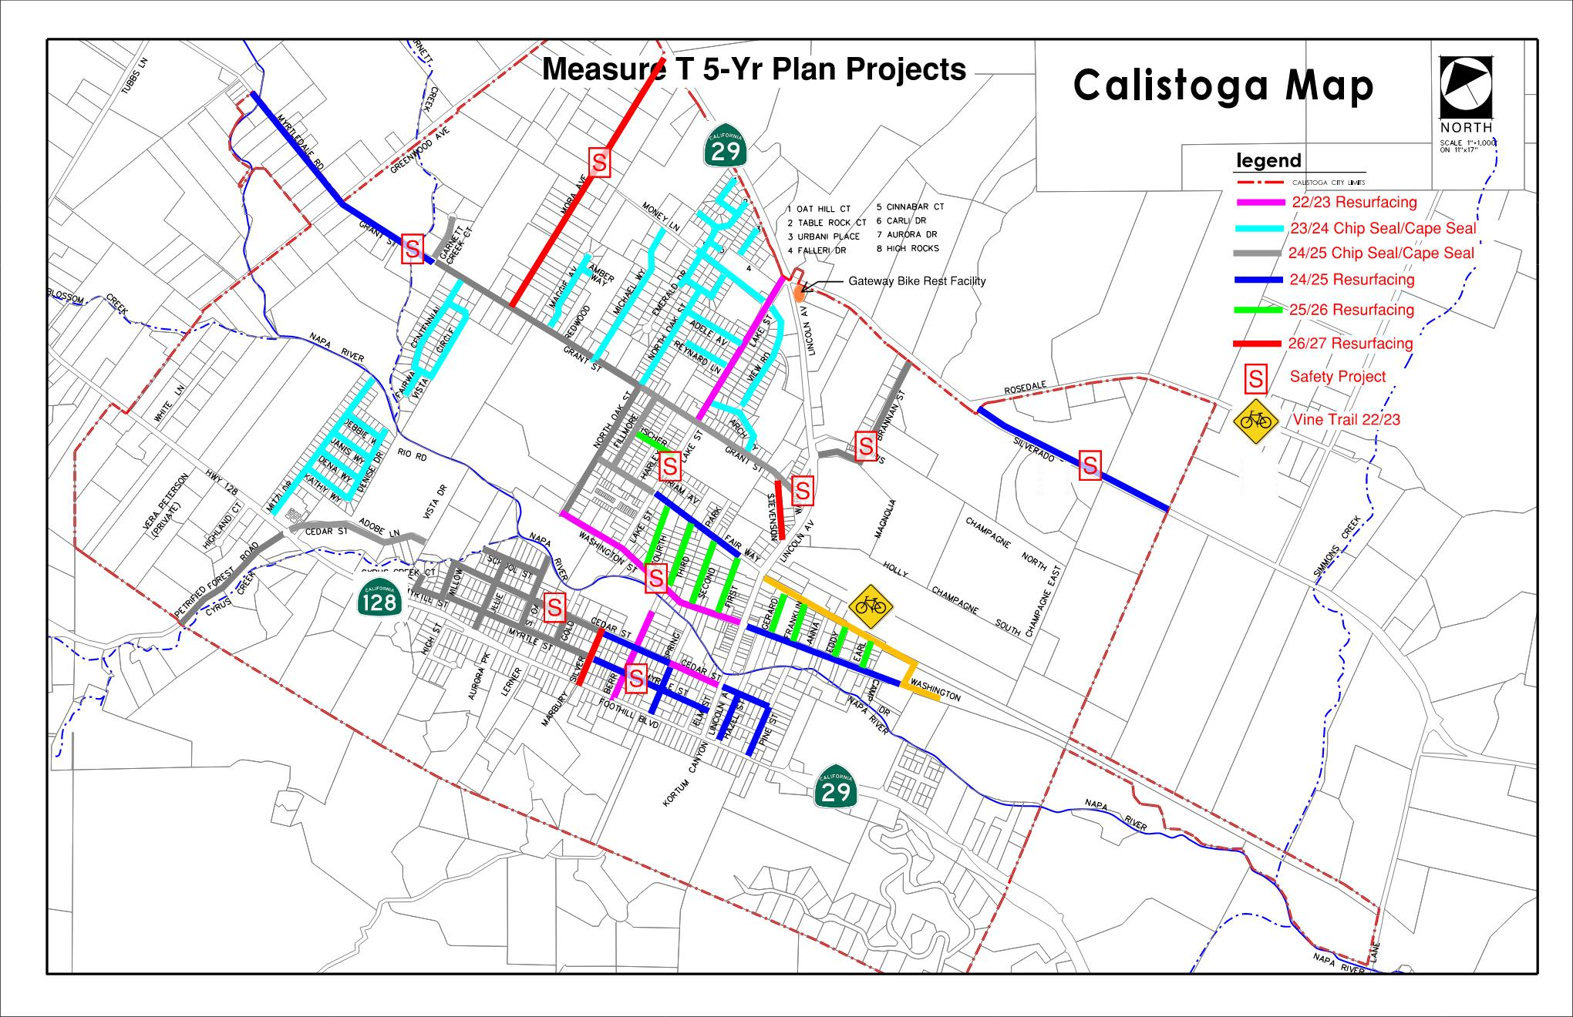

Slide 4
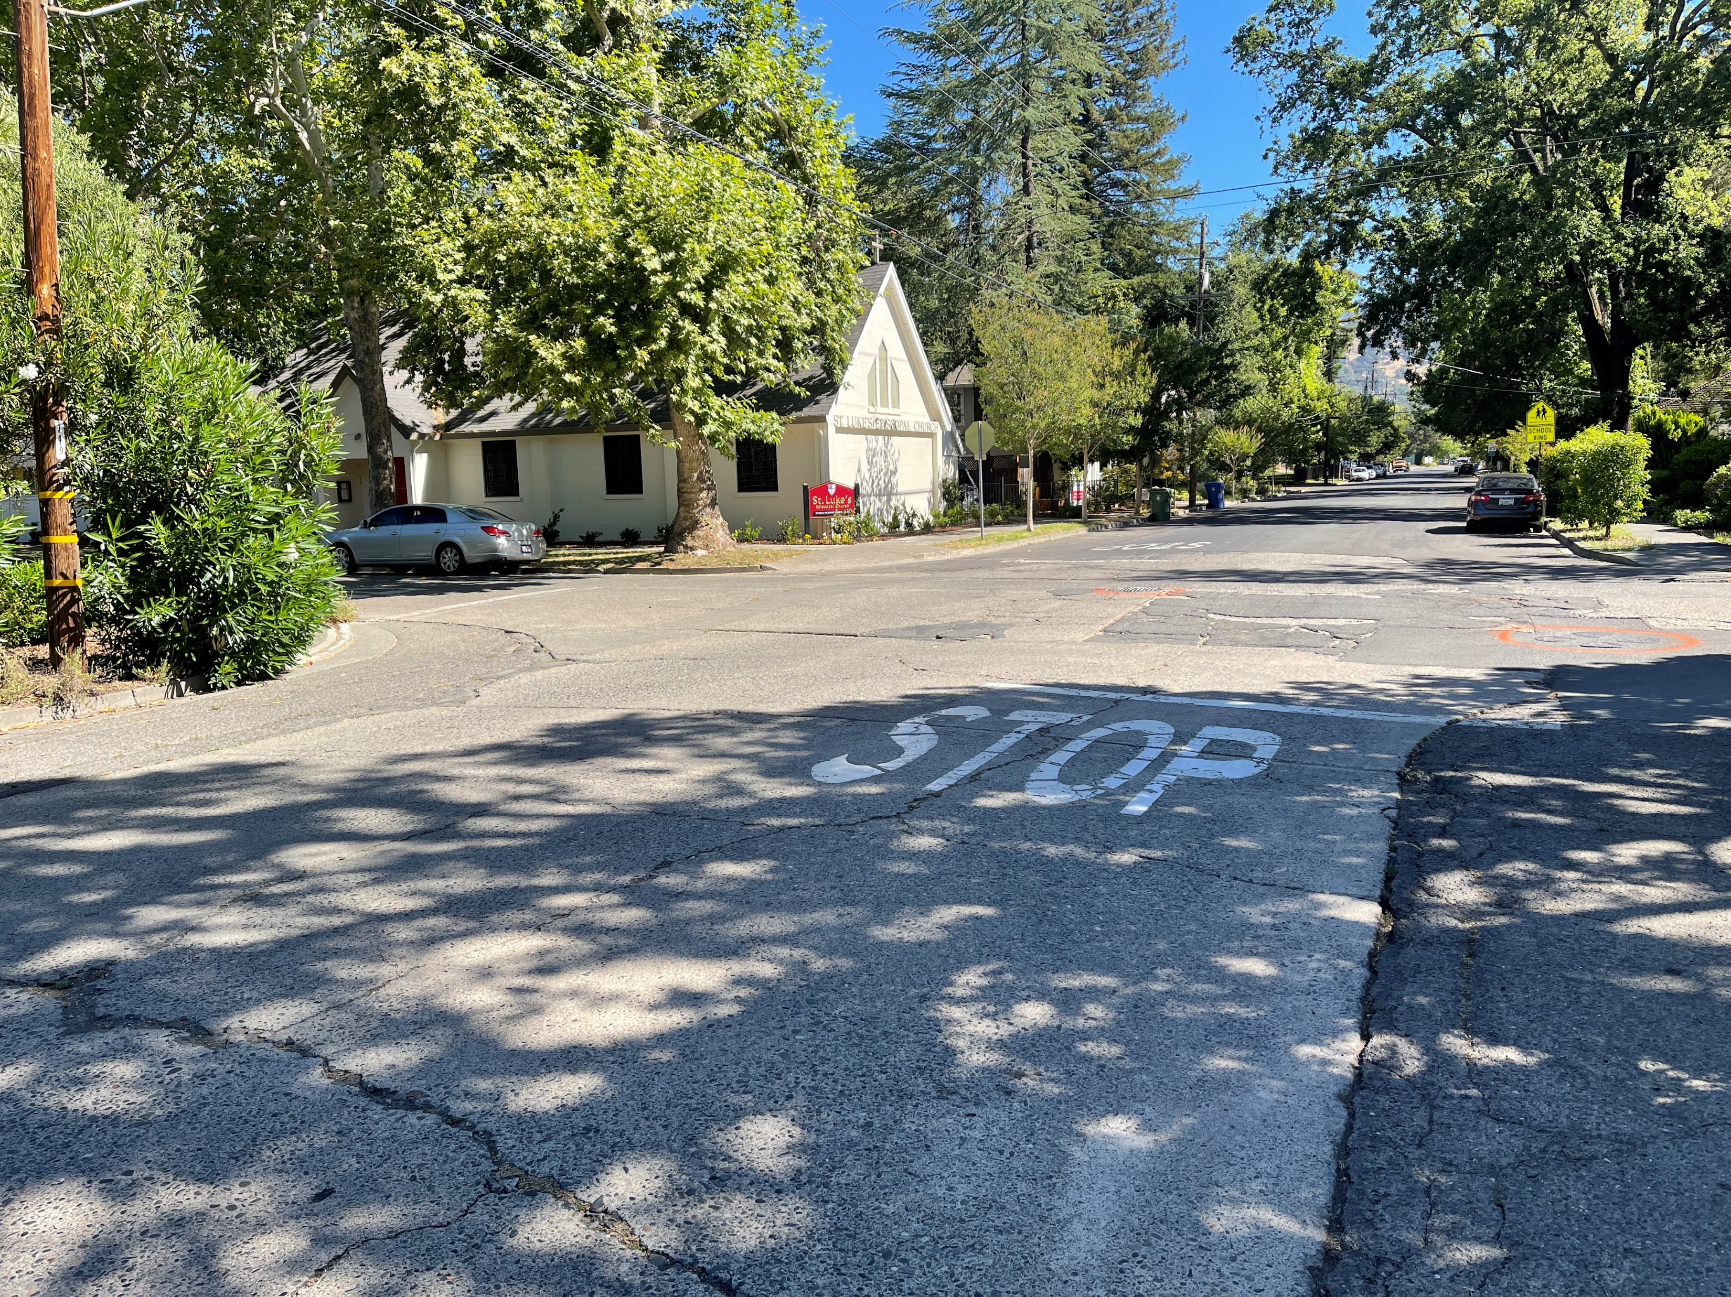
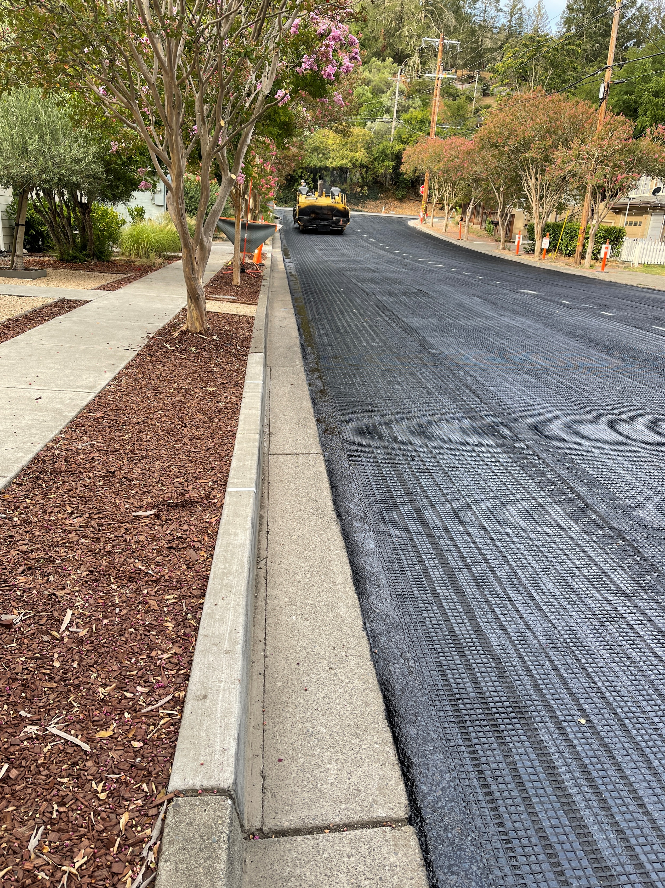
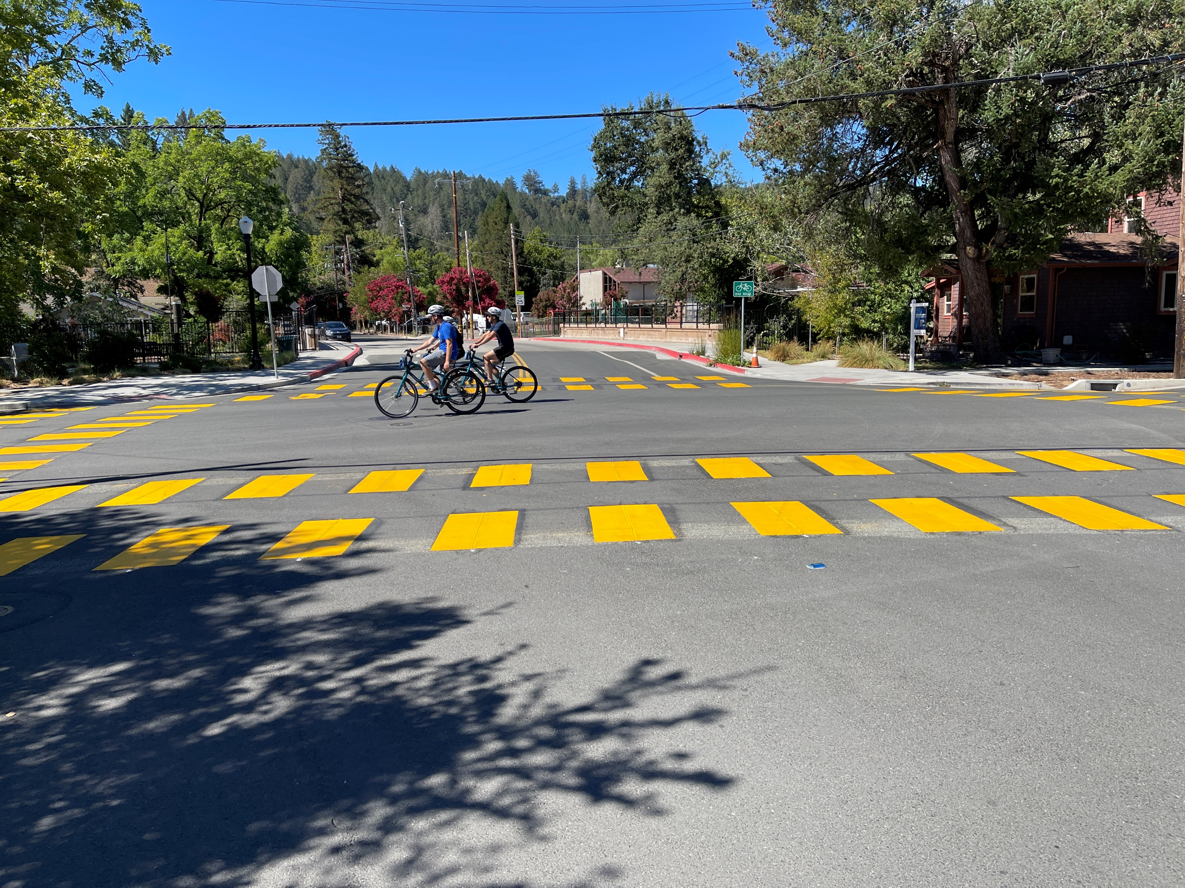
Completed Pavement Projects FY22/23 Berry Street Repaving 1,000LF Berry Bridge to Foothill Blvd.
Design for Cedar, Berry and Washington Street Pavement Projects
During Construction
Berry Street Before Improvements
Berry Street After Improvements

Slide 5
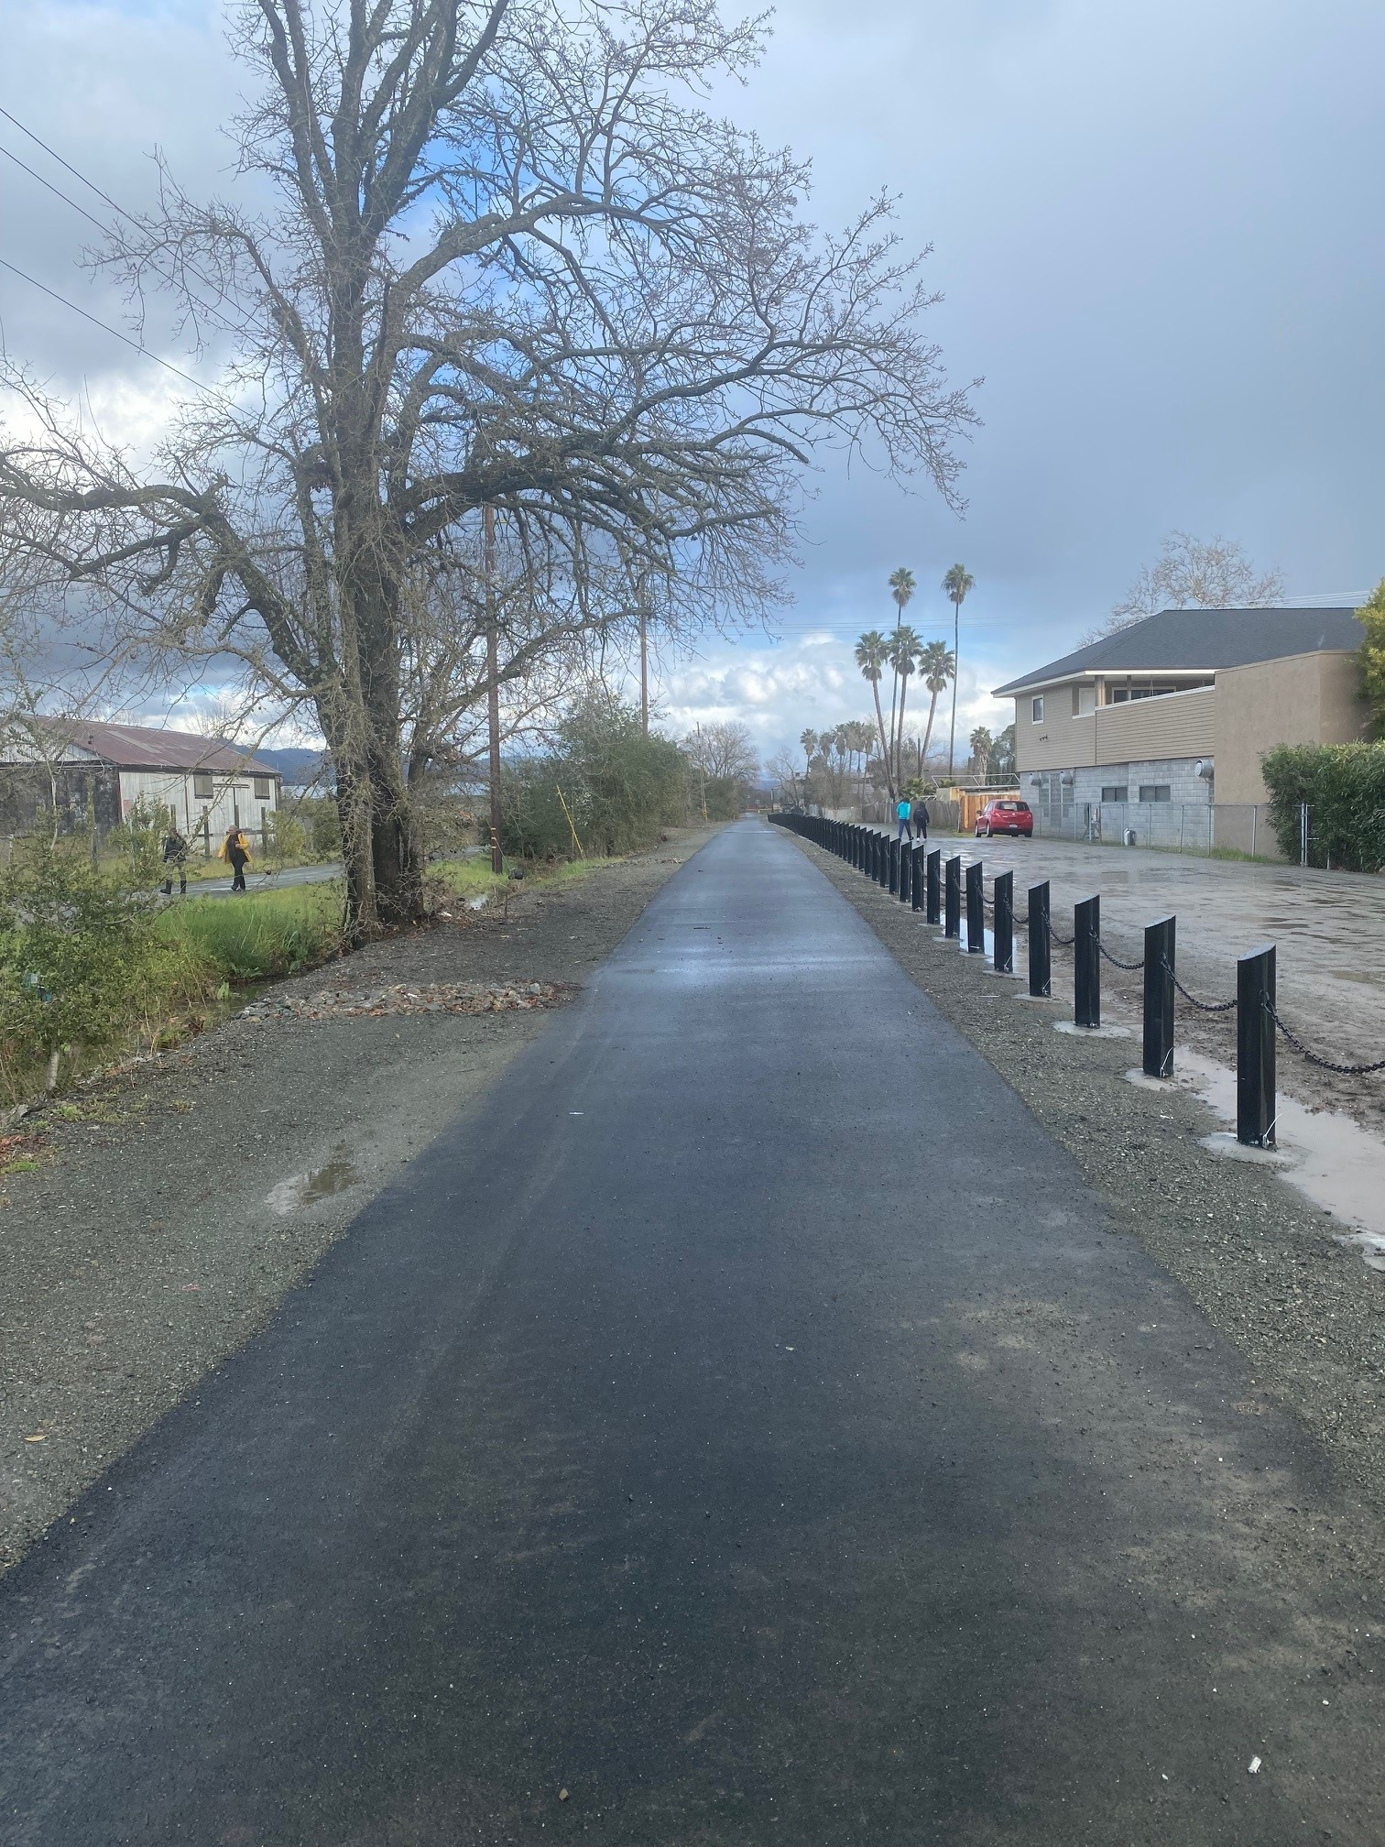
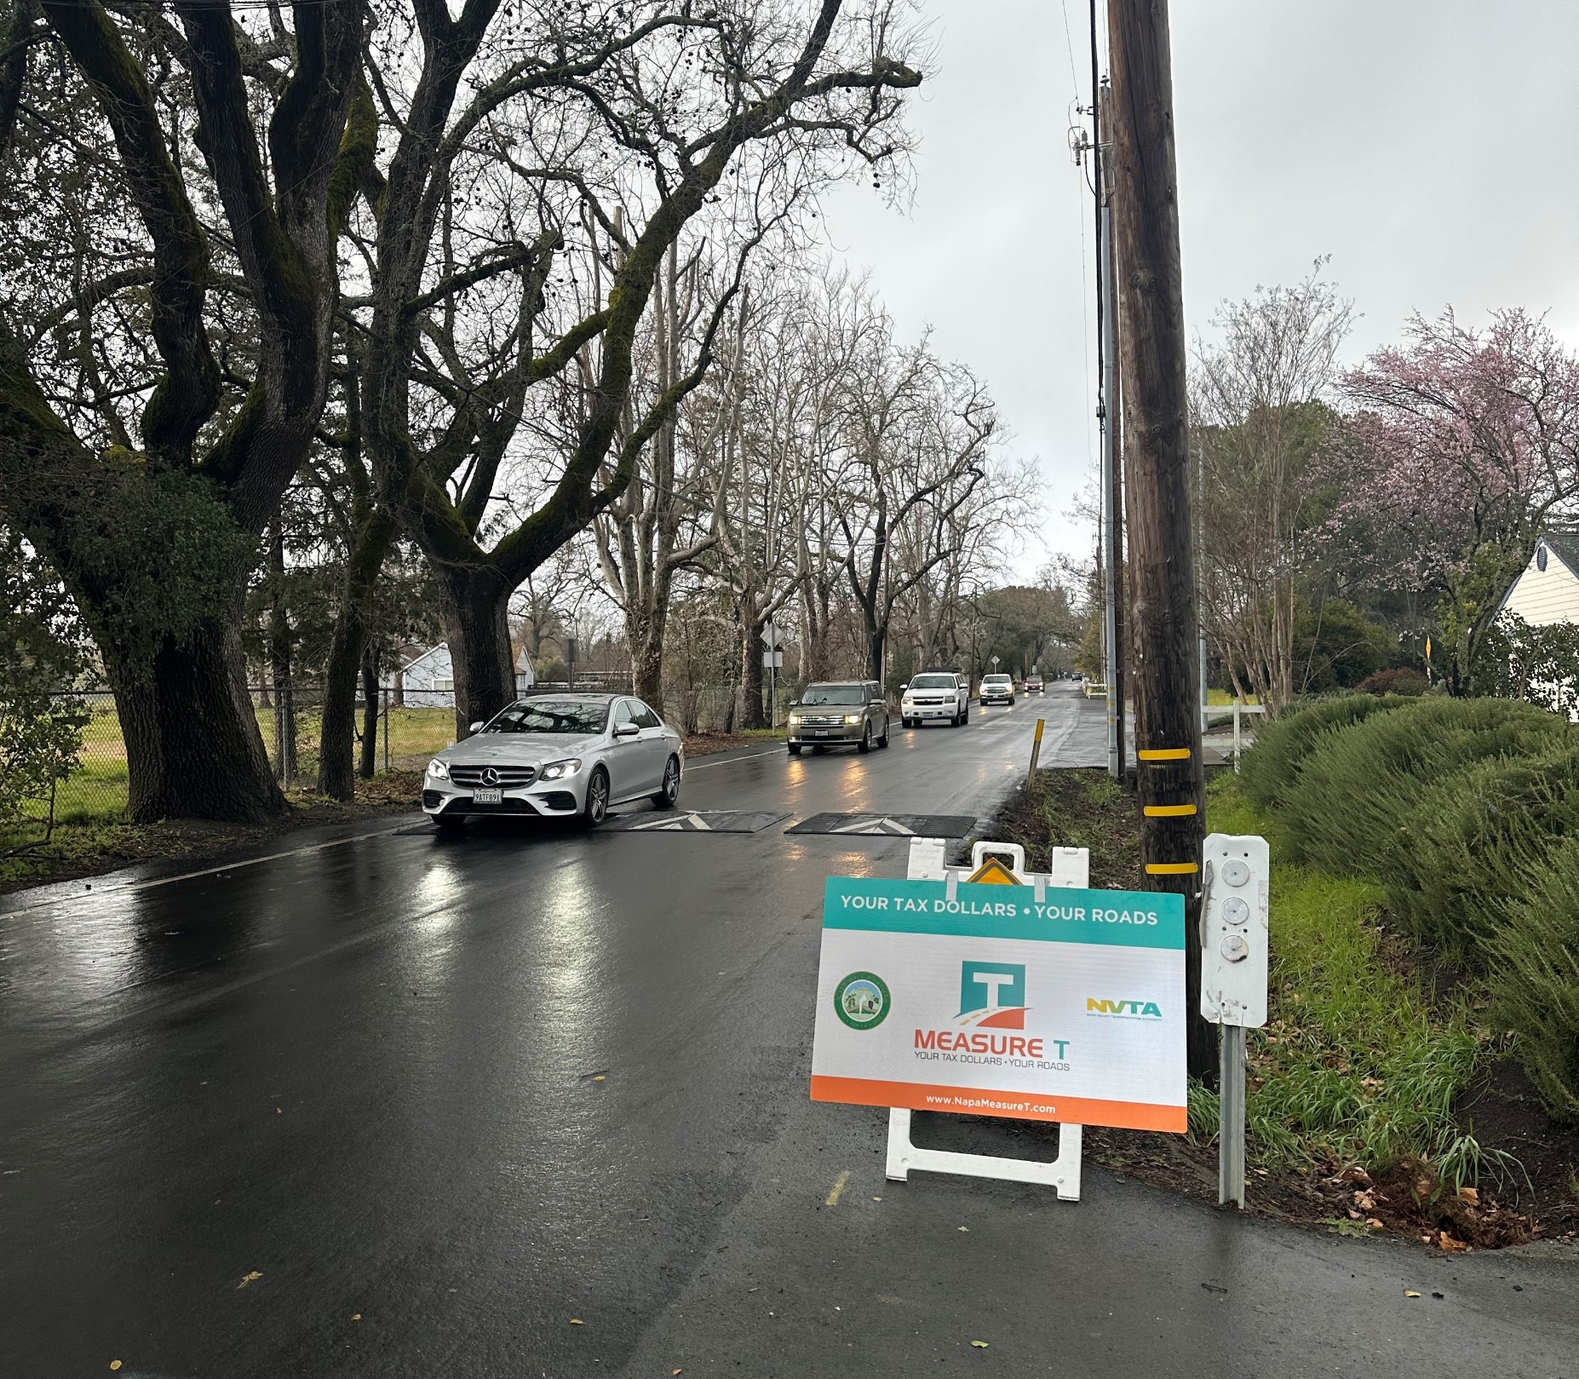
Completed Bike and Safety Projects FY22/23 Grant Street Traffic Calming Measures
Vine Trail - Reach 7
Grant Street Traffic Calming
Vine Trail – Reach 7

Slide 6
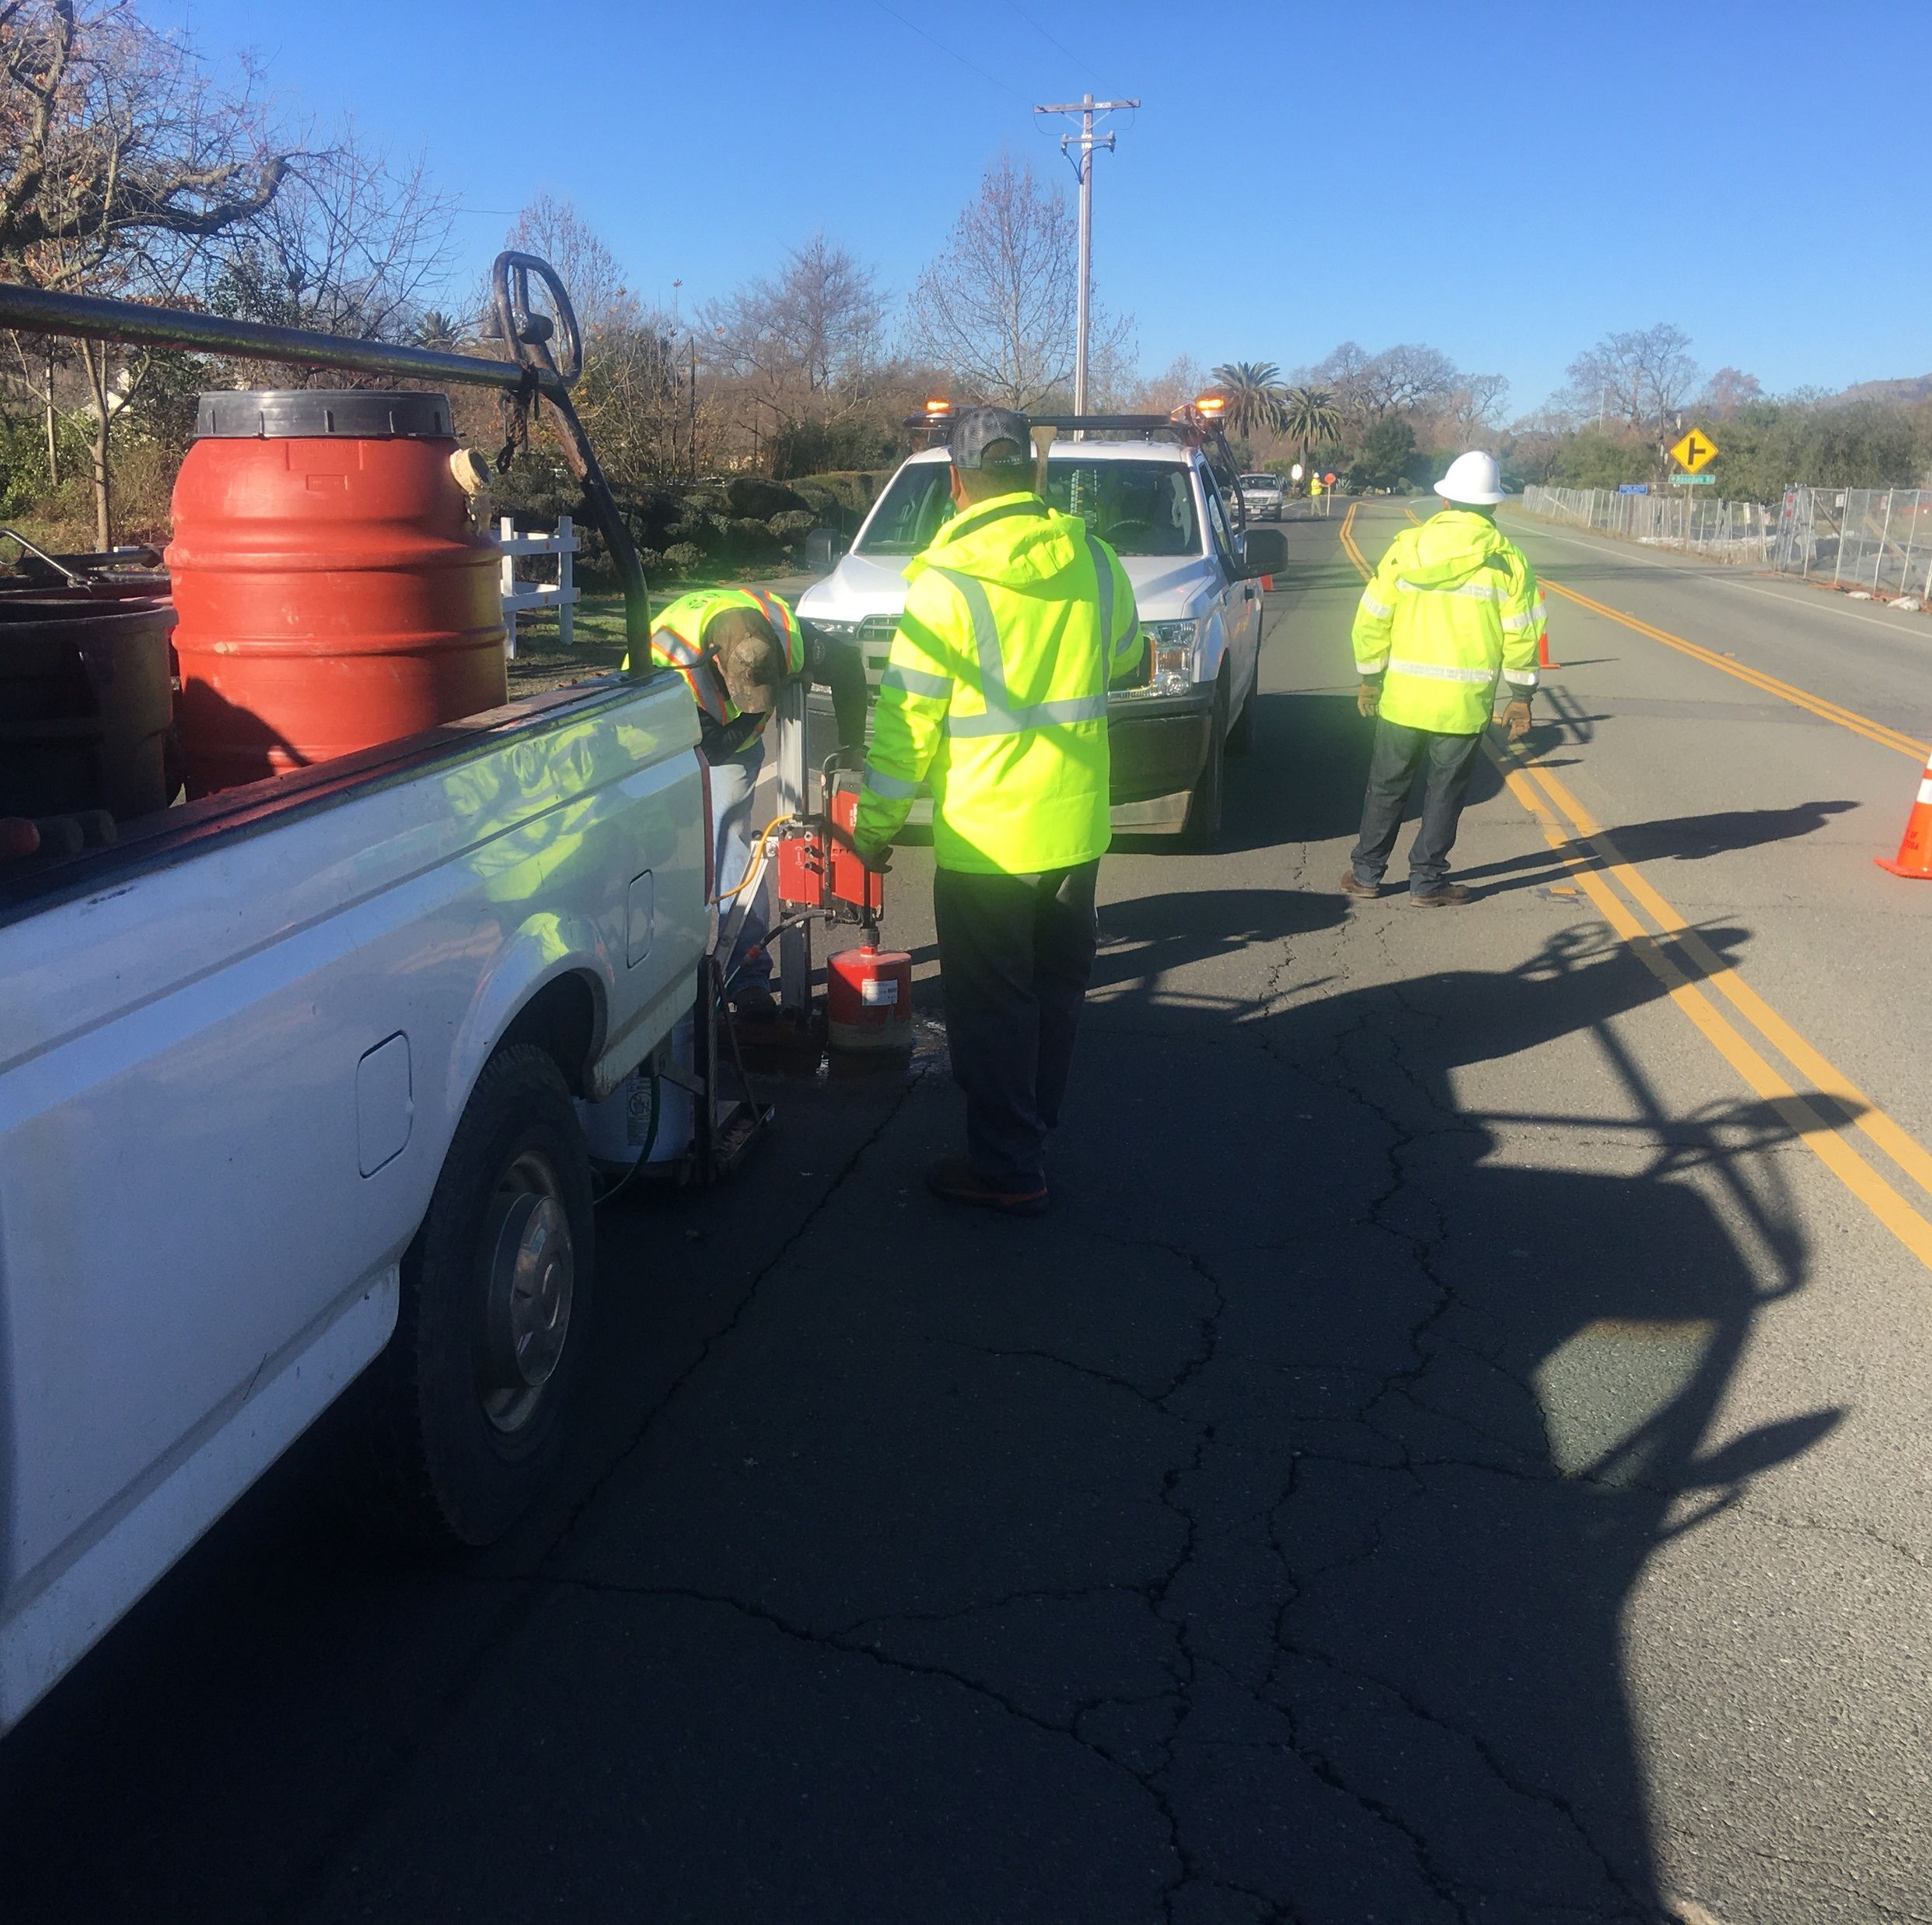
Future Projects (23/24)
Street Reconstruction
Micro Surfacing Phase I
Silverado Trail Overlay
Cedar Street Improvements
Bike Ped
Flashing Beacon Brannan/Lincoln
Class I Bike Path – Lincoln Avenue
Designs
Additional Traffic Calming Projects
Micro surfacing Phase II
Equipment Purchasing
Street Sweeper

Slide 7
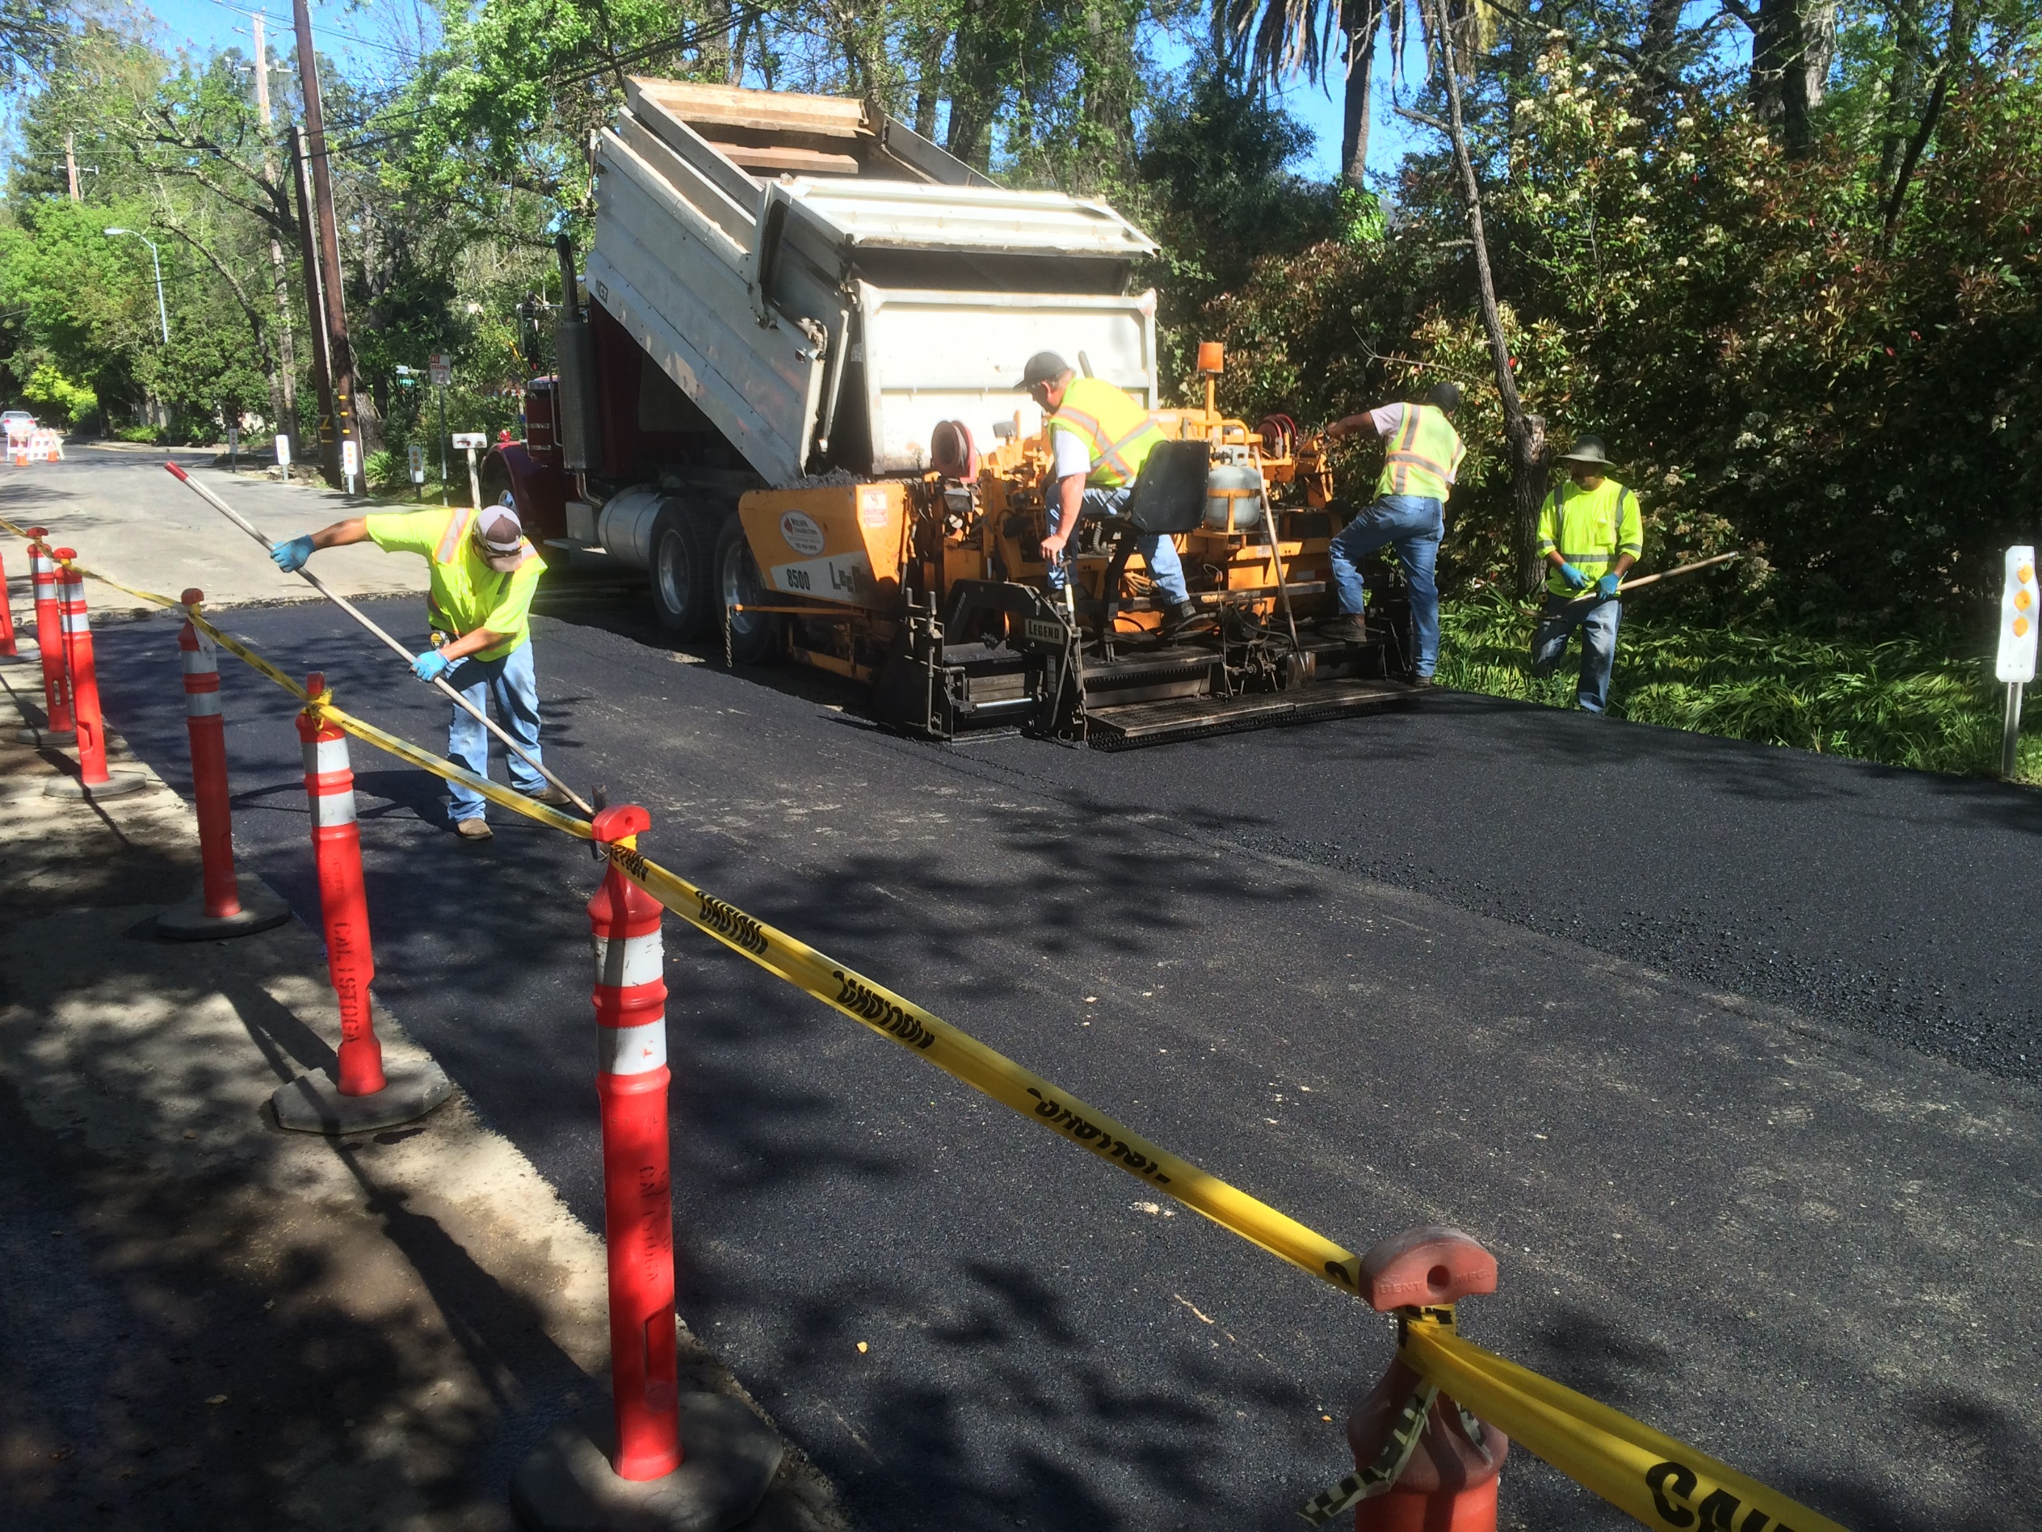
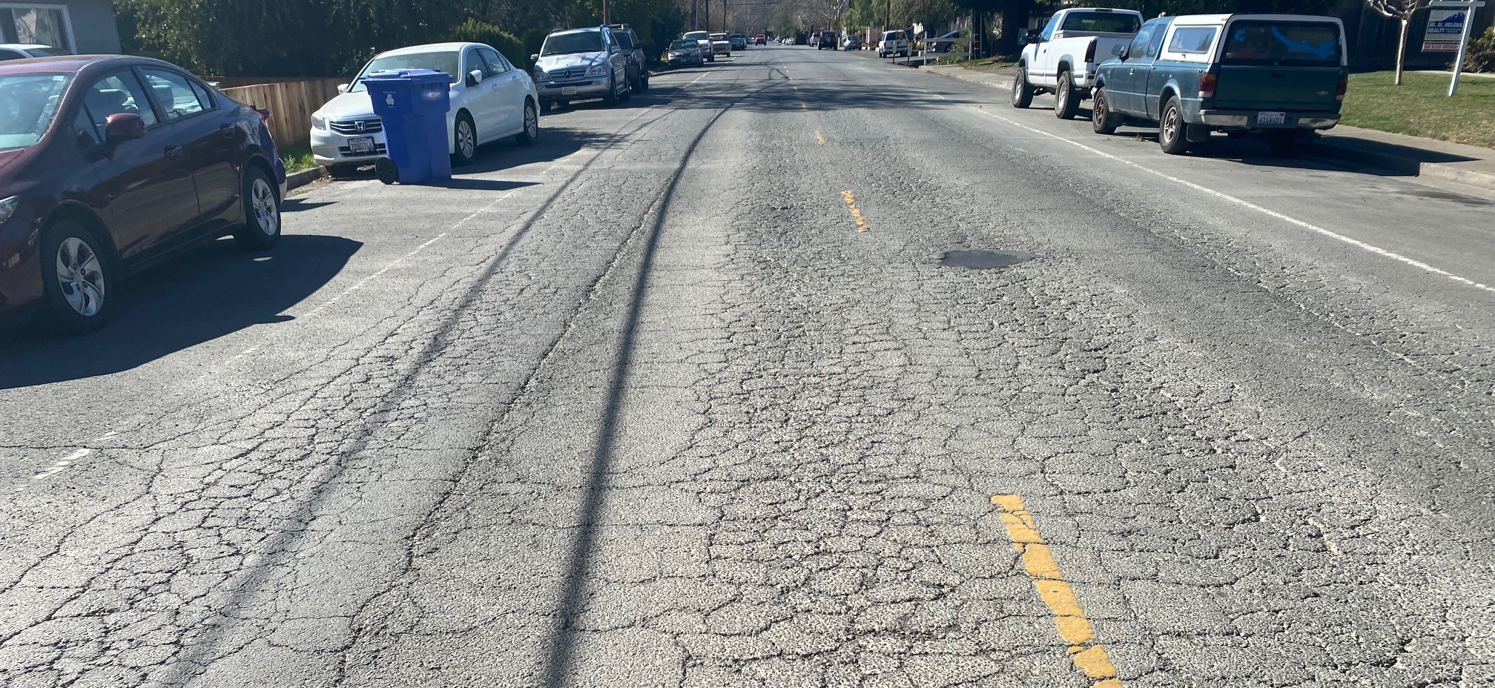
Future Projects (24/25)
Street Reconstruction
Micro surfacing Phase II
Grant Street
Bike Ped Construction
Gateway
Grant Street Multi-use Path
Logvy Path
Designs
Grant, Fairway

Slide 8
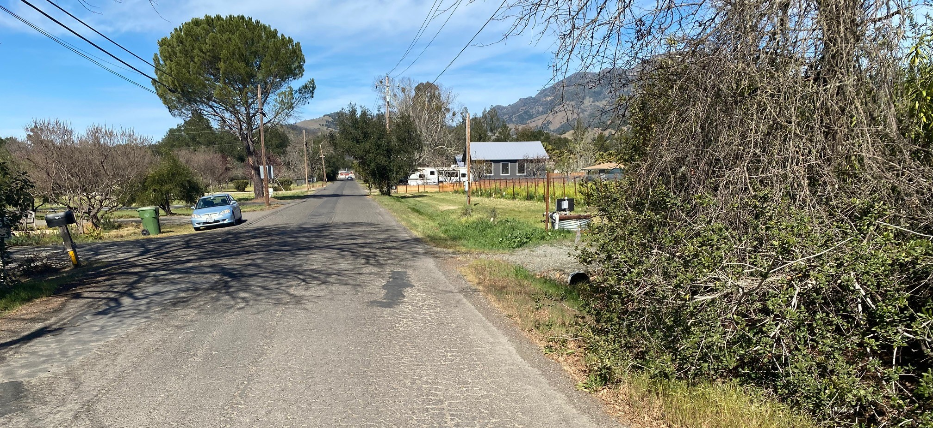
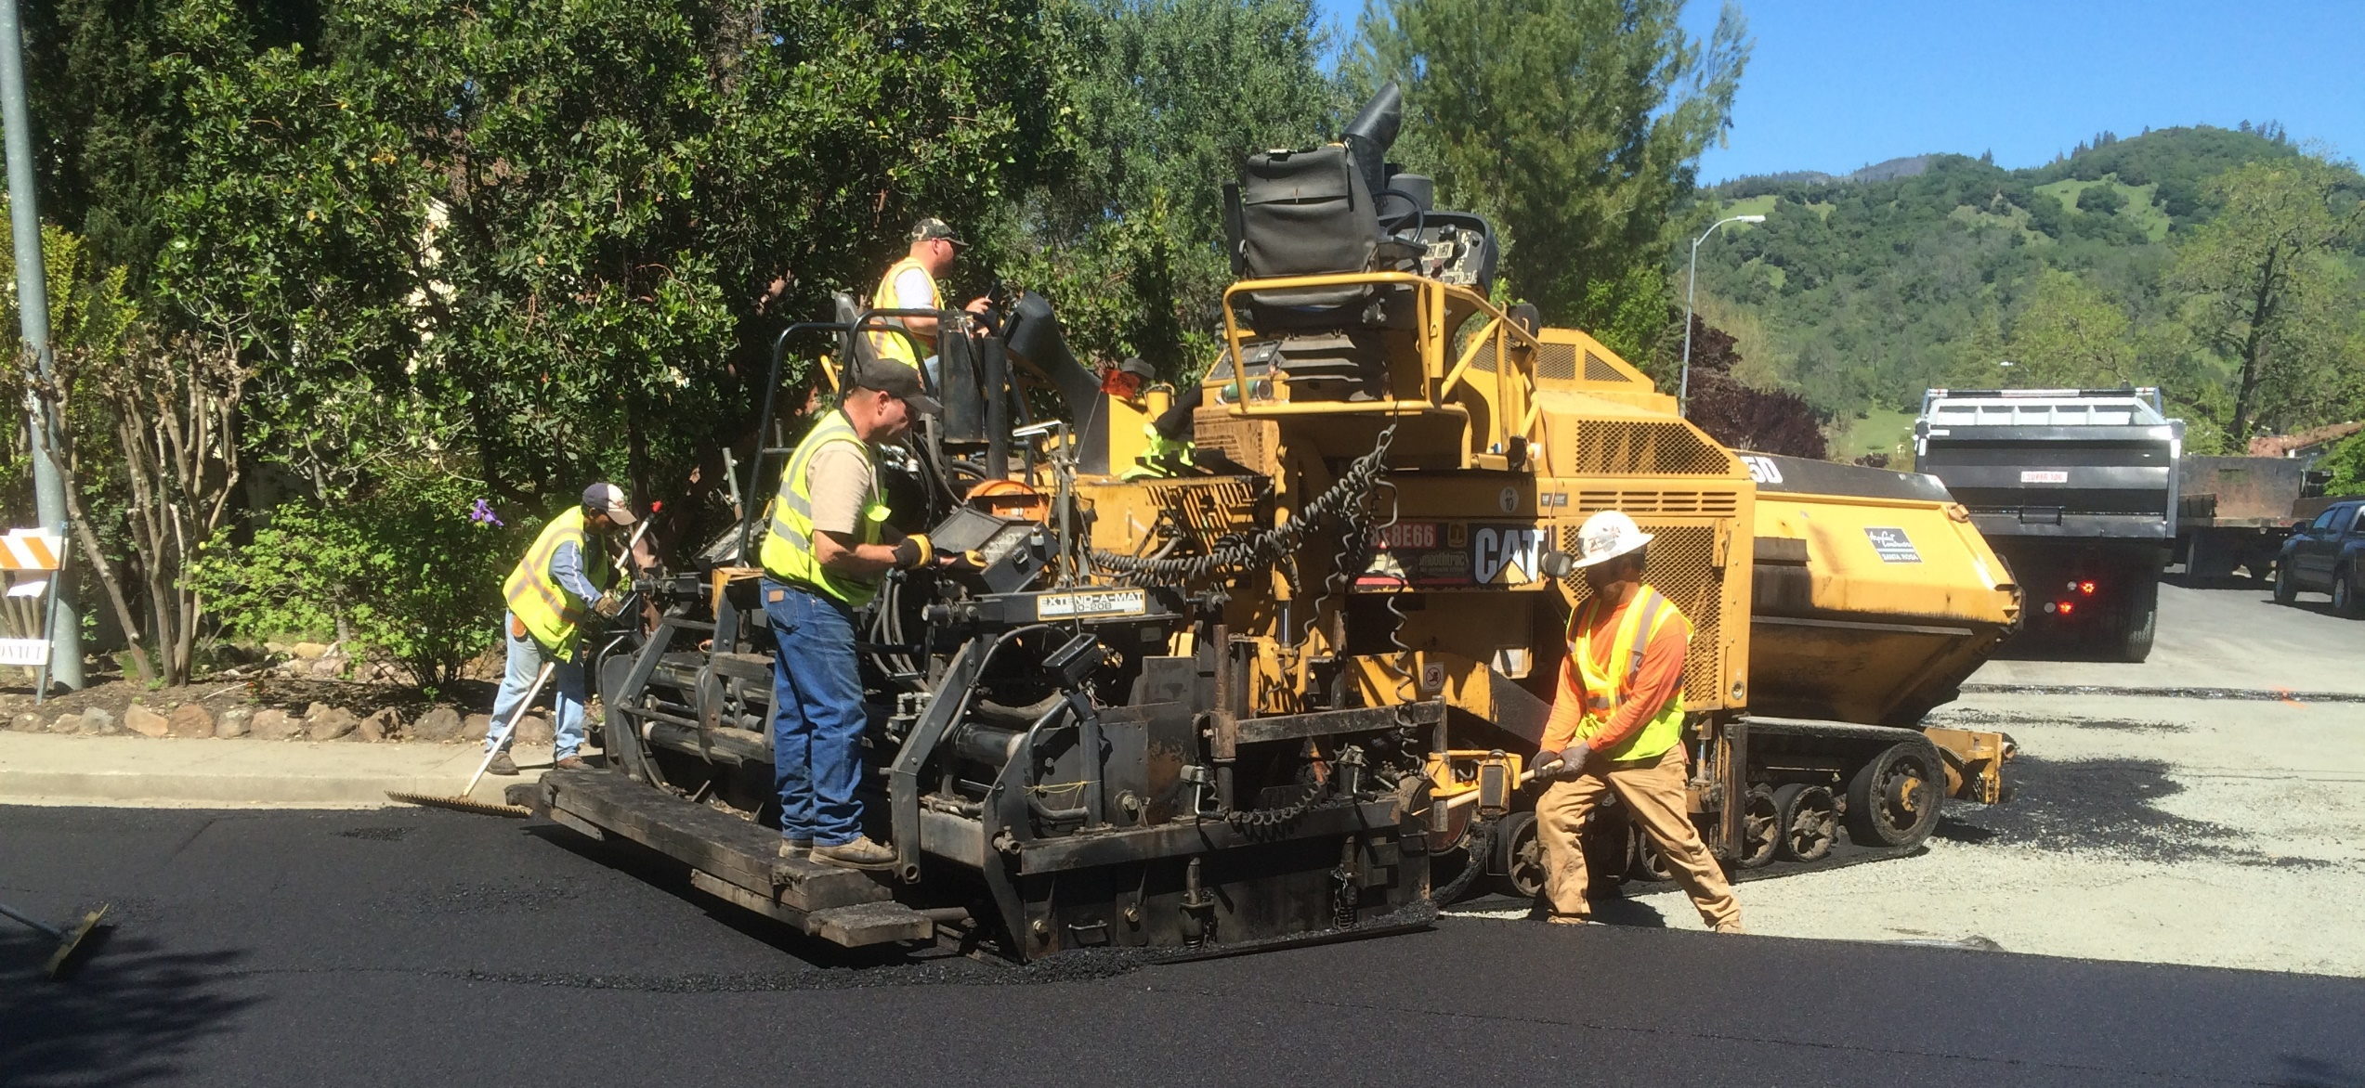
Future Projects (25/26)
Street Reconstruction
Lake Street
Washington
Designs
Fisher
Earl
Eddy
Franklin
Gerard

Slide 9
Future Projects (26/27)
Street Reconstruction
Fisher
Earl
Eddy
Franklin
Gerard
Designs
Mora
Stevenson
Silver

Slide 10
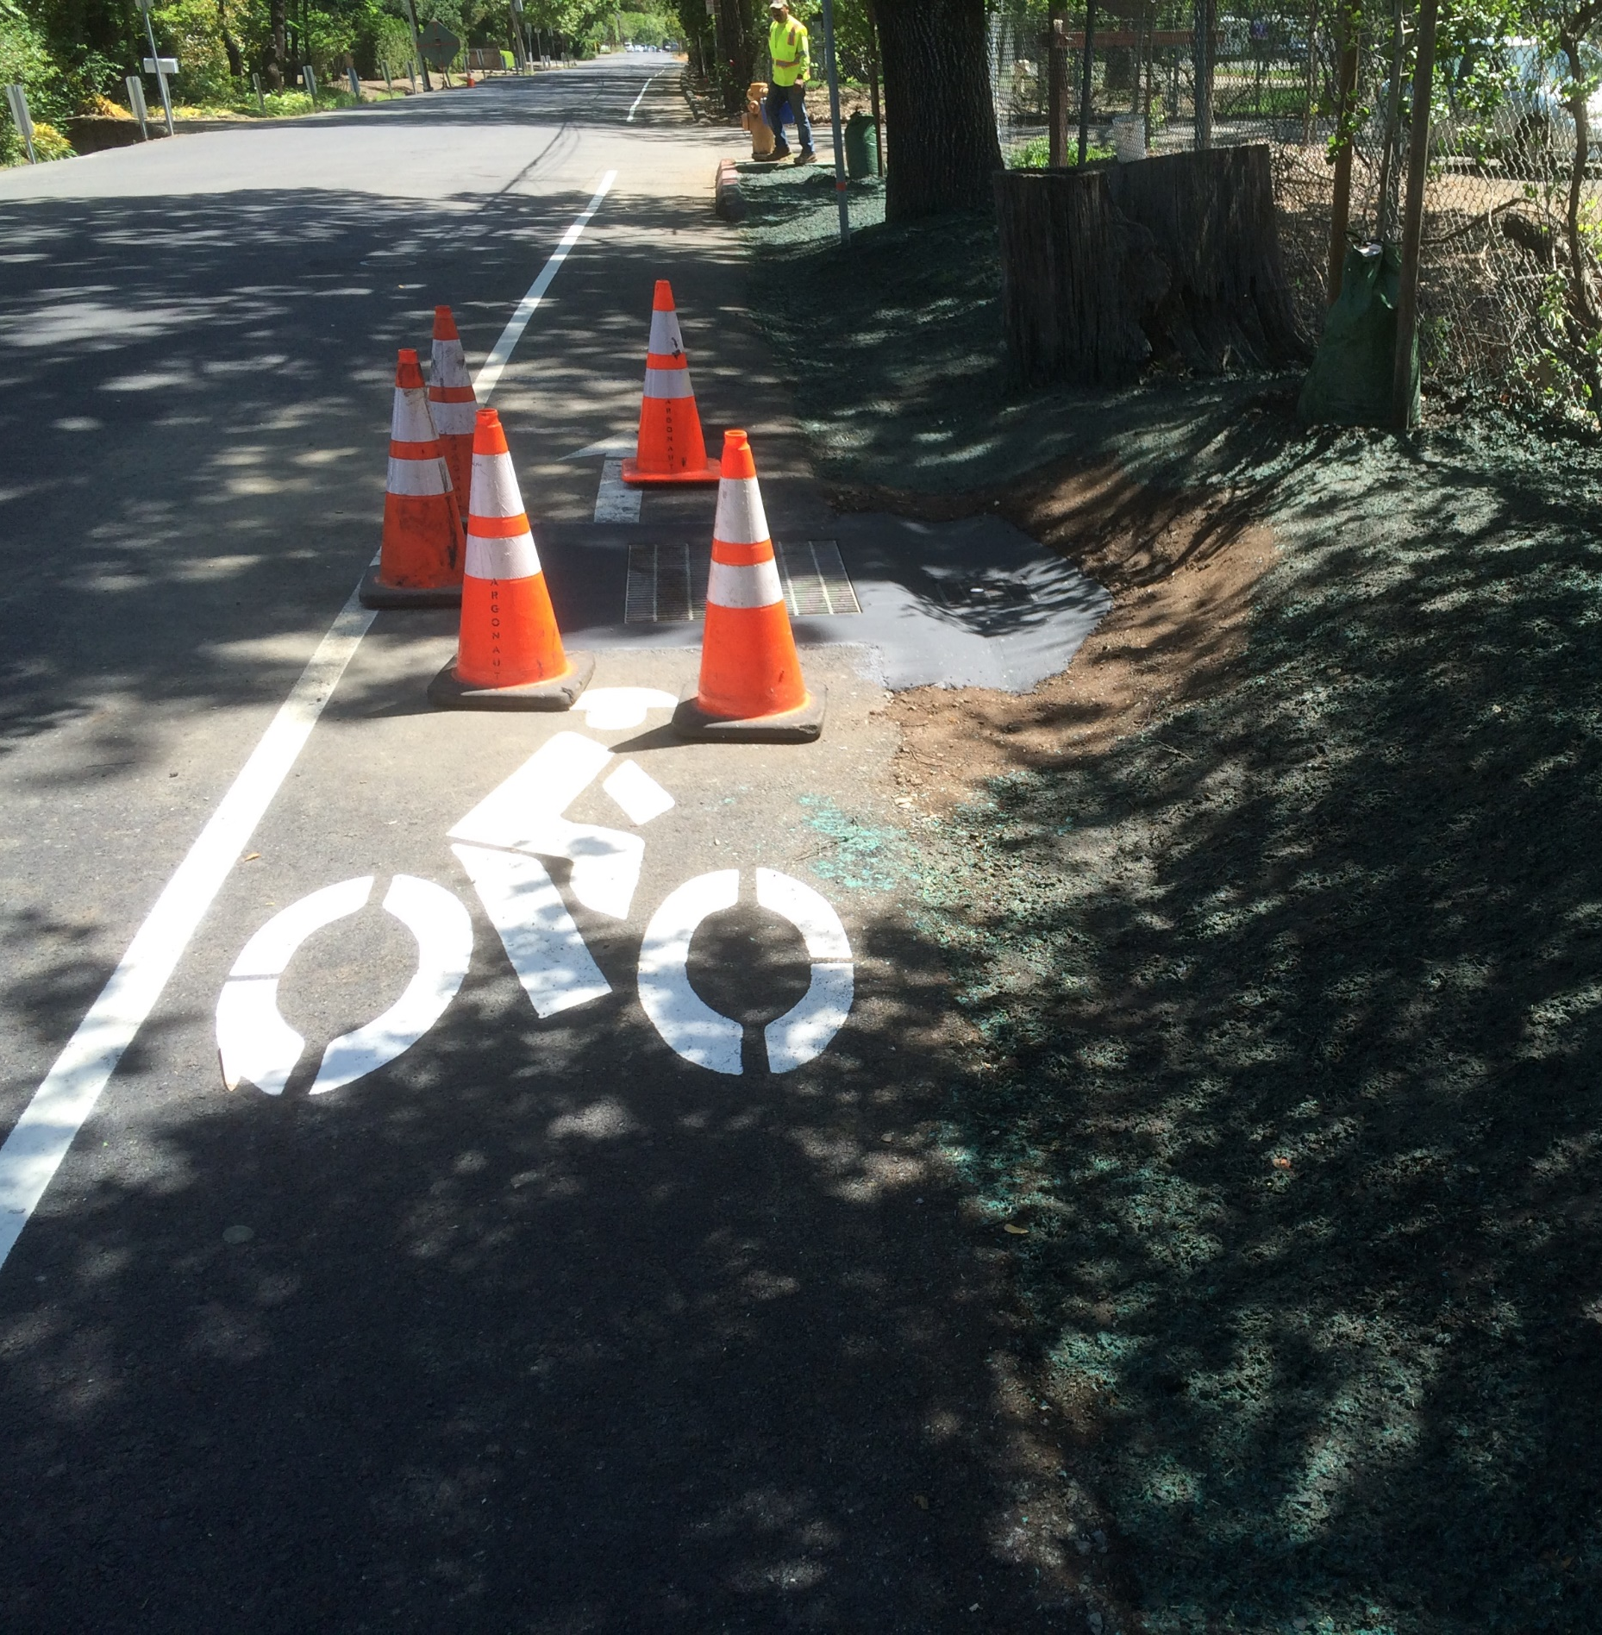
Thank You
Questions & Answers
Contact Information:
Hamid Heidary, PE
Senior Civil Engineer
707-942-2828
hheidary@ci.calistoga.ca.us

