Slide 1

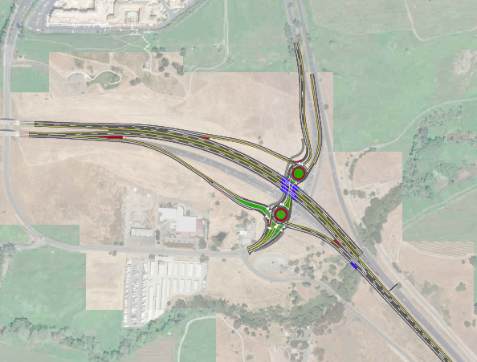
Public Meeting October 8, 2019 5:30 PM to 7:30 PM

Slide 2
Presentation Outline
Project Description/ Background Info
Studies on Traffic and Transportation
Other Agencies
Simulated Views
Questions/Answers

Slide 3
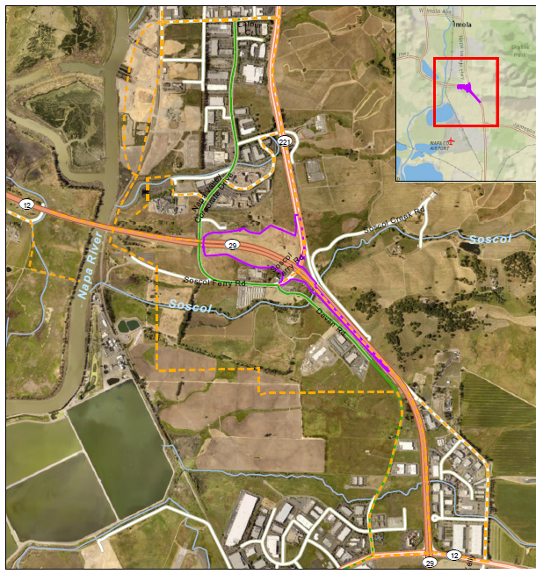
Project Description: Location, Purpose & Need
The purpose of the project is to alleviate congestion, between Napa Valley and the Fairfield/ Vallejo areas and improve operations.
As a result of the project bicycle and pedestrian access at the SR 29/ SR 221 intersection will be enhanced.

Slide 4
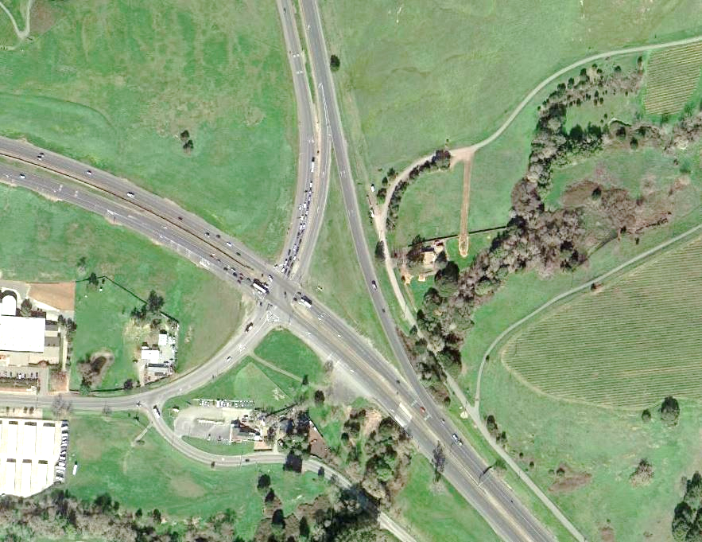



Project Description: Location, Purpose & Need
Need: Operational Improvements to the
SR 29/ SR 221 intersection are
necessary to alleviate existing and
future traffic congestion and improve traffic flow.
Sponsor Agency: NVTA
Implementing Agency: Caltrans
Major Movement AM/PM
Major Movement AM
Major Movement PM
Soscol Ferry Rd
Devlin Rd
Notes:
These traffic volumes would be significantly higher than the capacity of the existing intersection

Slide 5
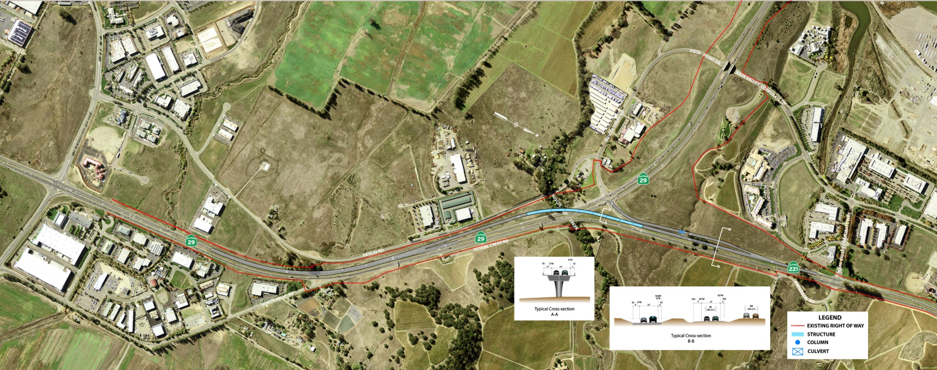
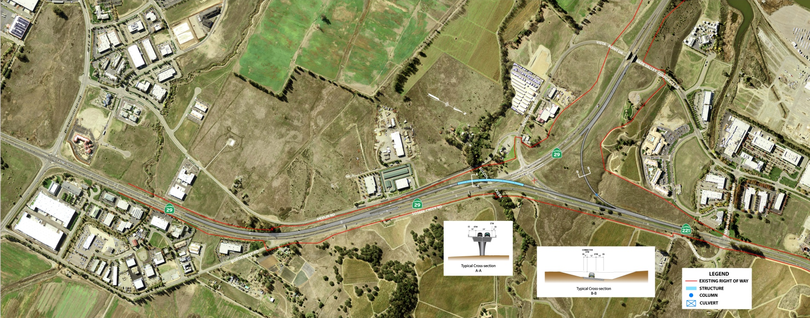
Project Description: Earlier Outreach: April 14, 2015
Alternative 5 Option 1
Alternative 5 Option 2

Slide 6
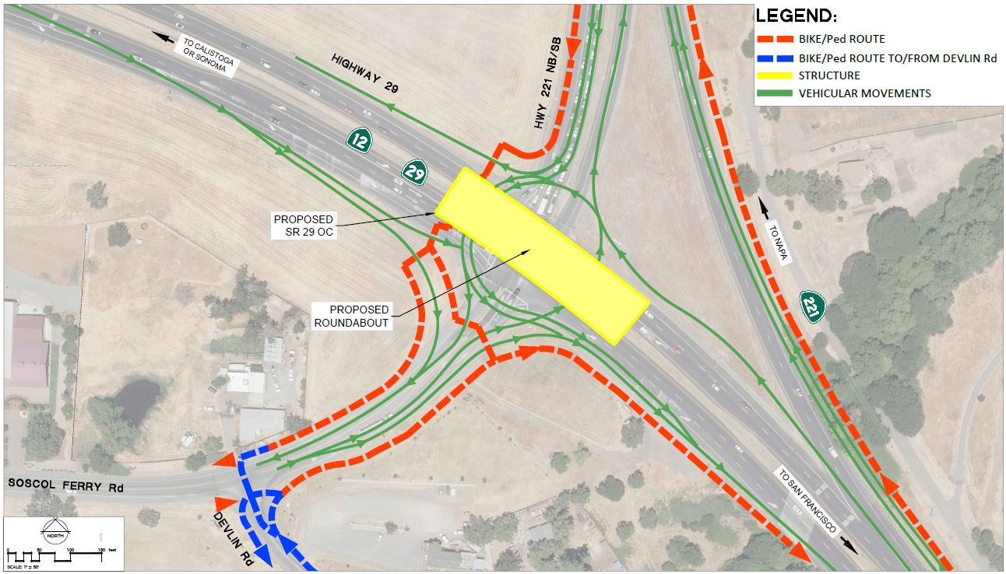
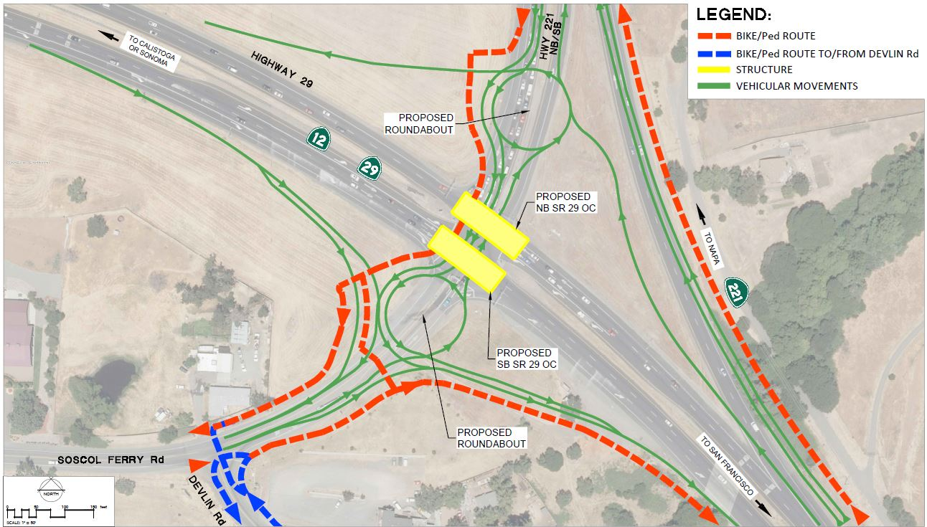
Project Description: Earlier Outreach: August 16, 2018

Slide 7
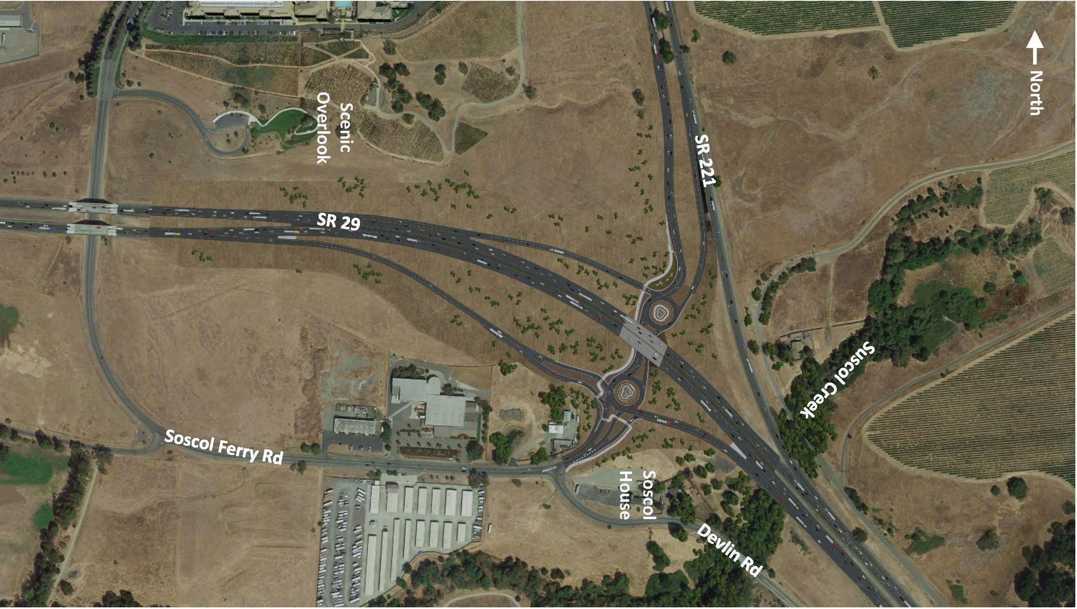
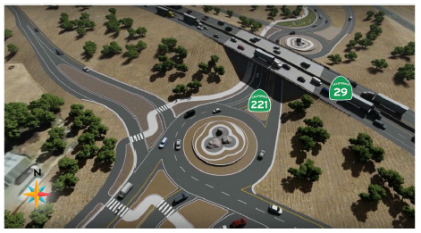
Project Description: Proposed Solutions
Notes:
Purpose:
The signalized intersection is currently experiencing traffic congestion during AM and PM peak periods and is operation at or near capacity.
It is expected that rear end accidents, which are normally a consequence of traffic congestion condition will be reduced by the proposed improvements.
Proposed Scope
The first four alternatives proposed per initial Project Study Report were found to be inadequate due to potential environment impacts and non-standard freeway entrance and exit designs

Slide 8
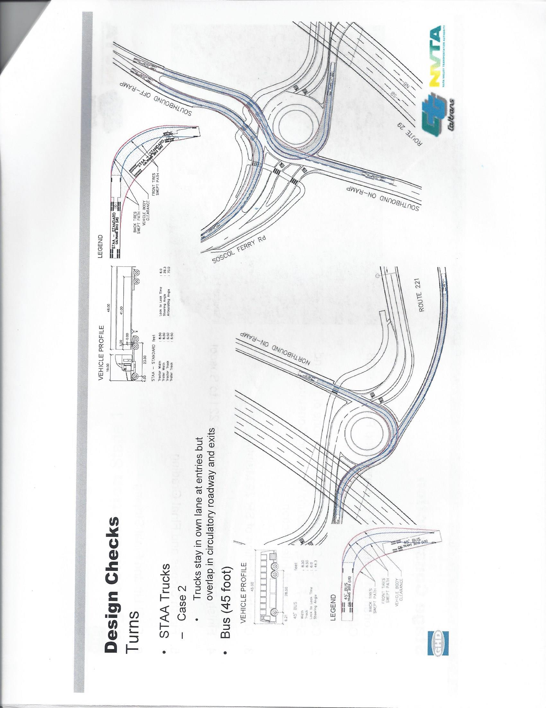
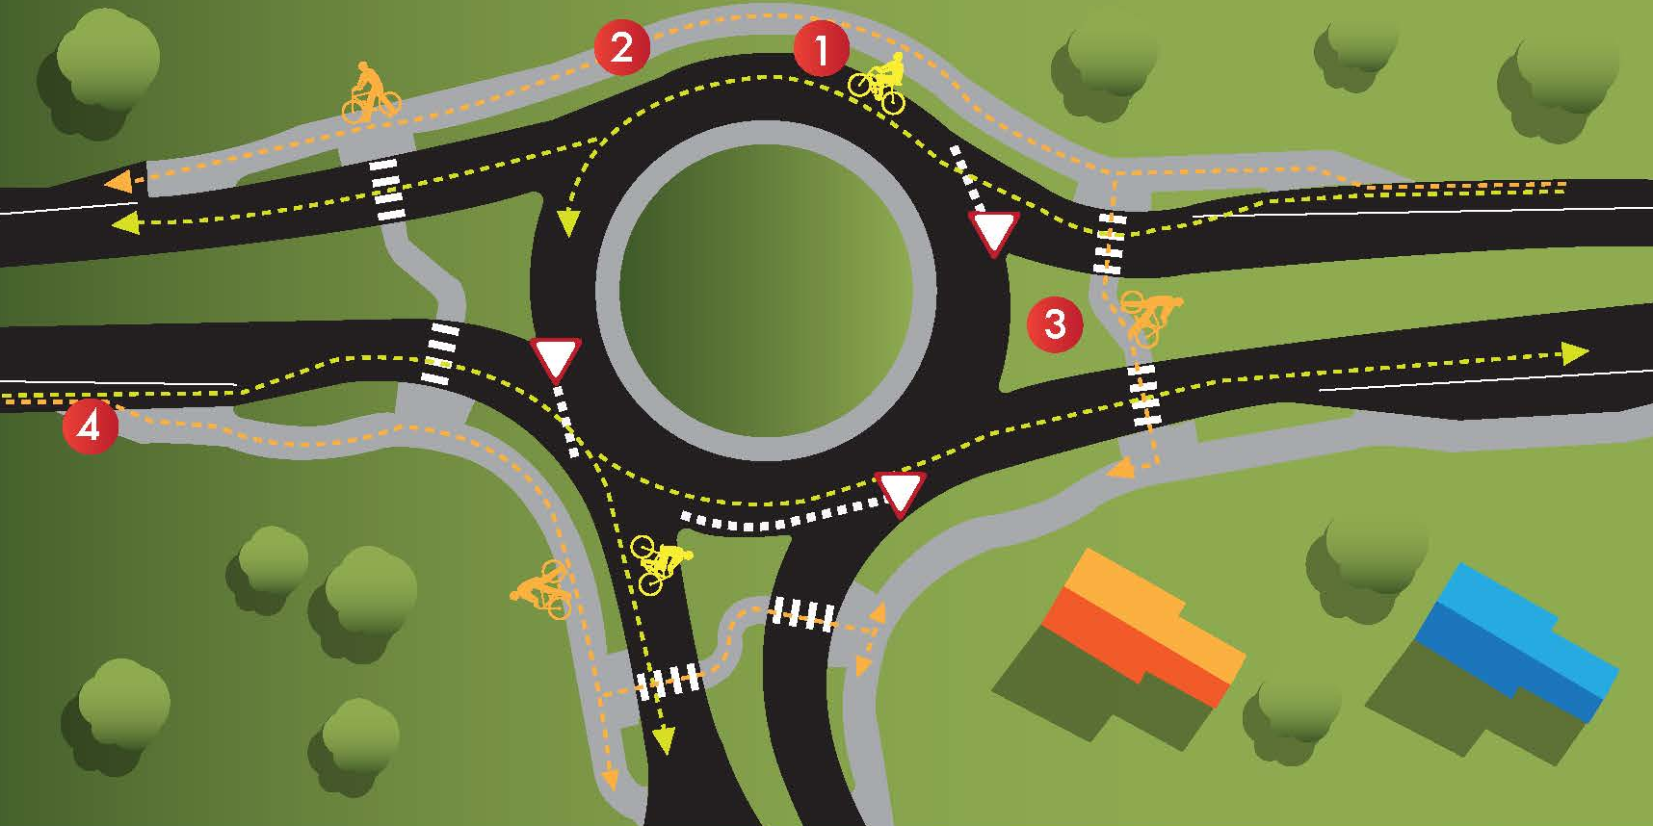
Project Description: Proposed Solutions
Bus Movement
STAA Truck Movement
Bicycle Movement
Notes:
Bicycle Movement
Experienced Riders travel as a vehicle
Novice Riders use Shared Path
Pedestrian Refuges are wide enough to shelter bicyclists
Enter and Exit Shared Path from bike ramps located away from the intersection

Slide 9
Studies on Traffic and Transportation:
SR 29/SR 221/ Soscol Ferry Road Intersection
2018 - Current Condition
AM Peak Hour |  | PM Peak Hour
Delay (sec) | LOS | Delay (sec) | LOS
239 | F | 187 | F
2025
No Build Alternative
AM Peak Hour |  | PM Peak Hour
Delay (sec) | LOS | Delay (sec) | LOS
334 | F | 307 | F
 | Build Alternative
 | AM Peak Hour |  | PM Peak Hour
Roundabouts | Delay(sec) | LOS | Delay (sec) | LOS
North | 8 | A | 14 | B
South | 10 | A | 13 | B
2045
No Build Alternative
AM Peak Hour |  | PM Peak Hour
Delay (sec) | LOS | Delay (sec) | LOS
435 | F | 372 | F
 | Build Alternative
 | AM Peak Hour |  | PM Peak Hour
Roundabouts | Delay (sec) | LOS | Delay (sec) | LOS
North | 8 | A | 17 | B
South | 10 | A | 16 | B

Slide 10
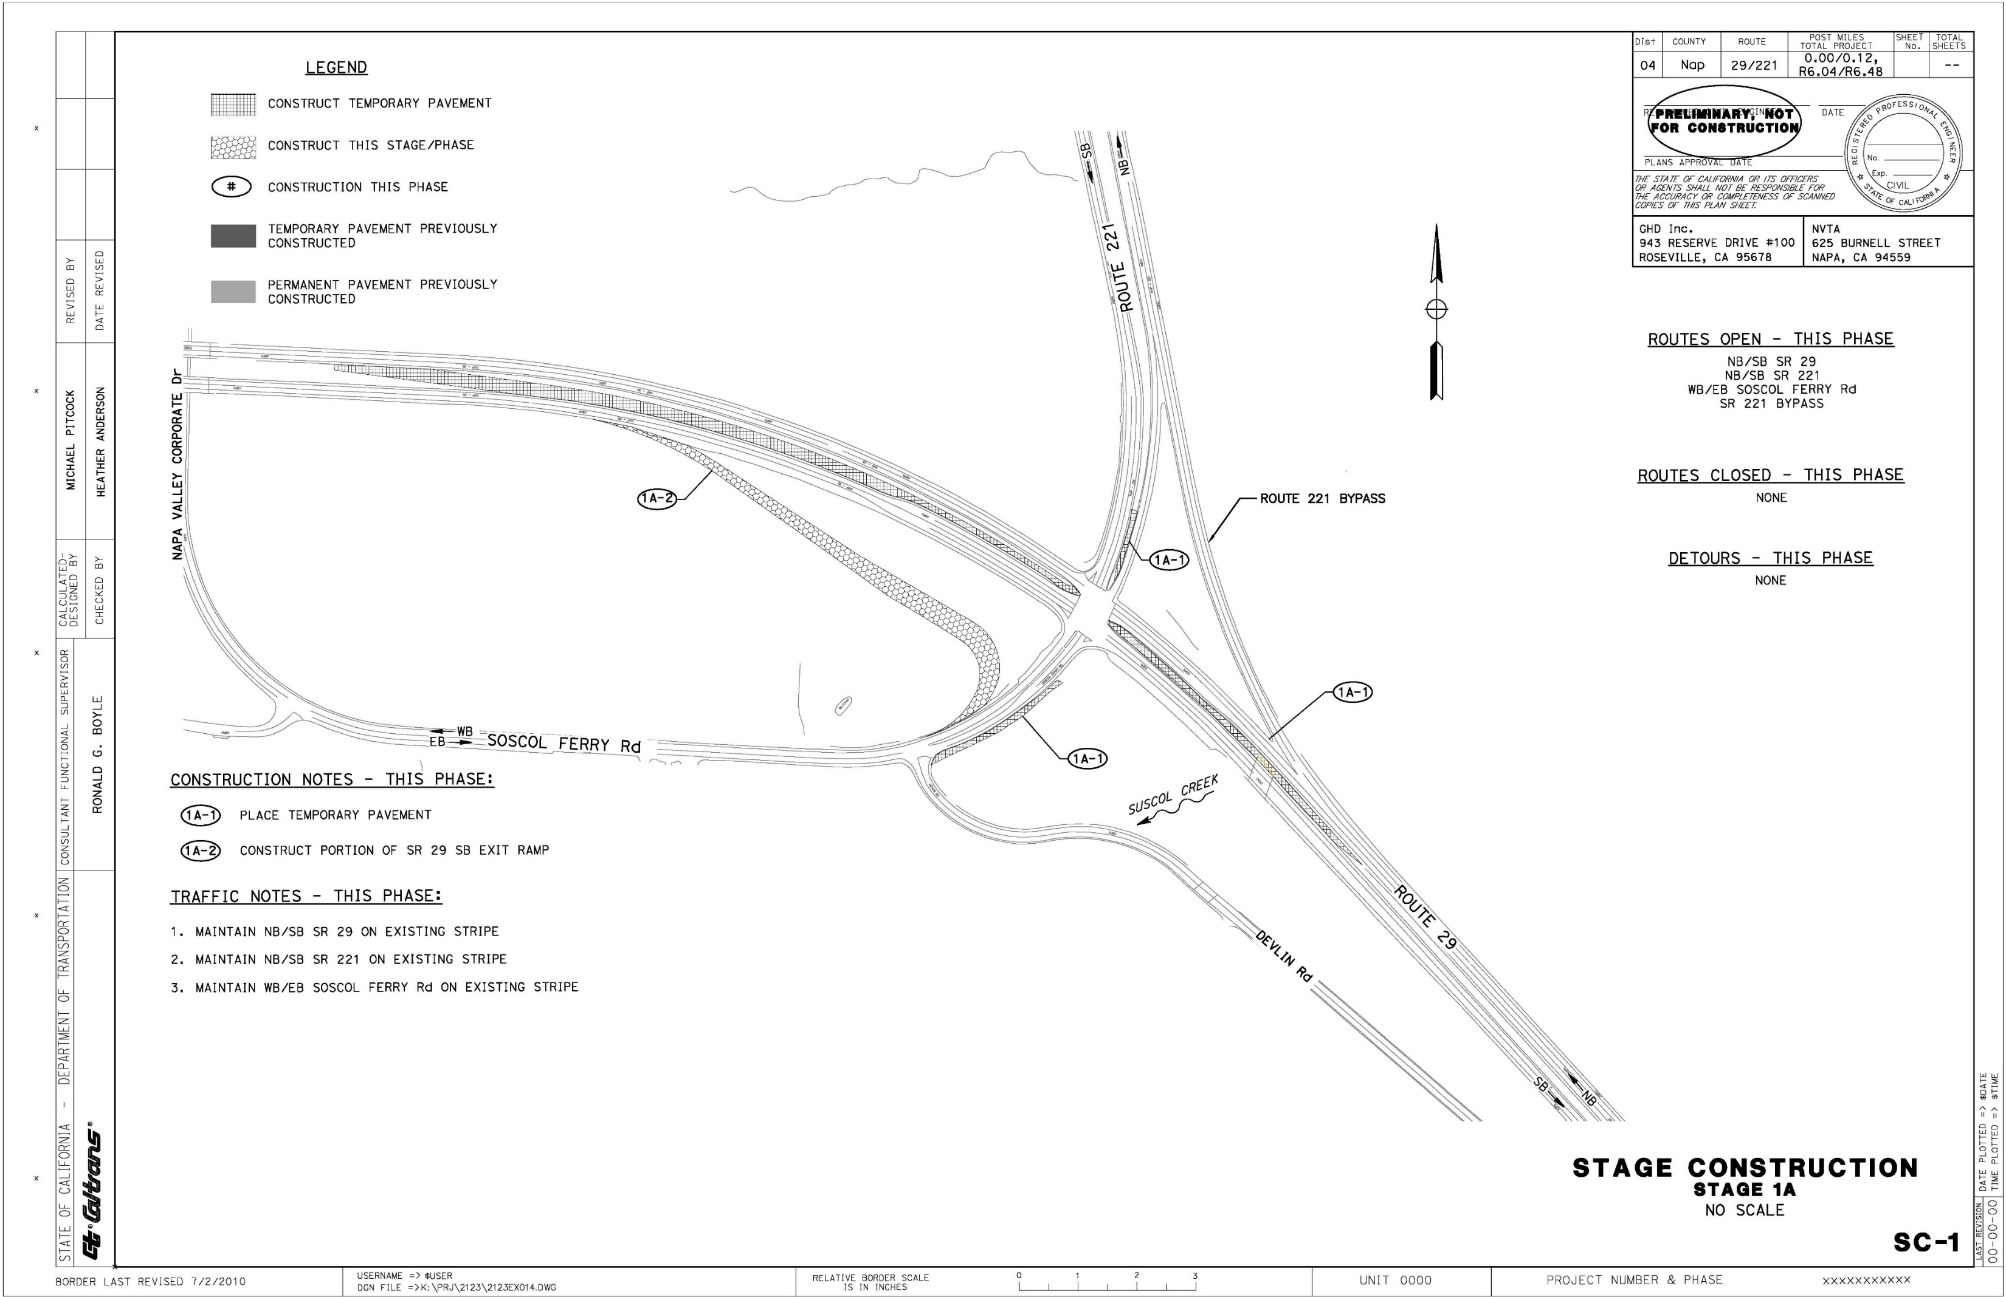
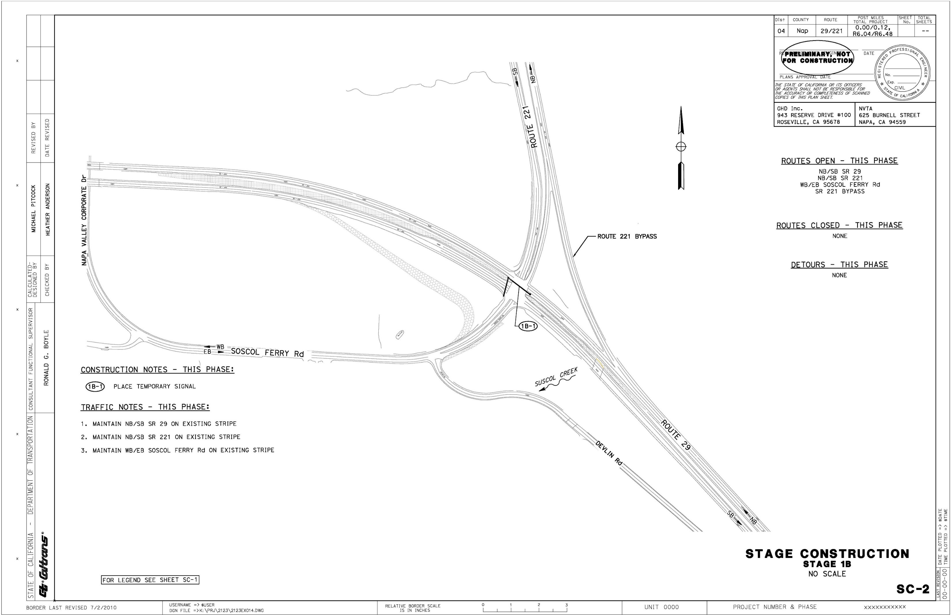
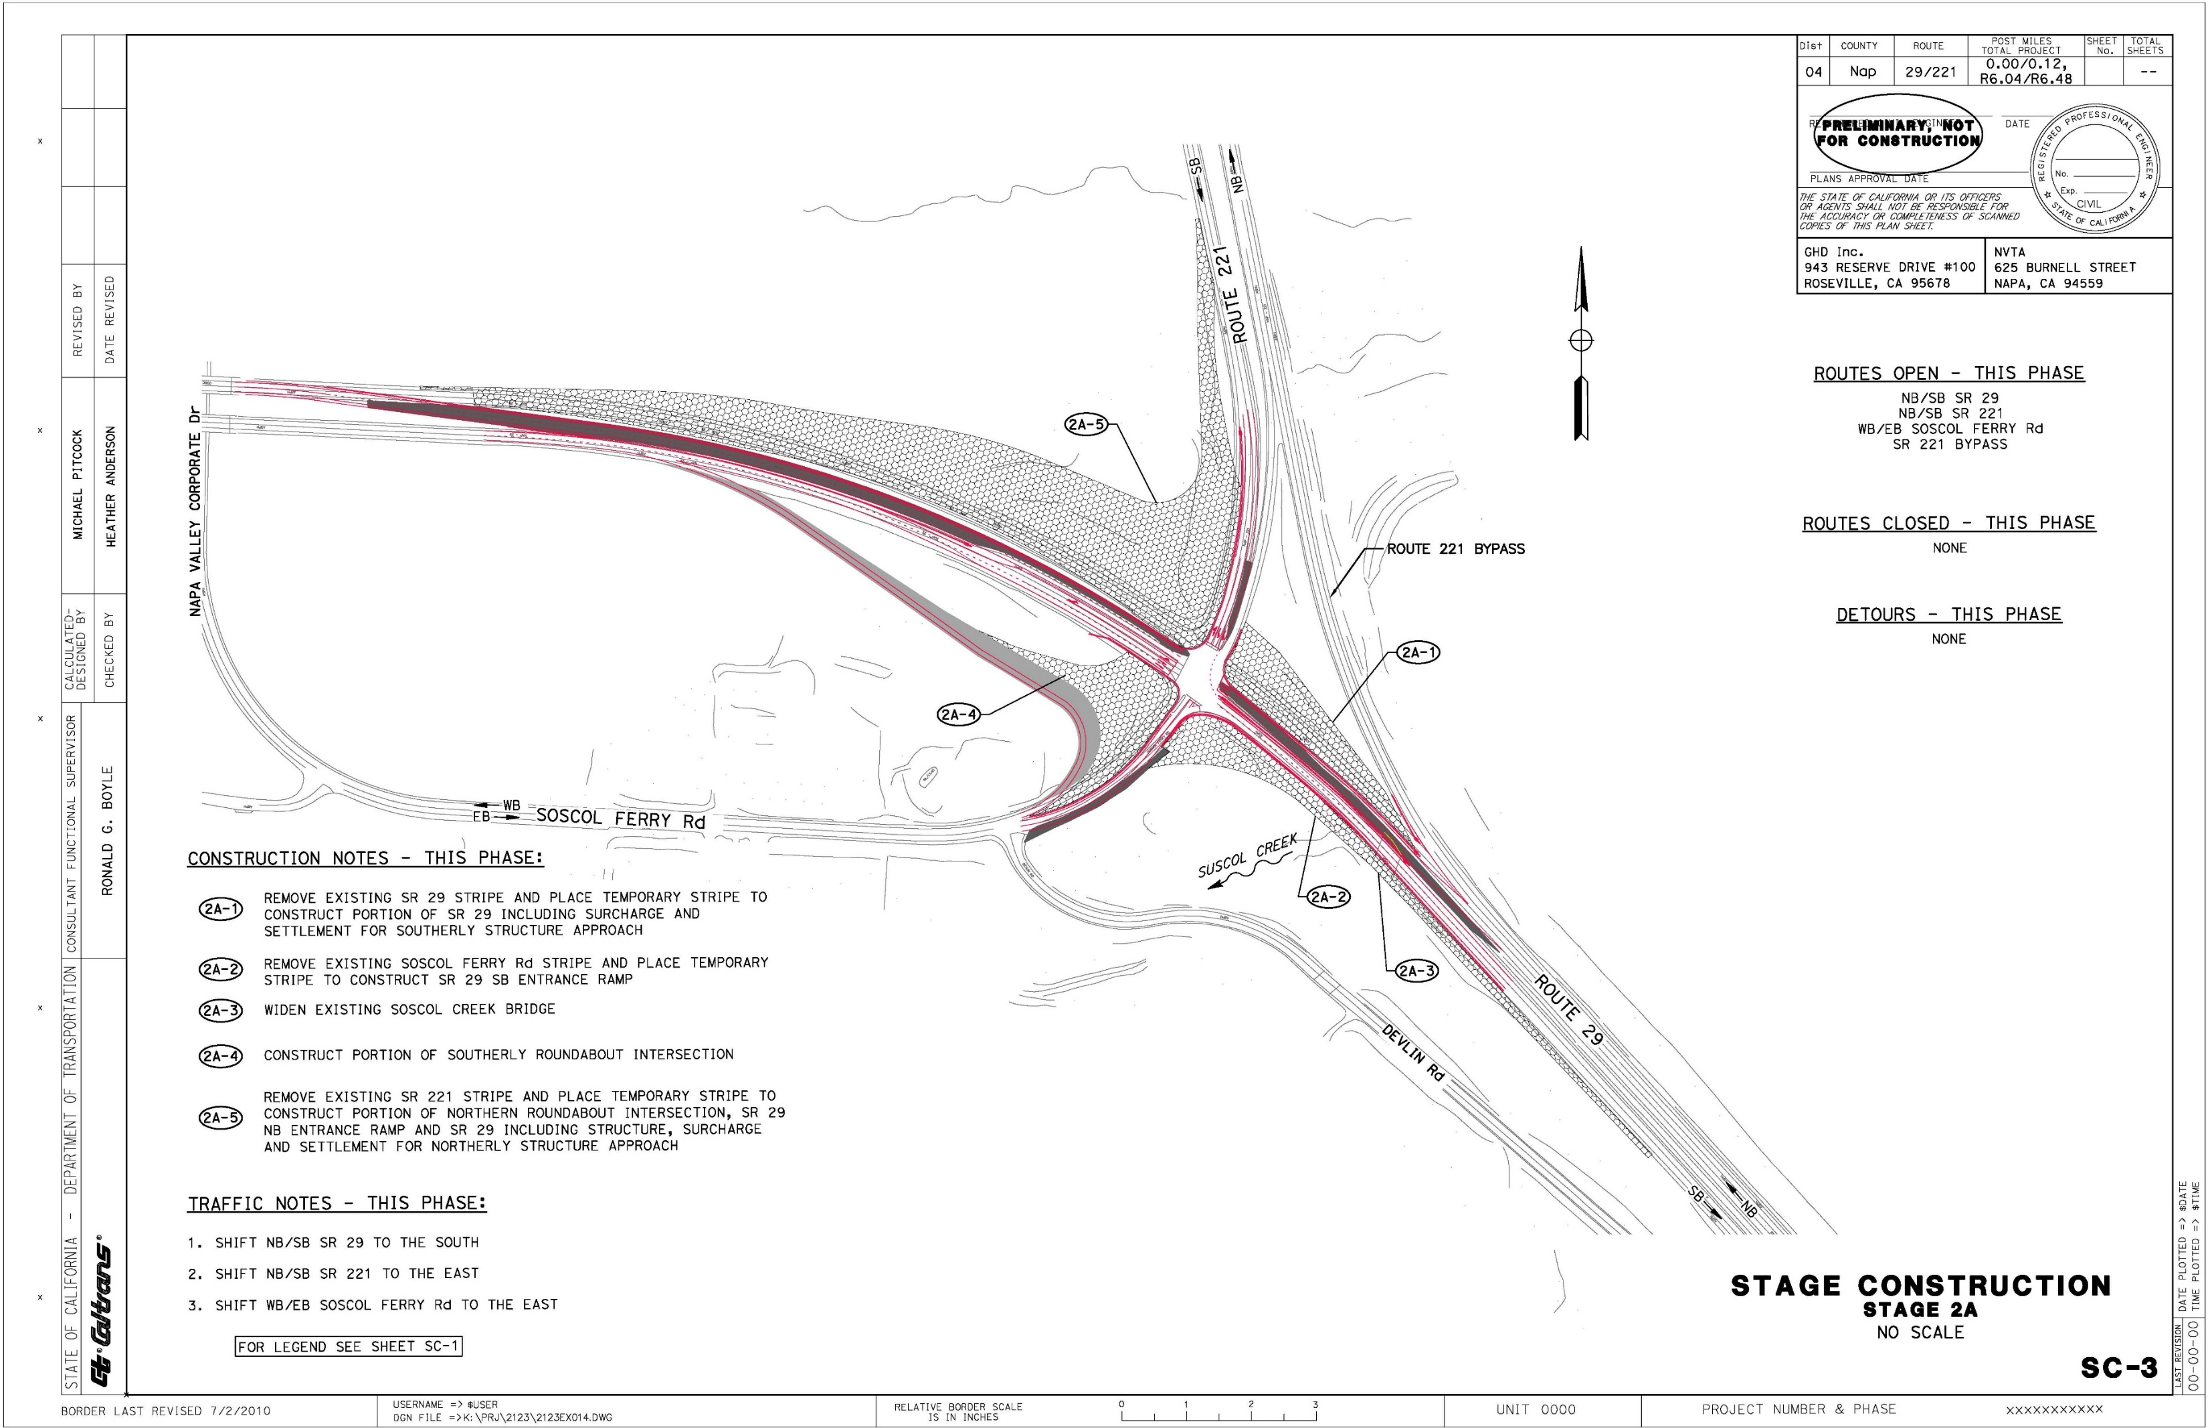
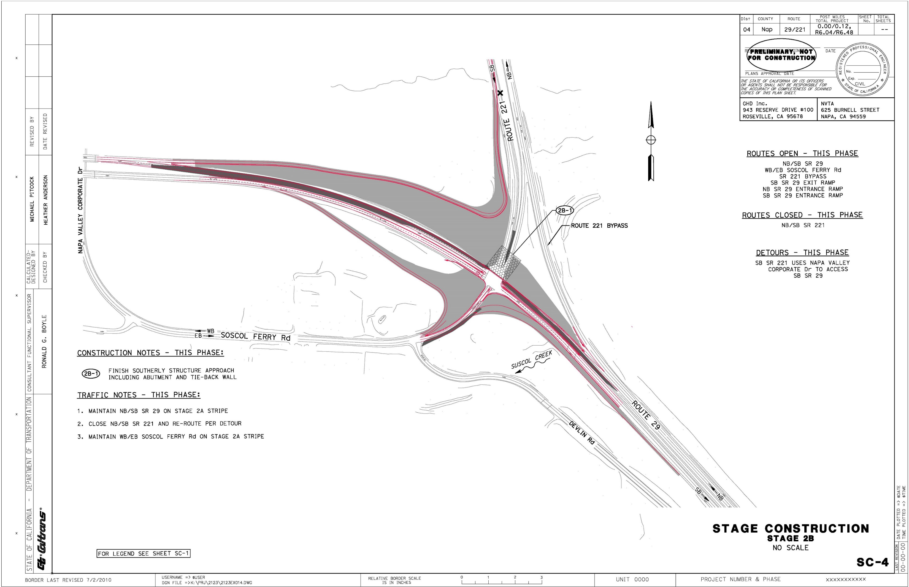
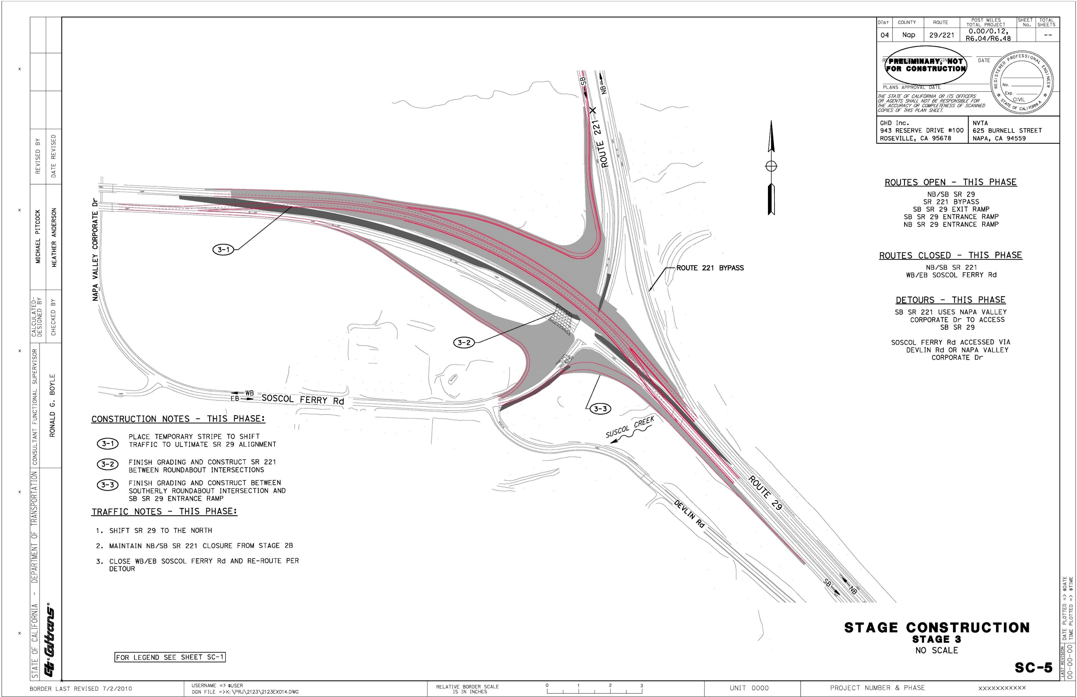
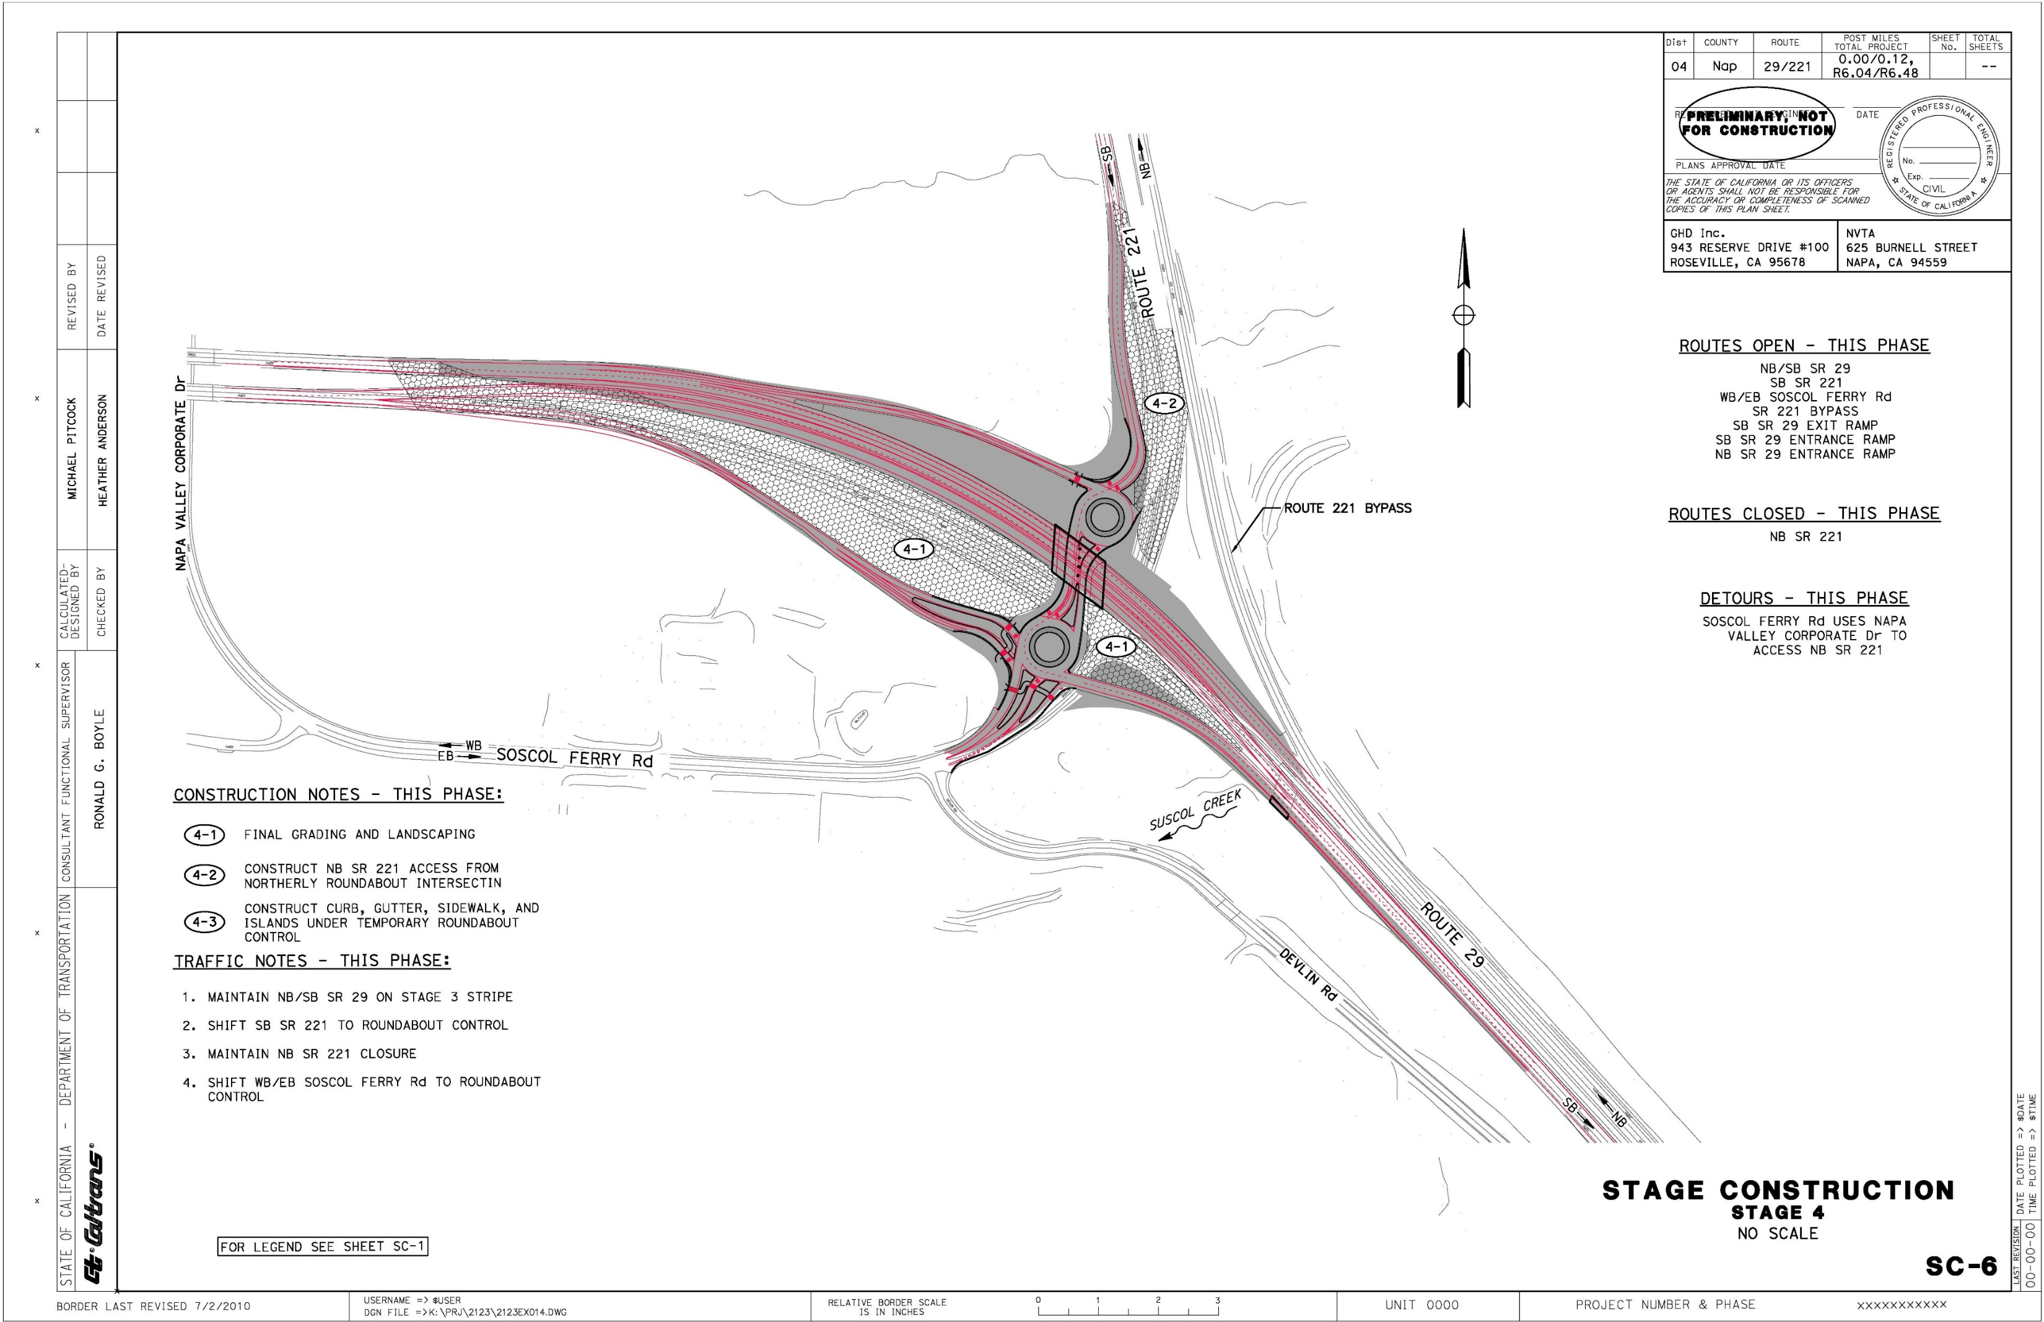
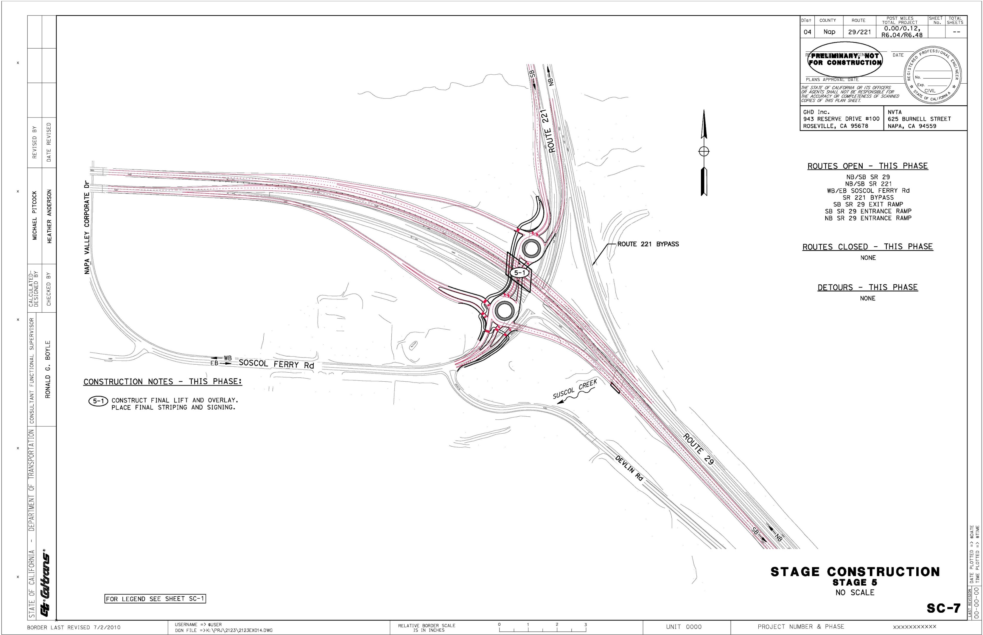
Studies on Traffic and Transportation: Stage Construction

Slide 11
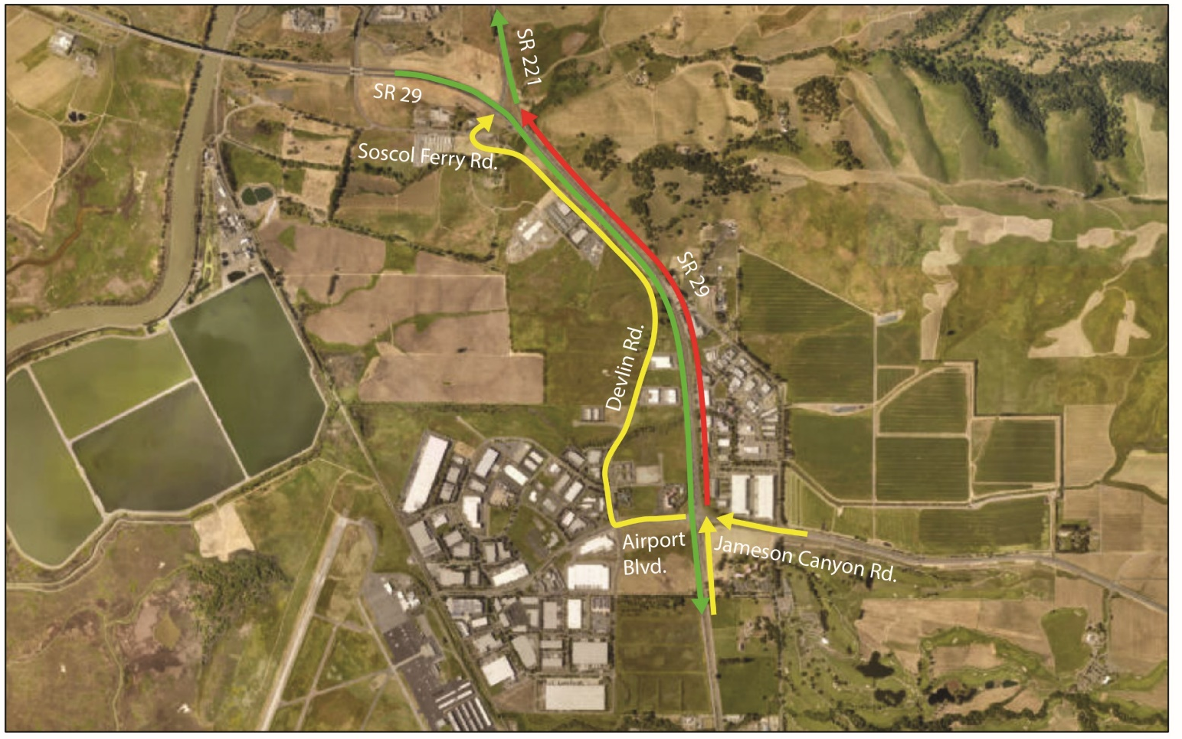
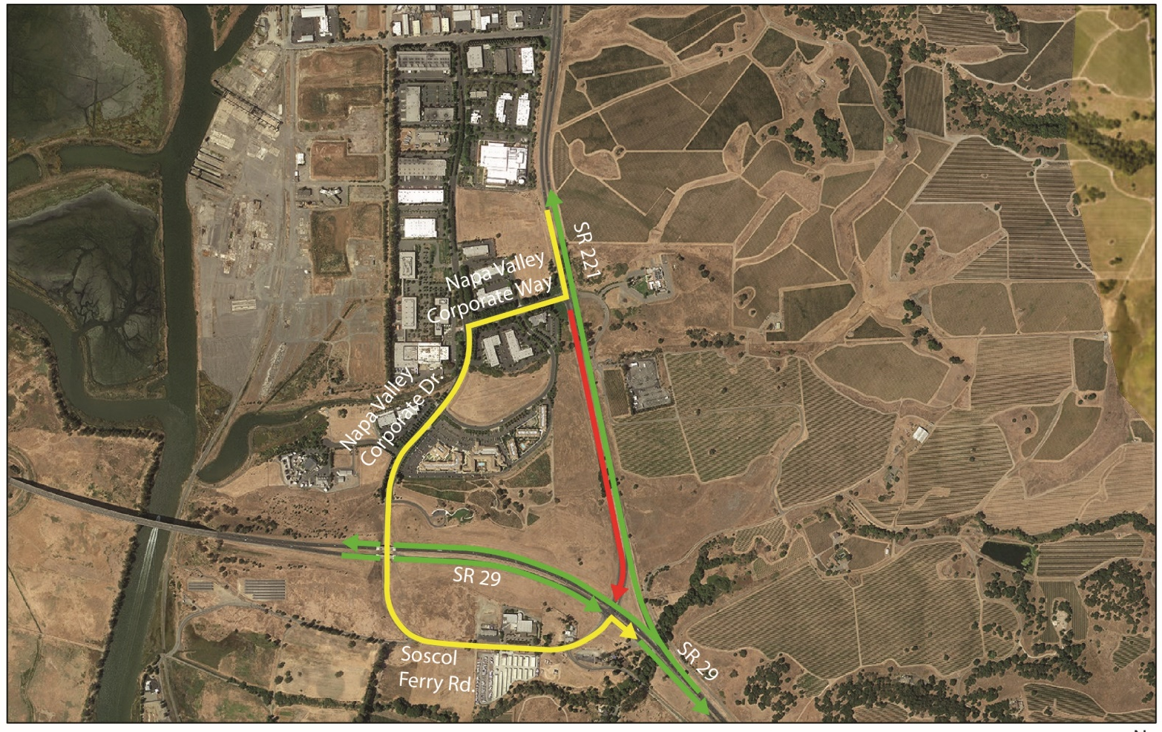

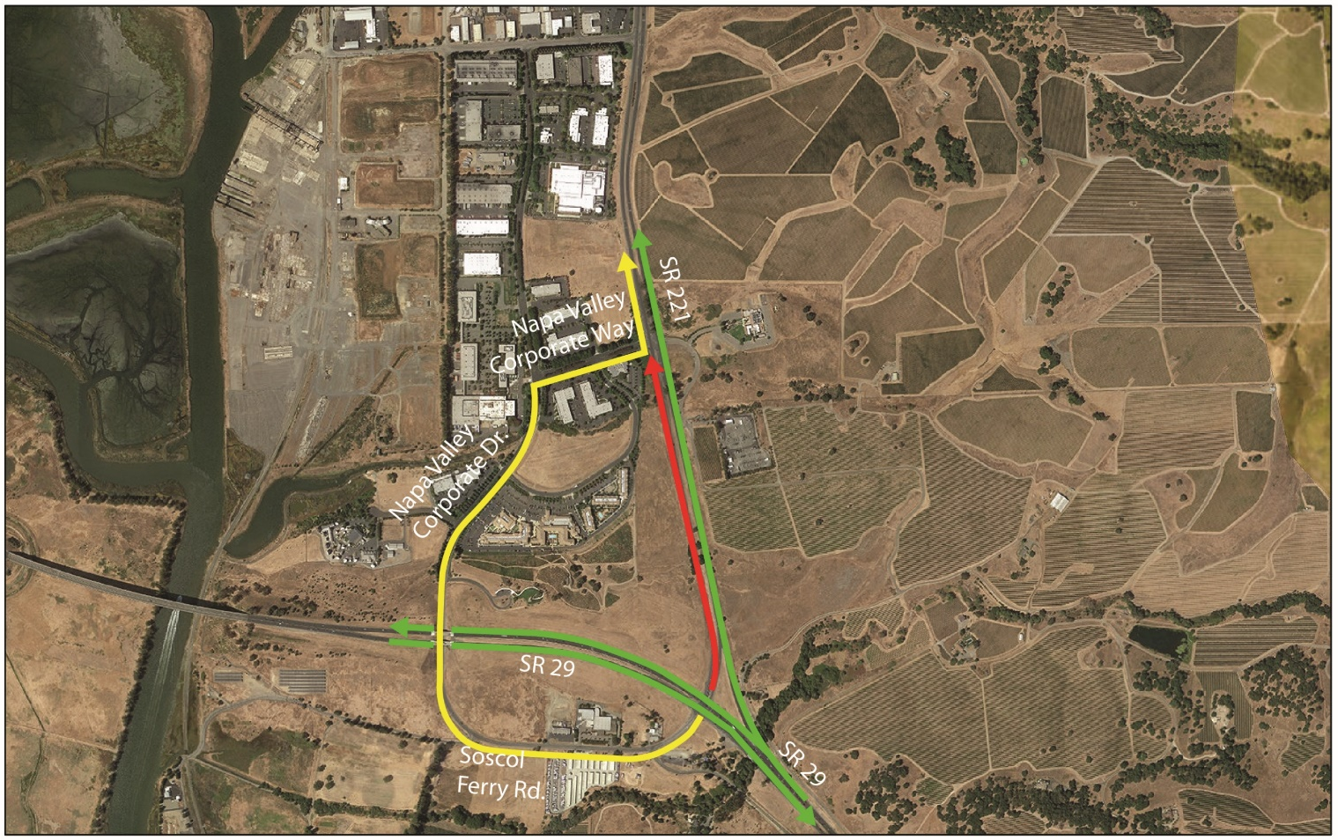

Studies on Traffic and Transportation: Detours

Slide 12
Other Agencies :
State and Federal
United States Fish and Wildlife Service
National Marine Fisheries Service
United States Army Corps of Engineer
Regional Water Quality Control Board
California Department of Fish and Wildlife
Cultural Resources
State Historic Preservation Officer
Air Quality Conformity
MTC
FHWA

Slide 13
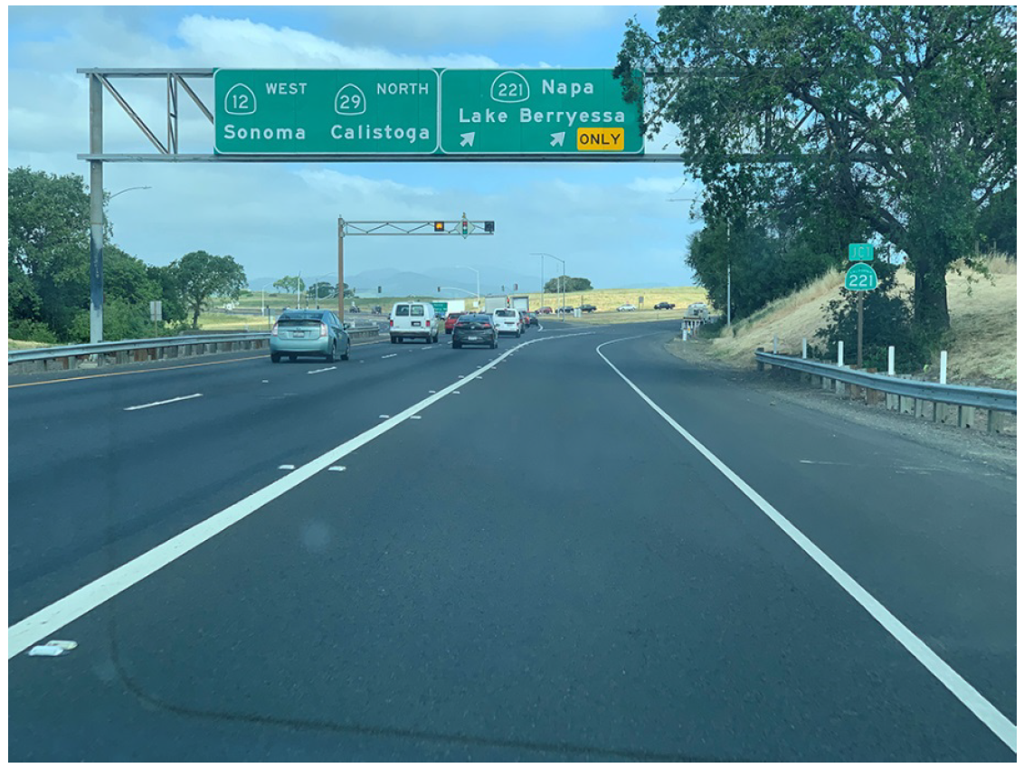
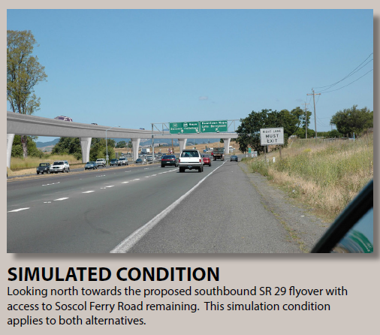
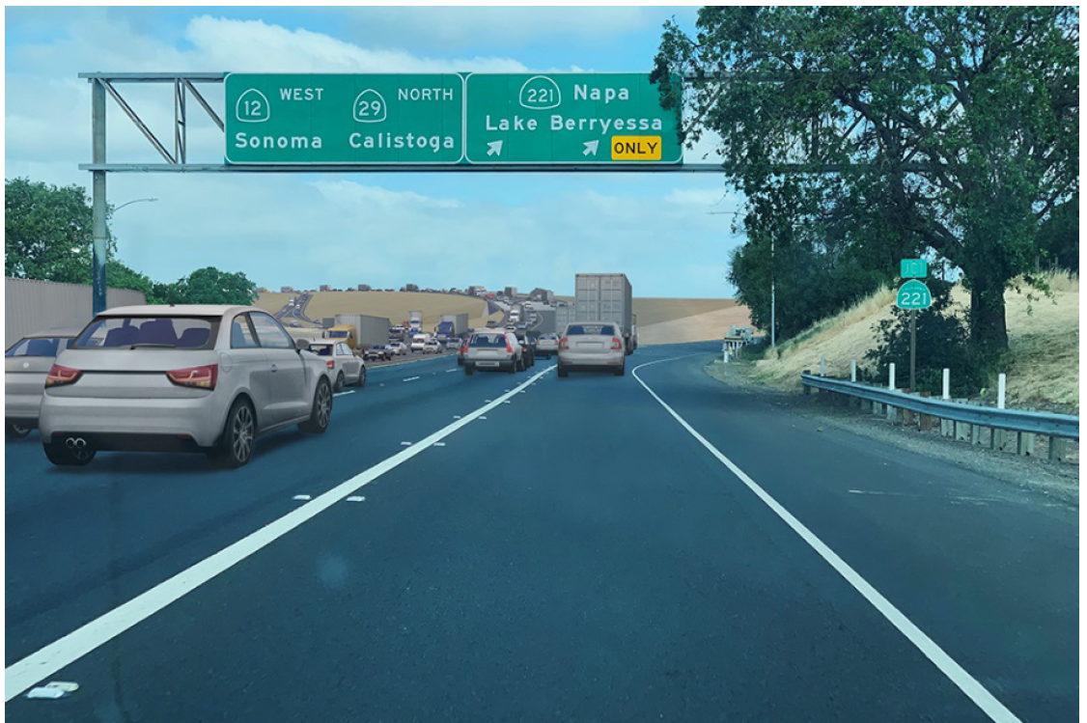
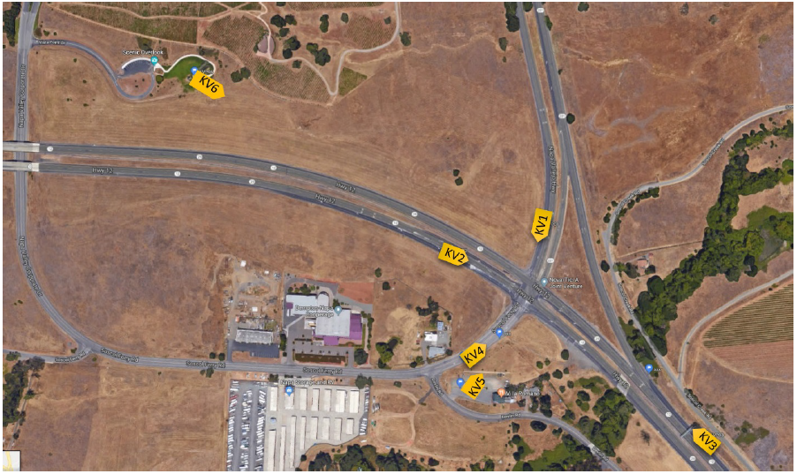
Simulated Views - 2
Simulated Views: From Northbound SR 29
Eliminated Alterative: Flyover Structure
Existing Condition
Proposed Condition

Slide 14
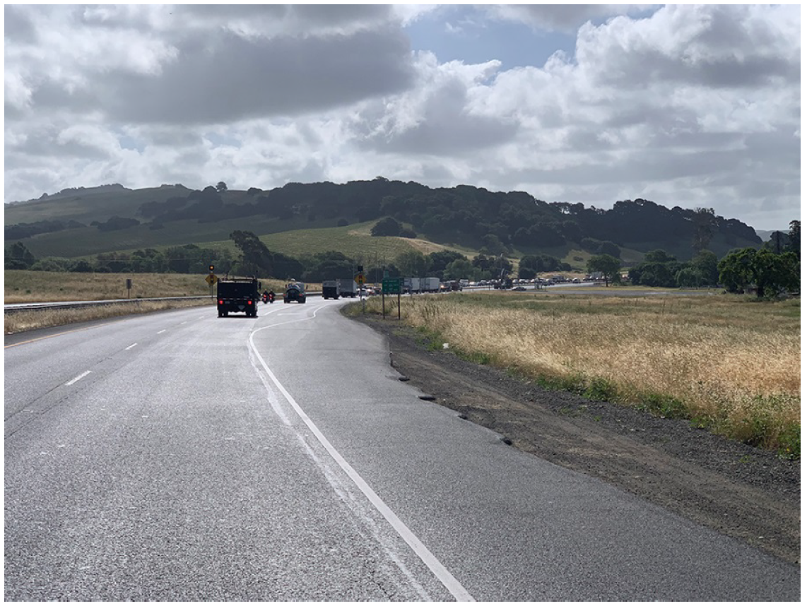
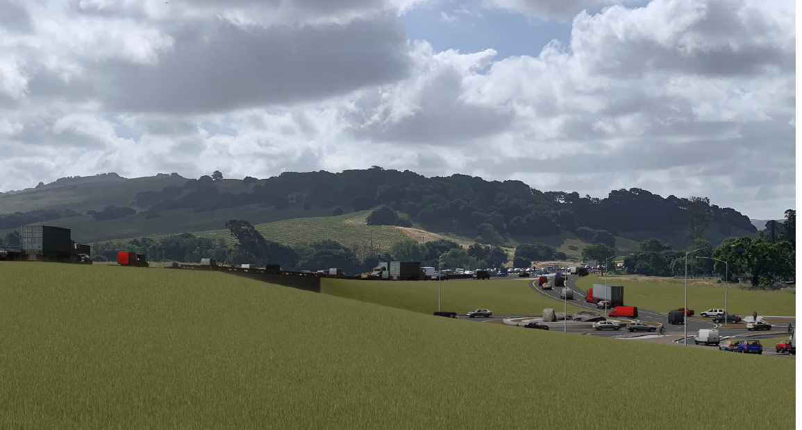
Simulated Views - 4
Simulated Views: From Southbound SR 29
Existing Condition
Proposed Condition

Slide 15
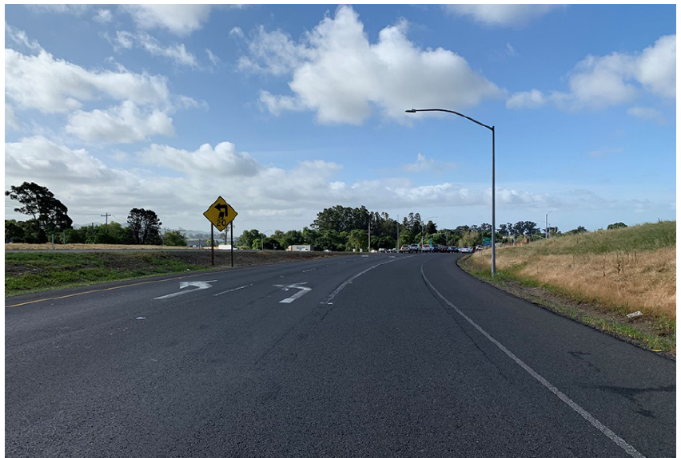
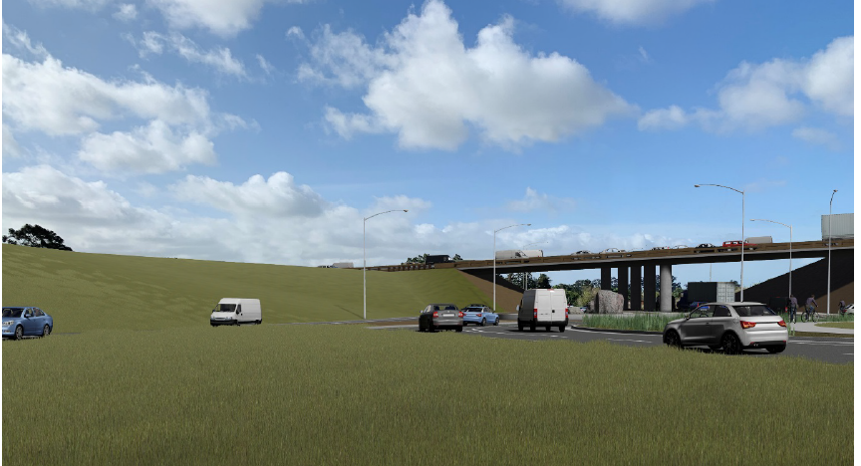
Simulated Views: From Southbound SR 221
Existing Condition
Proposed Condition

Slide 16

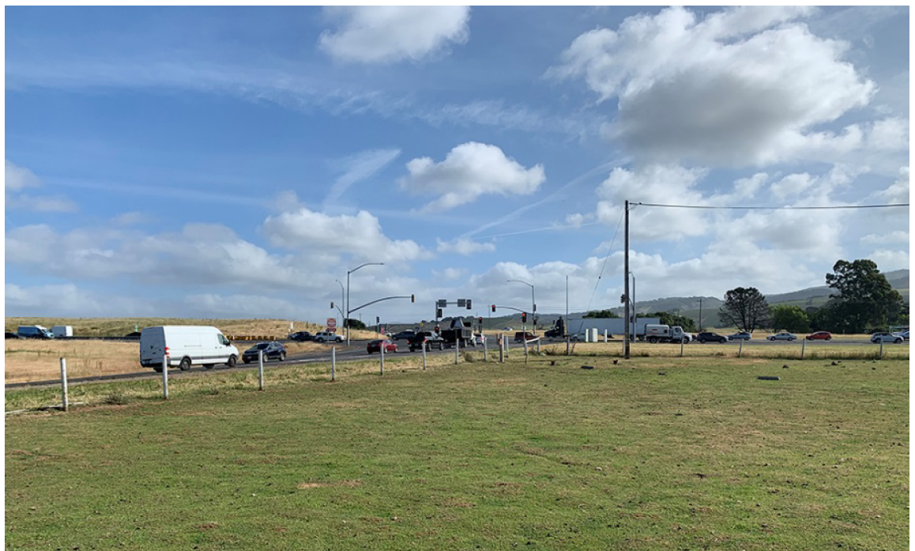
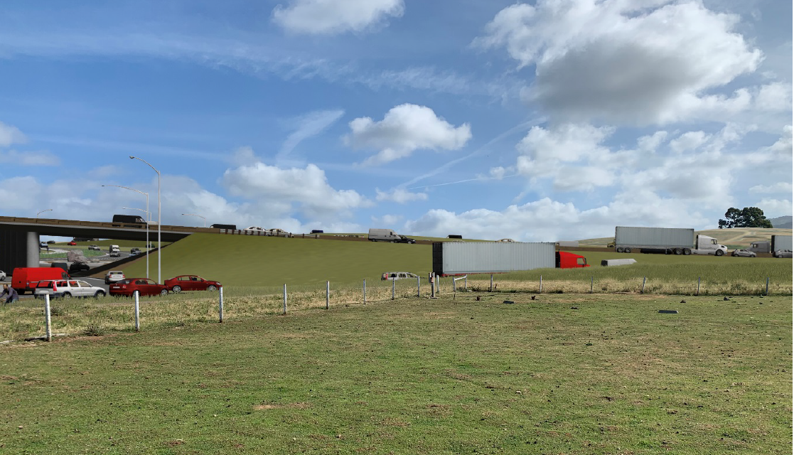
Simulated Views - 3
Simulated Views: From Soscol Ferry Road
Existing Condition
Proposed Condition

Slide 17
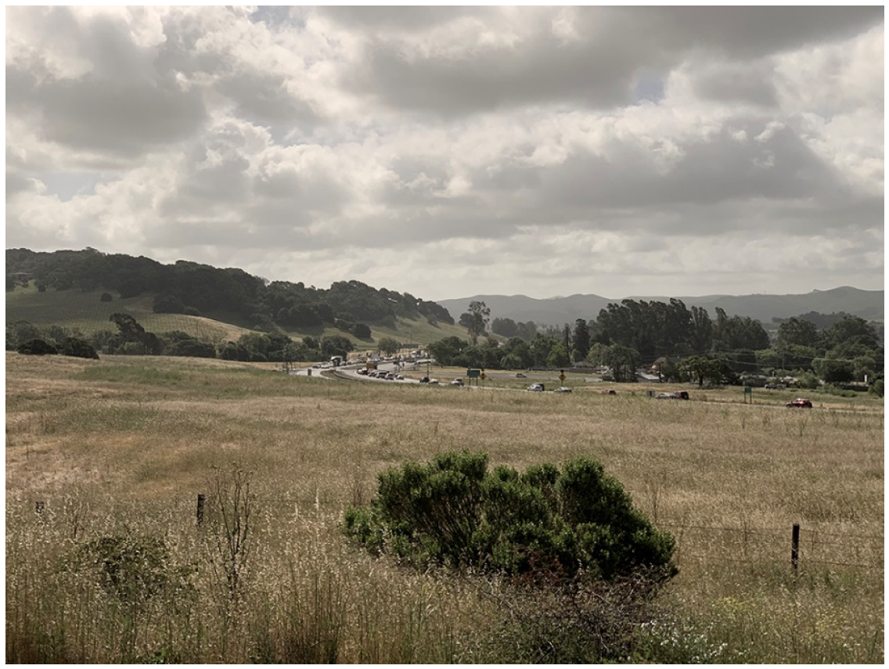
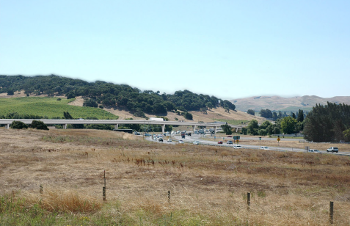
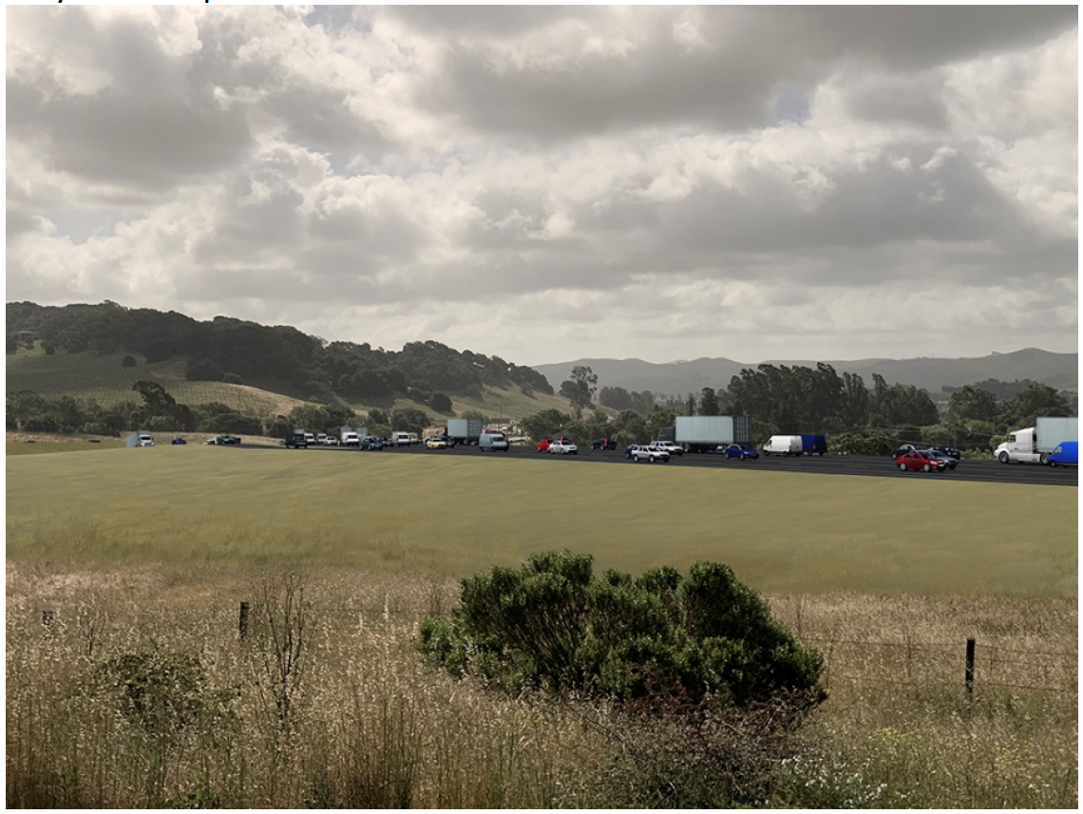
Simulated Views: From the Vista Point
Simulated Views - 1
Eliminated Alterative: Flyover Structure
Existing Condition
Proposed Condition

Slide 18
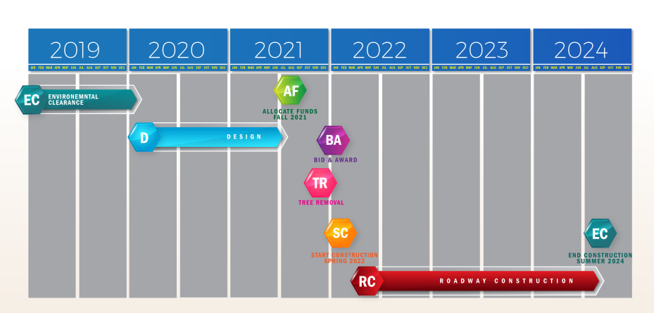
PAED

Slide 19
End / Questions?
Attendees:
Wahida Rashid: Caltrans Environmental
Cindy Fong:Caltrans Environmental
Halim Mathkour: Caltrans Design
Hillal Hamdan: Caltrans Design
Susan Lindsay: Caltrans Landscape
Jake Freeman: Caltrans Planning
Robert Blizard: Caltrans Biology
Kevin Krewson: Caltrans Env. Engineering
Janis Mara: Caltrans PIO
Vince Jacala: Caltrans PIO
Heather Anderson: GHD-OmniMeans
Sanjay Mishra: NVTA
Rebecca Schenck: NVTA
Danielle Schmitz: NVTA
Kelly Hirschberg: Caltrans Project Mgmt
Please send your comments
to Cindy Fong cindy.fong@dot.ca.gov
by 10/20/19.
Notes:
The proposed intersection improvements will not change the cost-effectiveness of commute times for workers or change the behavior of tourists traveling to or from Napa Valley.

