Slide 1


Napa Valley Countywide Active Transportation Plan
October 16, 2024

Slide 2
Agenda
Introduction to the Plan
Scope and Tasks
Timeline
Outreach and Engagement Opportunities
Interactive Map Demonstration
Next Steps

Slide 3
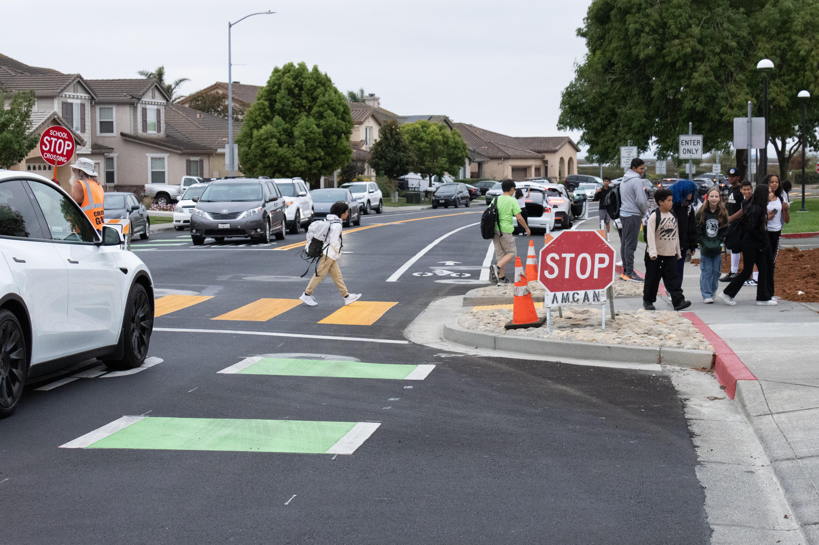
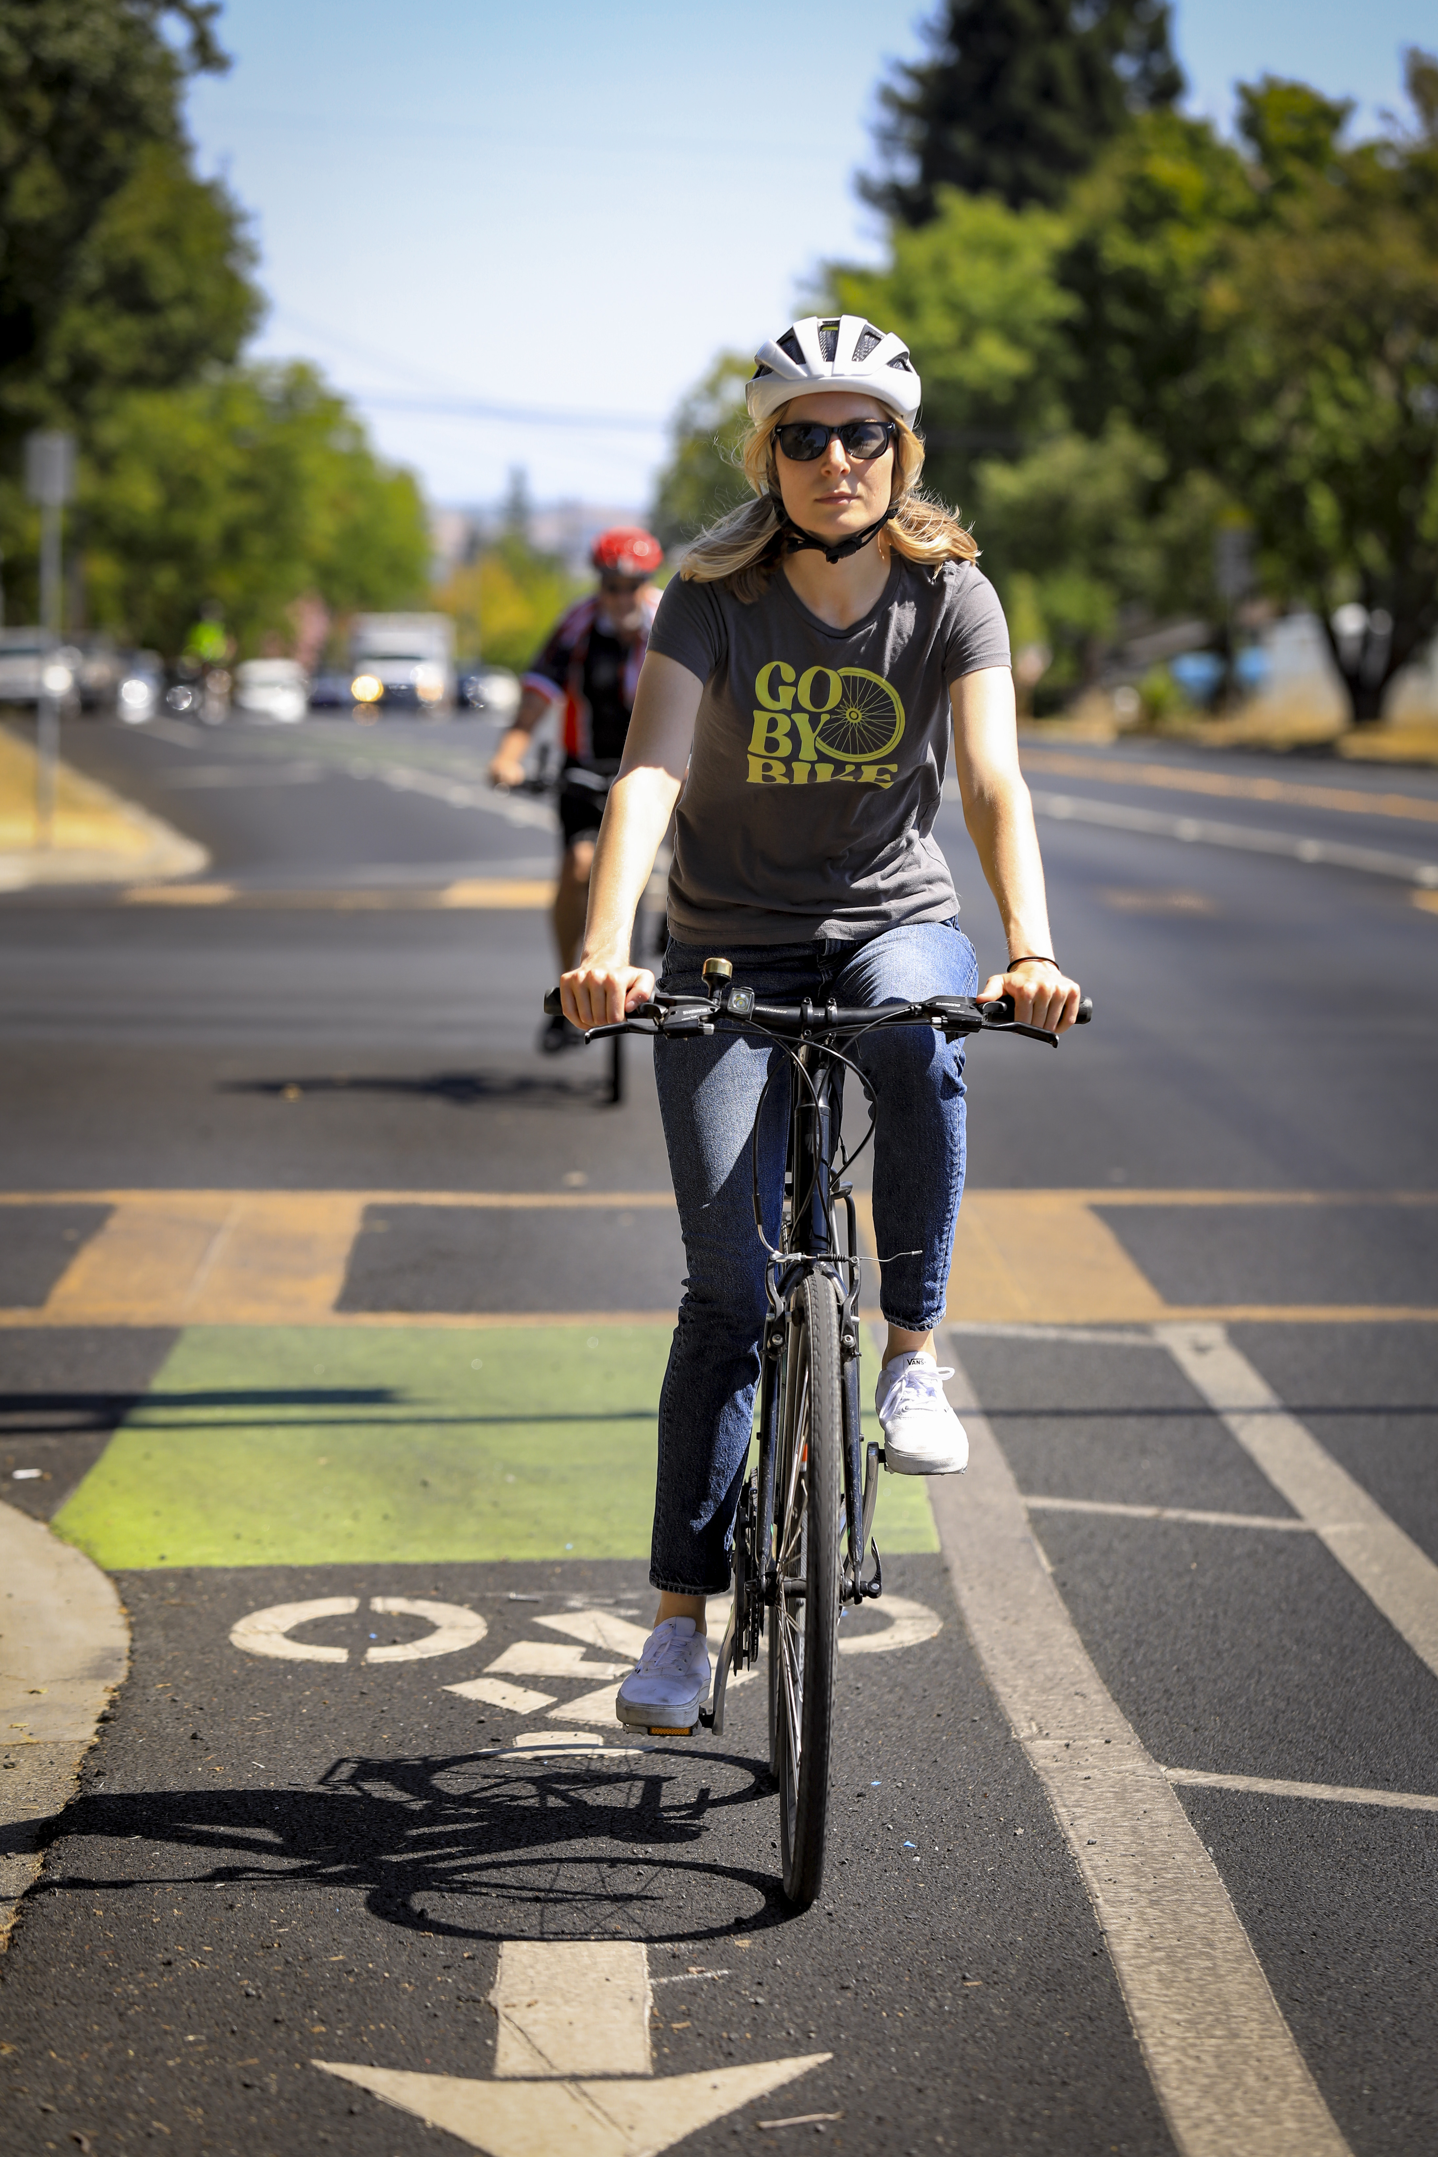
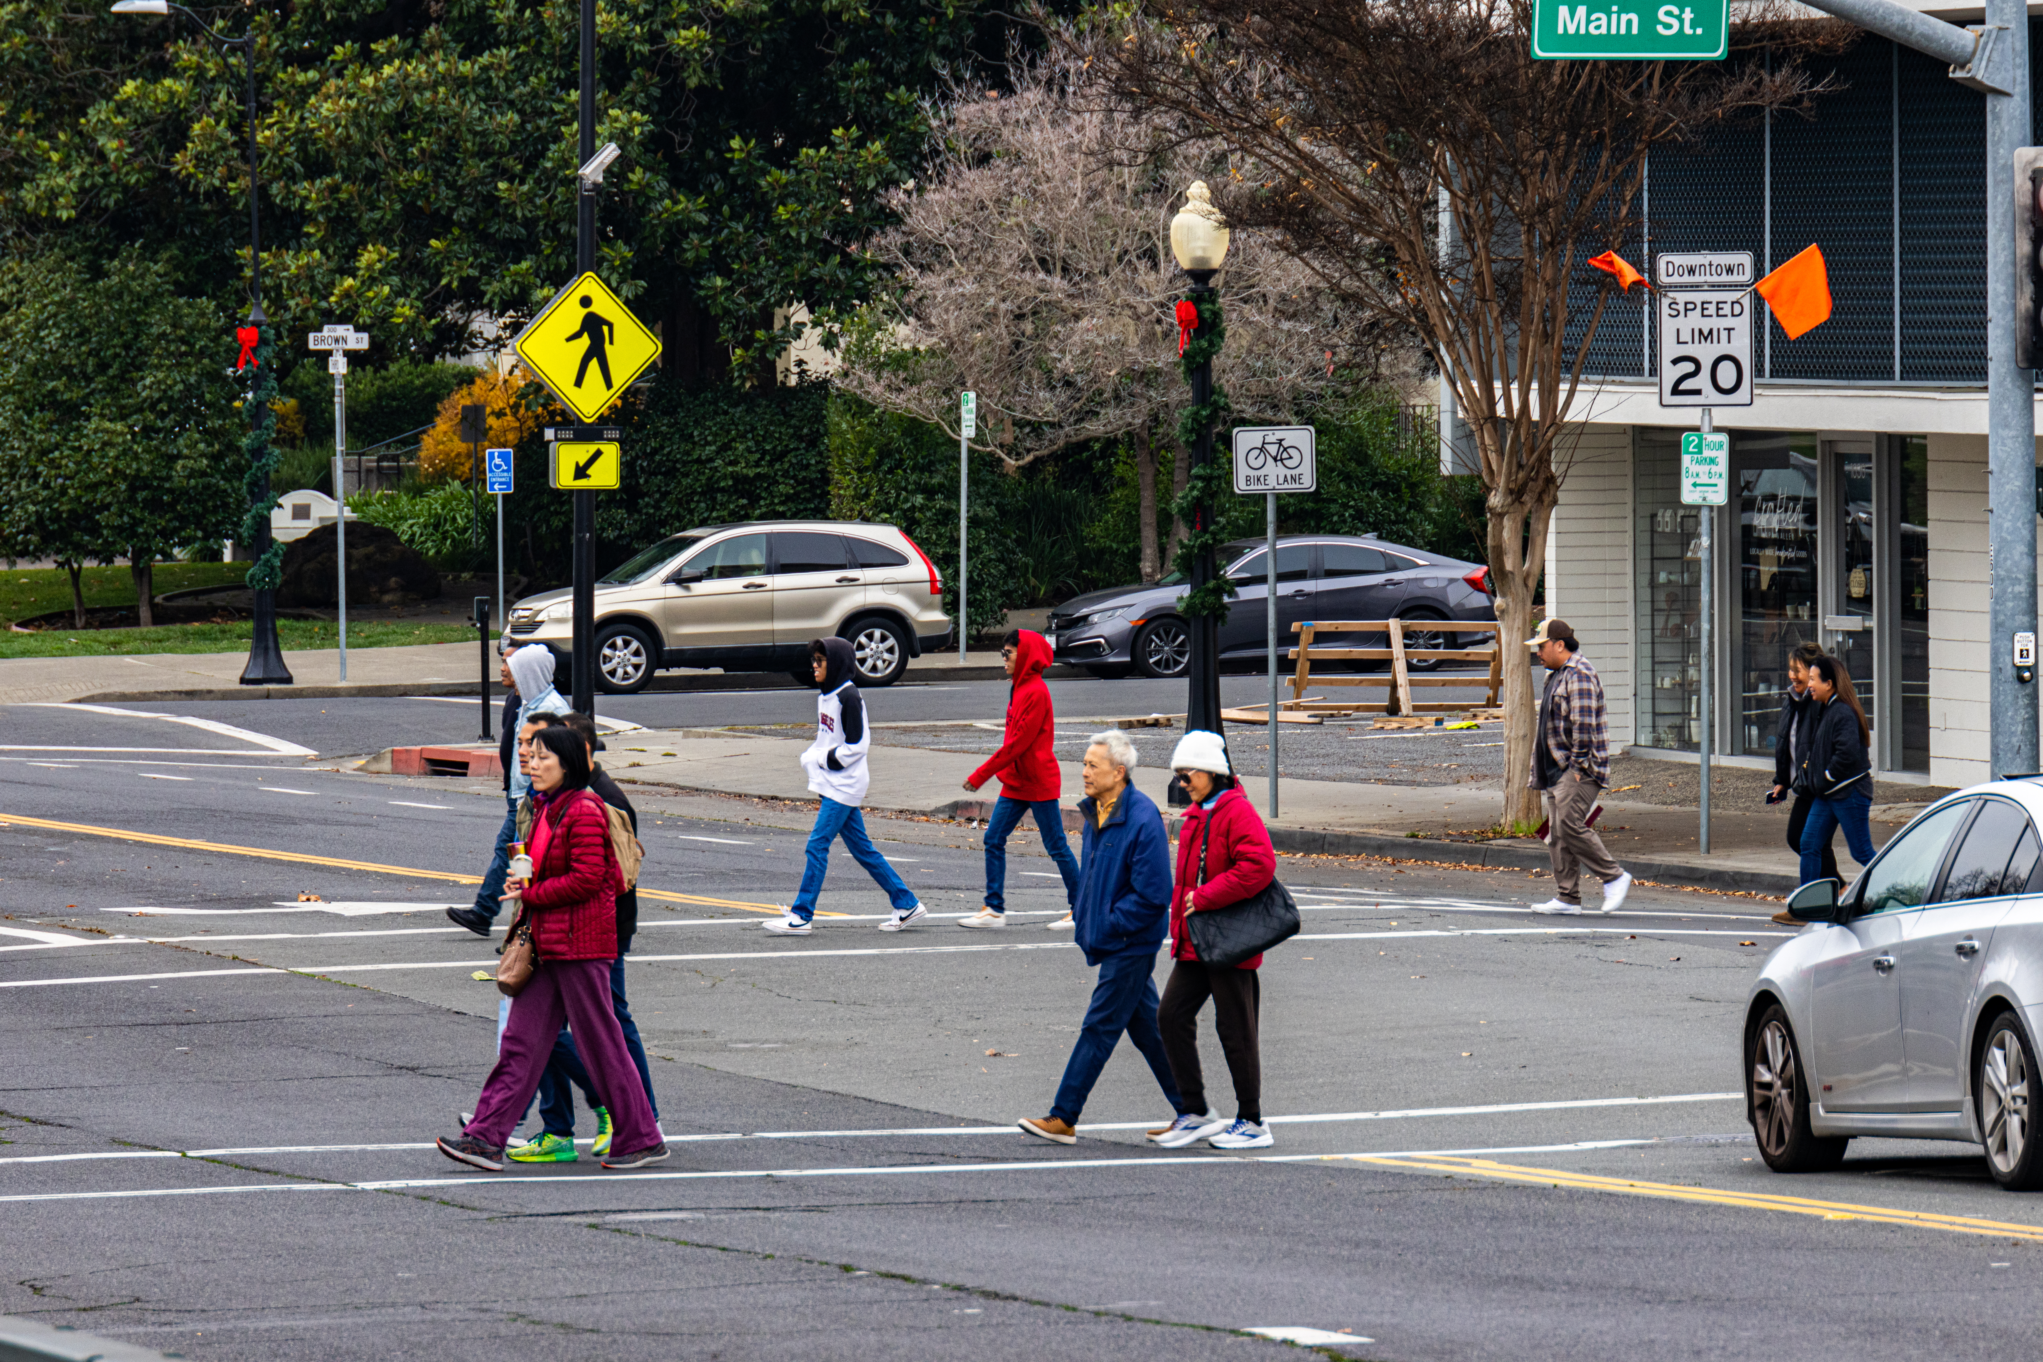
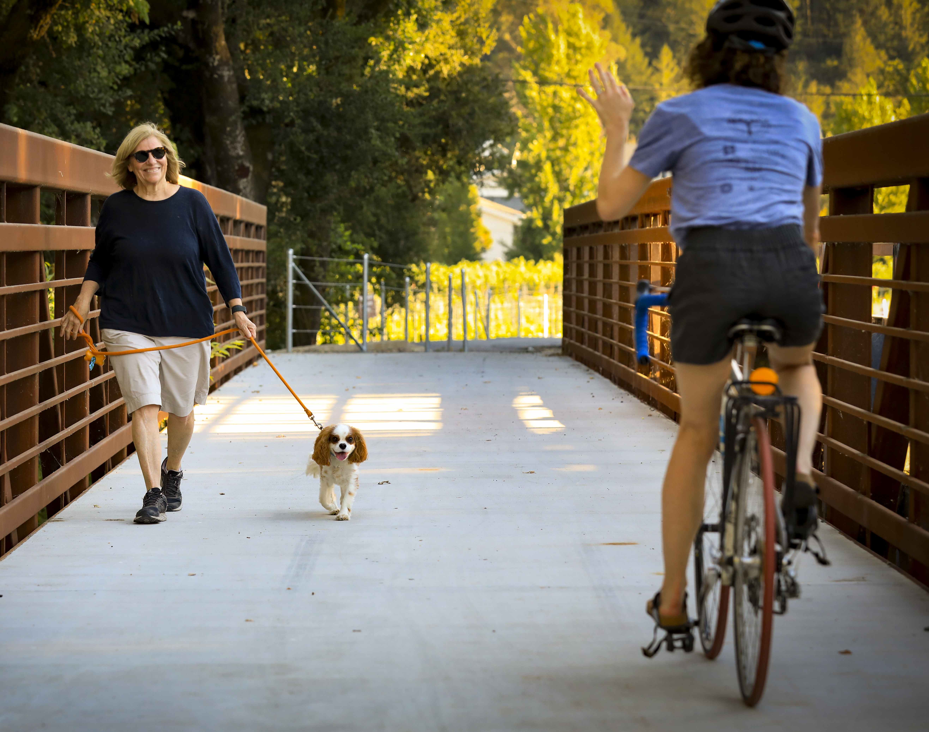
What is Active Transportation (AT)?
Any non-motorized mode of transportation
Walking/using a wheelchair
Bicycling
Include e-bikes, scooters, mobility devices, etc.
Connections to public transportation
AT Facilities
Sidewalks and crosswalks
Bike lanes, paths, trails, or routes that prioritized active transportation
Amenities that improve AT: lighting, benches, shade, etc.

Slide 4
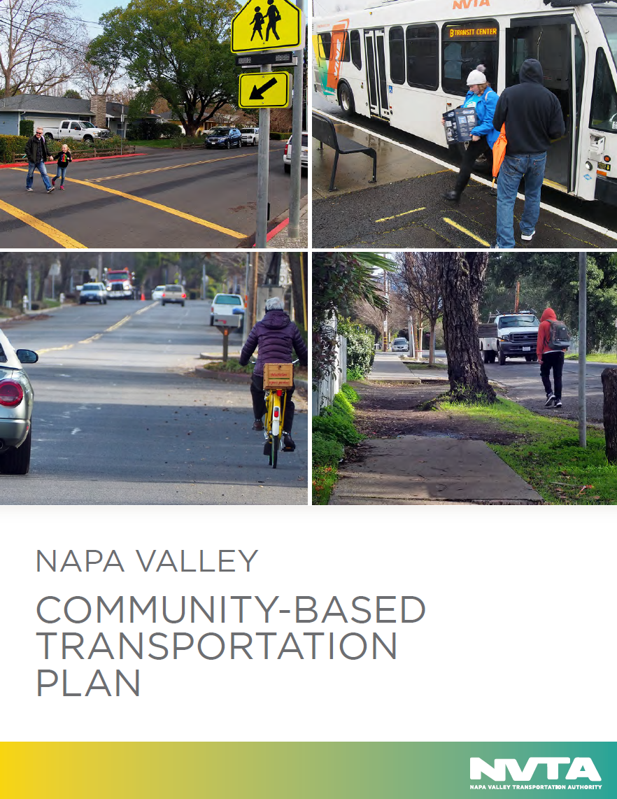
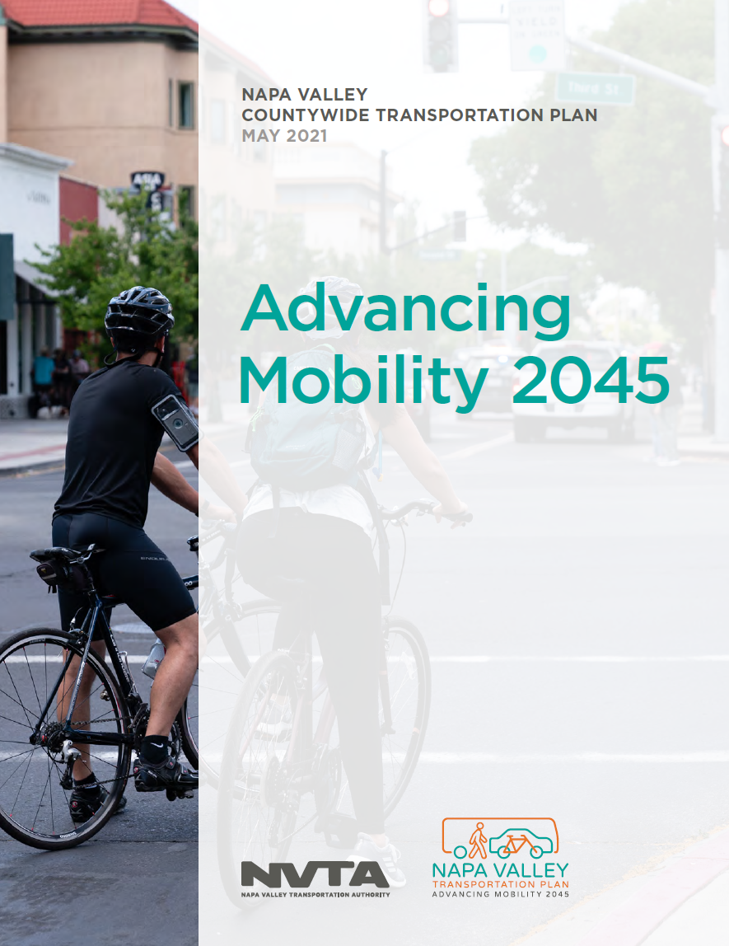
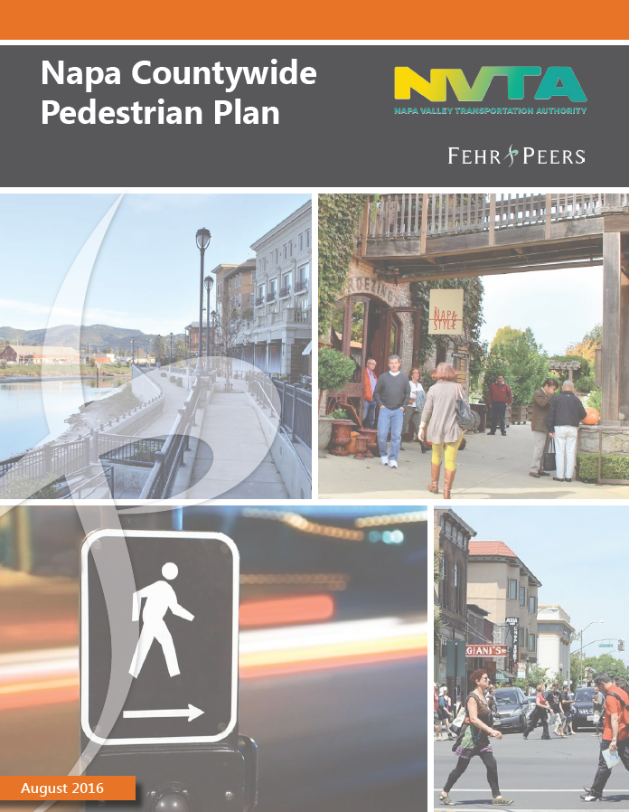
Existing NVTA Plans
Community-Based Transportation Plan (2020)
Countywide Pedestrian Plan (2016)
Countywide Bicycle Plan (2019)
Advancing Mobility 2045: Countywide Transportation Plan (2021)
Travel Behavior Study (2020)
Vision Zero Plan (2023)
SR 29 Comprehensive Multimodal Corridor Plan (2020)
State and Local Planning Efforts

Slide 5
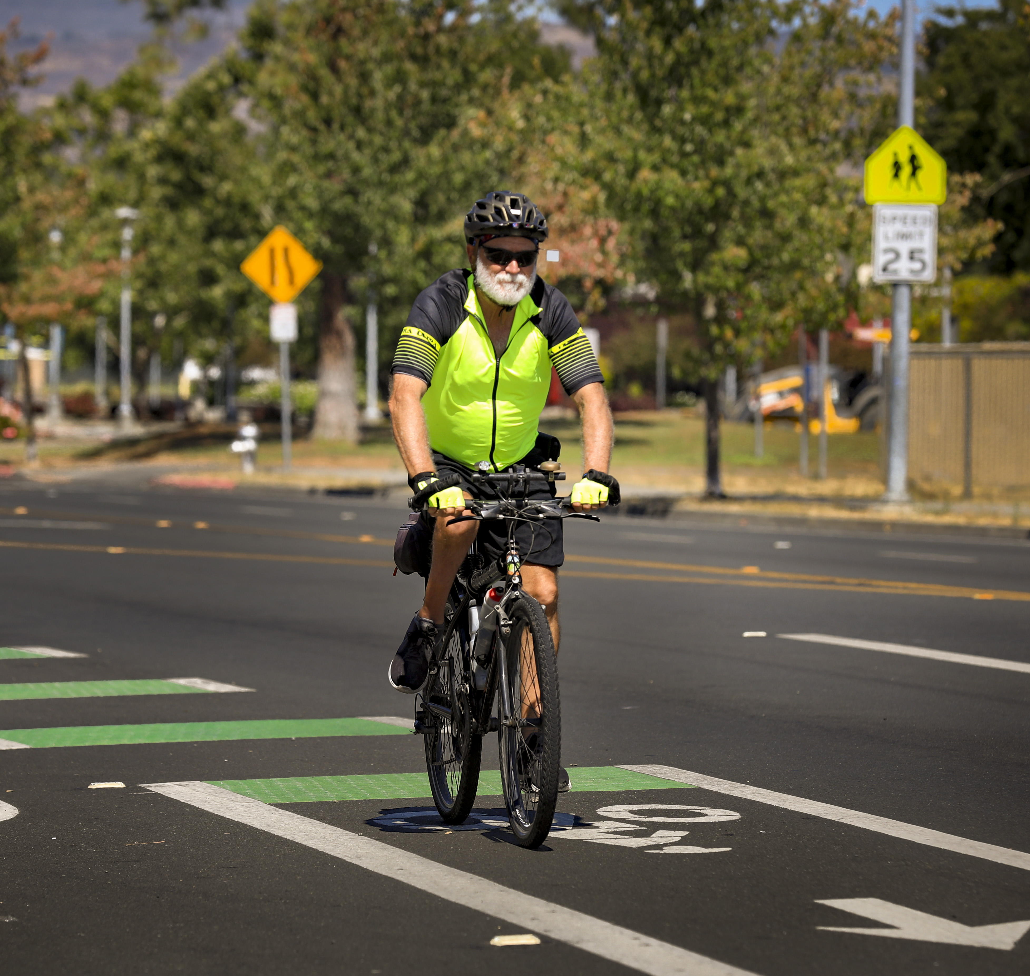
Why a New County Plan?
Growing Population
Changing Best Practices
New Community Needs
Climate Change and Emissions

Slide 6
Project Overview
Scope, Timeline, Community Engagement Opportunities

Slide 7
Scope and Tasks
Task 1: Project Kick-off and Local Landscape
Task 2: Existing Conditions Assessment
Task 3: Uniform Standards and Toolbox Development
Task 4: Future Demand Assessment
Task 5: Public Outreach, Stakeholder Meetings, and Presentations
Task 6: Policy Framework
Task 7: Proposed Facilities and Improvements
Task 8: Implementation and Funding Plan
Task 9: Document for Plan Approval and Adoption

Slide 8
Project Timeline
August 2024
January 2025 – July 2025
April 2025 – October 2025
Community & Stakeholder Engagement
Project
Kick-Off
Plan Development
Data Collection & Existing Conditions
Recommendations Development
August 2024 – January 2025
April 2025 – September 2025

Slide 9
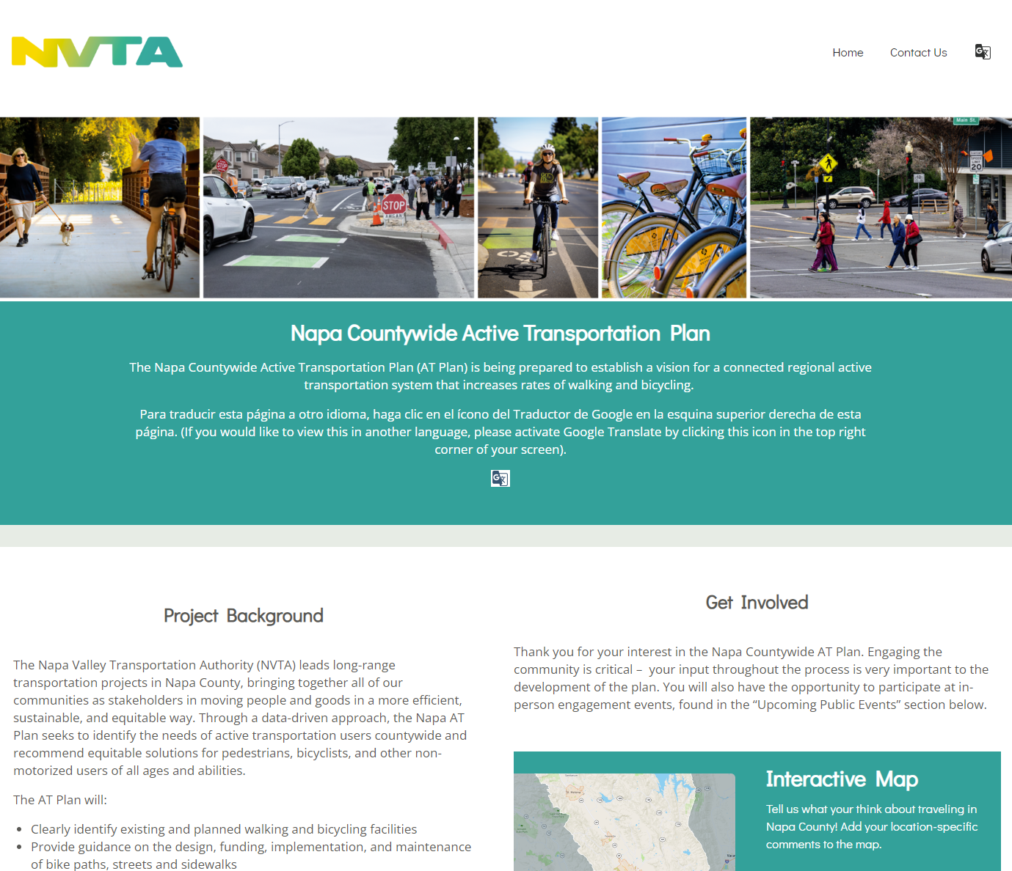
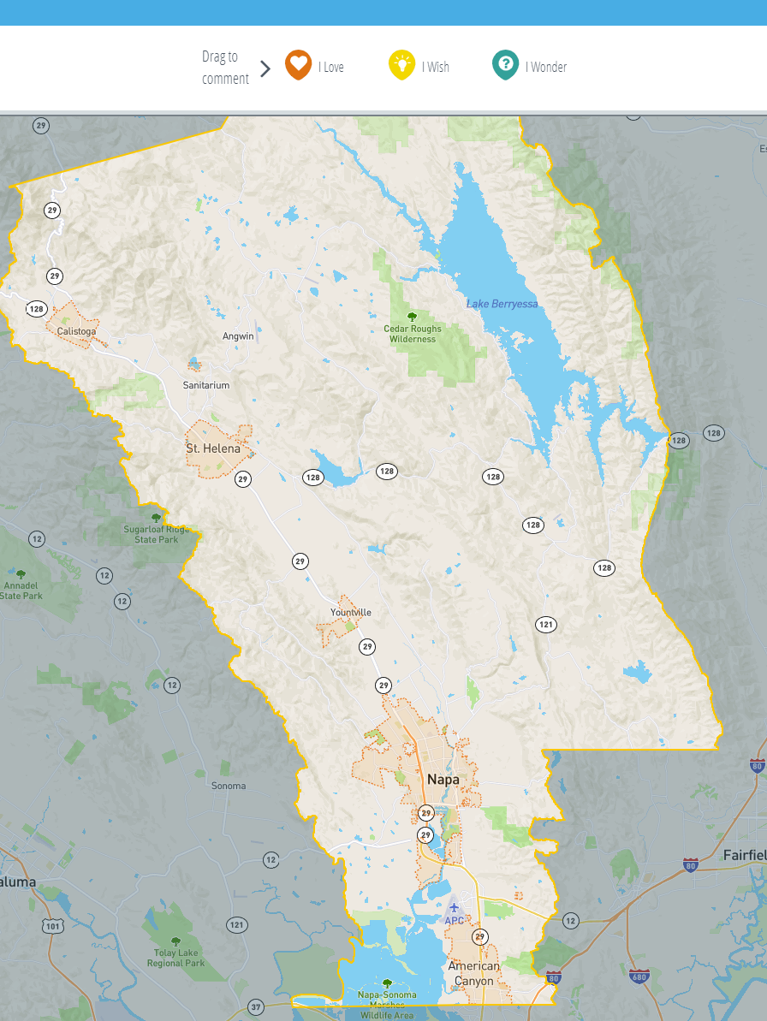
Community Engagement Opportunities
Project Website
Interactive Map
In-Person Engagement Opportunities
Workshop 1: February 2025
In-person outreach opportunities in Napa and American Canyon
Future outreach through Summer 2025
NapaATPlan.com

Slide 10

Agency Engagement Opportunities
Existing Conditions Report
Treatments Toolbox
Policy Farmwork
Timelines: December 2024 – January 2025

Slide 11


Loveable Communities Framework
I Love
I Wish
I Wonder
?
How do you like getting around you community?
What public spaces do you enjoy spending time in?
What are your favorite streets or trails, and why?
What do you wish you could change about getting around your community and beyond?
What are some changes you wish to see on our streets?
How do you imagine your community growing?
What kind of transportation solutions do you wonder about?
Notes:
The lovable community's framework approaches engagement in a different way by encouraging positive interactions and building excitement about the plan. It allows residents to identify what they love about their community so that the planning team can investigate ways to enhance to enhance community assests and build more of what residents love.

Slide 12
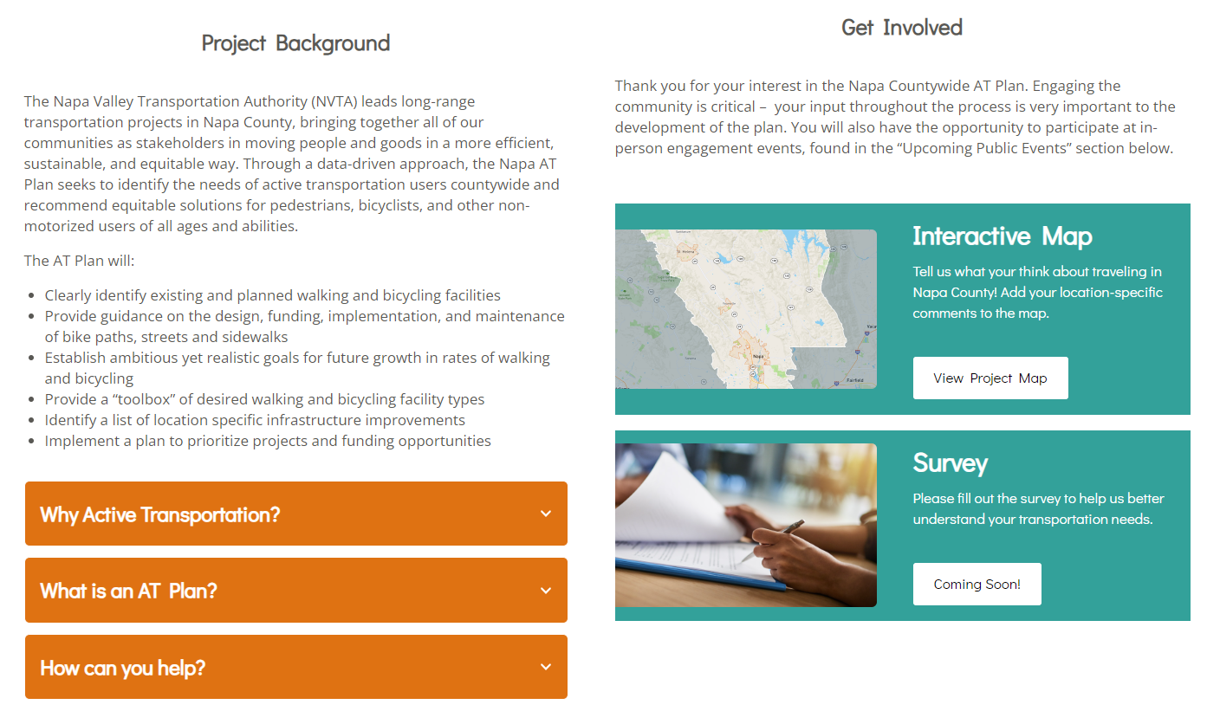

Interactive Map Demonstration
Visit NapaATPlan.com
Scroll to “Get Involved” and click “View Project Map”
Or scan the QR code to directly visit the Interactive Map
[Add when website is published]
Notes:
Todd

Slide 13
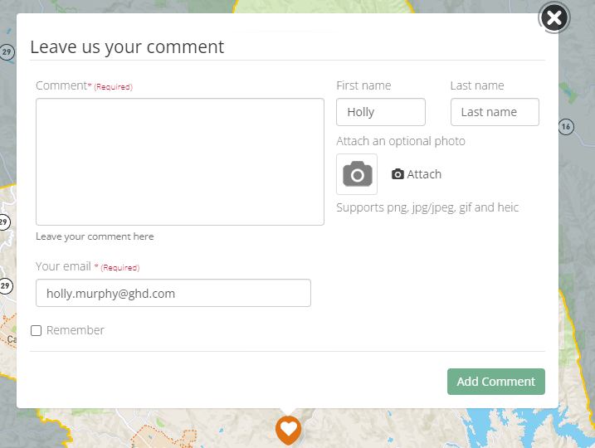
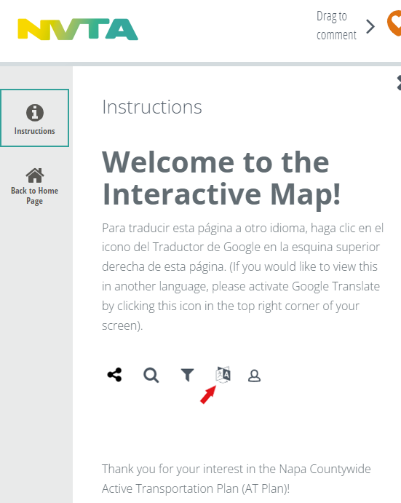
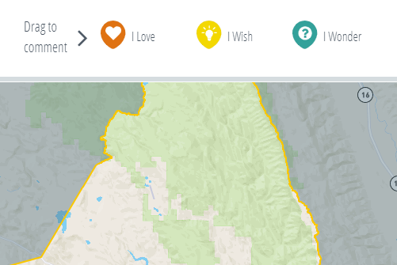
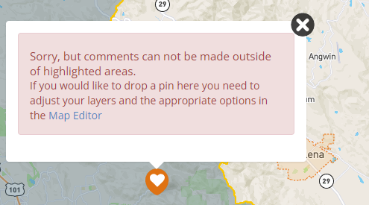
Interactive Map Demonstration
Read the instructions that pop up when you open the page, or located under “Instructions”
Drag one of the icons from the top of the page onto where you’d like to make a comment. Users may only add comments within the county boundary.
Type your comment and click “Add Comment”
Notes:
Todd

Slide 14
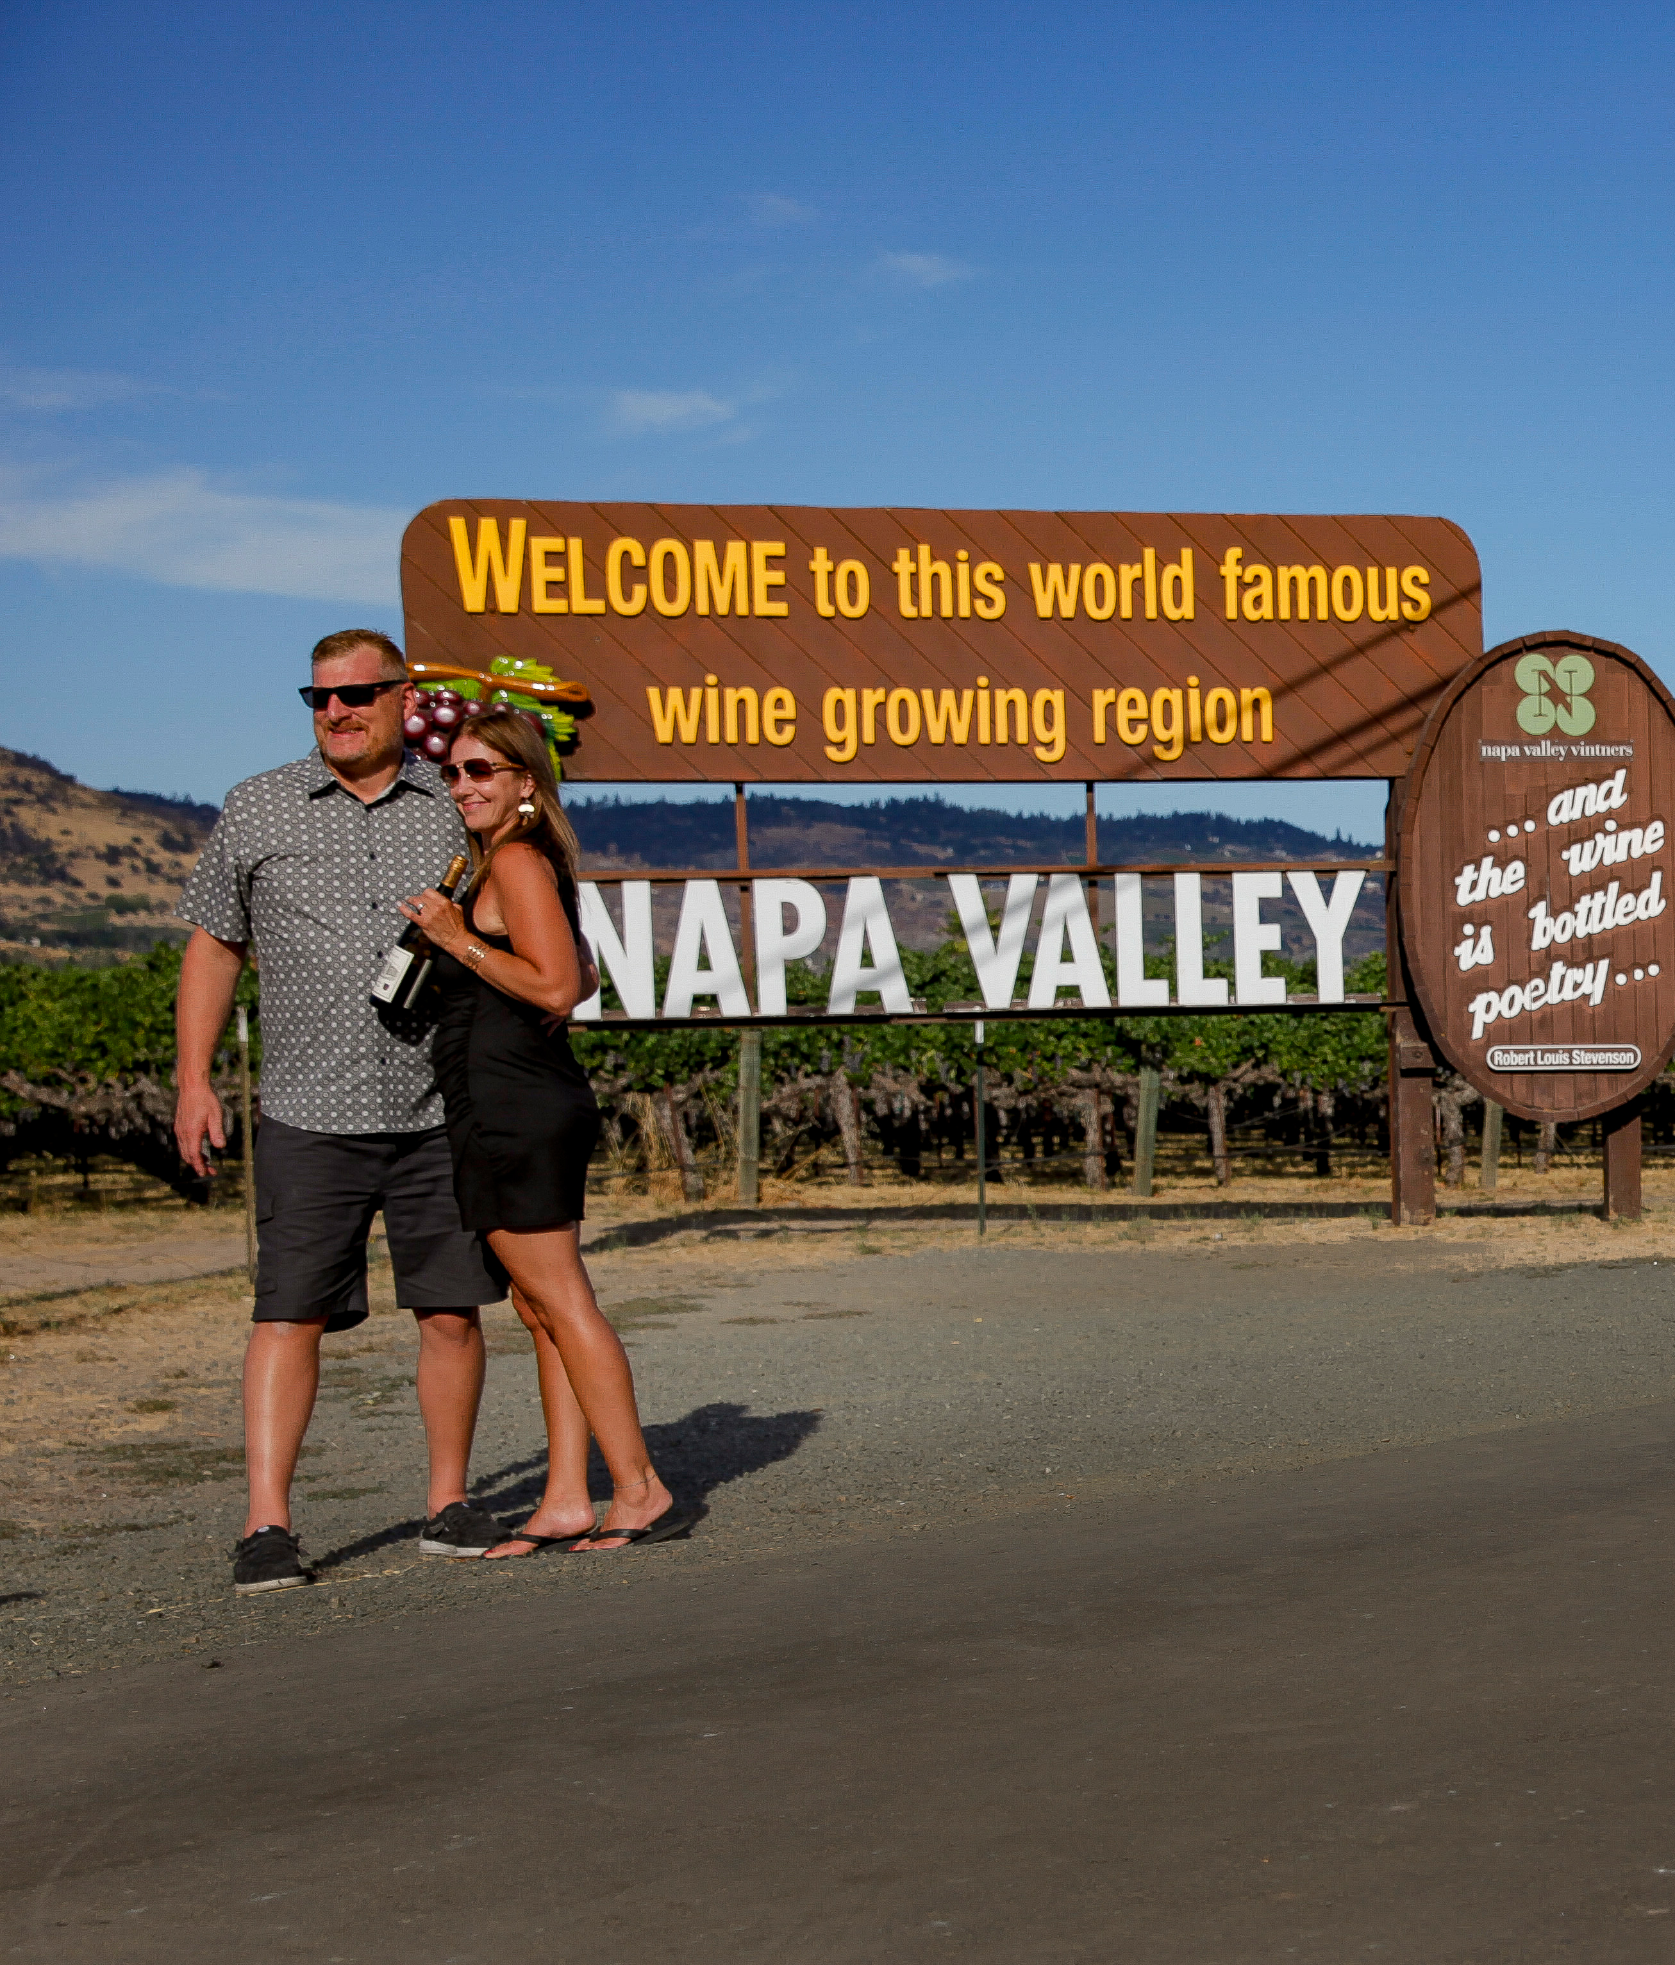
Next Steps
NVTA Board
Share website and interactive map with constituents, patterns, and stakeholders
NVTA Staff / Project Team
Provide social media graphics and links for constituent newsletters

Slide 15
Thank you! Comments/Questions?

